Slide 1
The Rare Earth Elements

Slide 2
The REE and the Periodic Table
1
2
H
He
3
4
5
6
7
8
9
10
Li
Be
B
C
N
O
F
Ne
11
12
13
14
15
16
17
18
Na
Mg
Al
Si
P
S
Cl
Ar
19
20
21
22
23
24
25
26
27
28
29
30
31
32
33
34
35
36
K
Ca
Sc
Ti
V
Cr
Mn
Fe
Co
Ni
Cu
Zn
Ga
Ge
As
Se
Br
Kr
37
38
39
40
41
42
43
44
45
46
47
48
49
50
51
52
53
54
Rb
Sr
Y
Zr
Nb
Mo
Tc
Ru
Rh
Pd
Ag
Cd
In
Sn
Sb
Te
I
Xe
55
56
57
72
73
74
75
76
77
78
79
80
81
82
83
84
85
86
Cs
Ba
La
Hf
Ta
W
Re
Os
Ir
Pt
Au
Hg
Tl
Pb
Bi
Po
At
Rn
87
88
89
104
105
106
107
108
109
110
111
112
114
Fr
Ra
Ac
Rf
Sg
Bh
Hs
Mt
Ds
Uuu
Uub
Uuq
Light REE
Heavy REE
Db
58
59
60
61
62
63
64
65
66
67
68
69
70
71
Ce
Pr
Nd
Pm
Sm
Eu
Gd
Tb
Dy
Ho
Er
Tm
Yb
Lu

Slide 3
Relative Abundance of the REE in the Earth’s Crust Normalized to Primitive Mantle
LREE
HREE
HREE
Y

Slide 4
The Lanthanide Contraction
Eu²⁺
REE³⁺
Y³⁺
Ionic radius (Angstroms)
Light
Ce⁴⁺
Y³⁺
Heavy

Slide 5
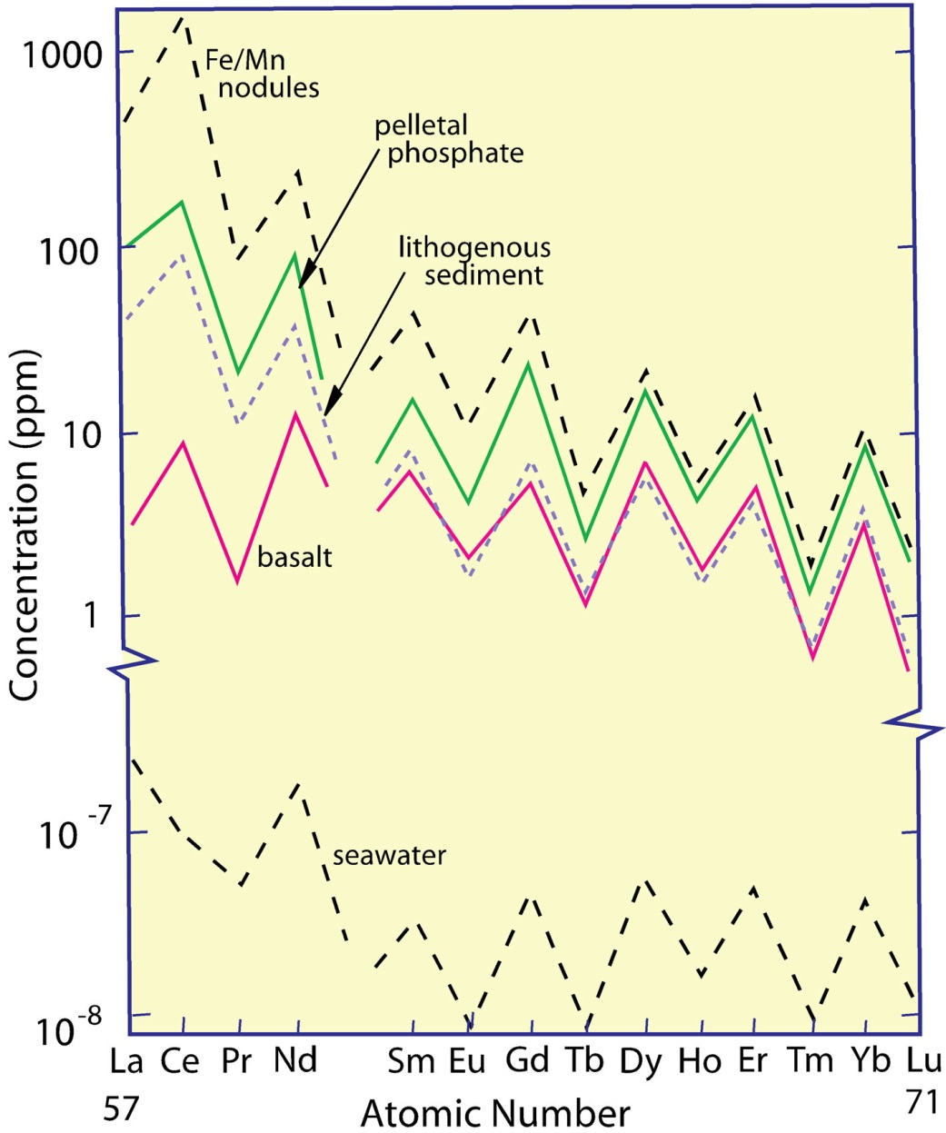
The Oddo-Harkins Rule
Elements with odd atomic numbers are less abundant in the cosmos than elements with even atomic numbers. This leads to a saw-toothed pattern in plots of element abundance vs atomic number.
During nucleosynthesis ⁴₂He is a basic building block and thus collision of two ⁴₂He nucleii will produce ⁸₄Be and collision of a ⁸₄Be nucleus with a ⁴₂He nucleus will produce ¹²₆C and so on.

Slide 6
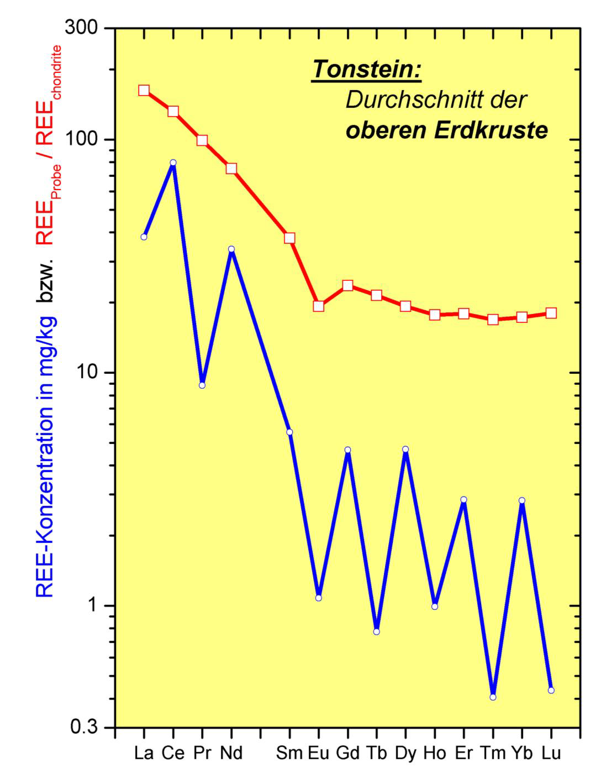
The Effect of Normalisation
Post-Archean
Australian Shale
The normalisation to chondrite smoothes the saw-toothed pattern and makes it possible to observe that relative to chondrite, shales are enriched in the LREE and display a marked negative Eu anomaly.
REE Concentration in mg/Kg
REE Concentration normalised to chondrite

Slide 7
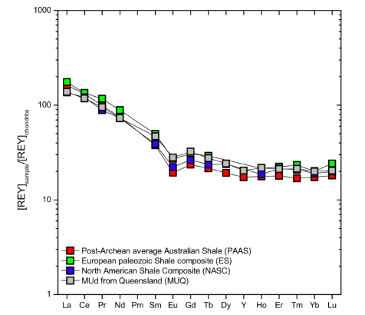
The Geochemical Twins Ho and Y
Yttrium and Holmium have the same charge 3+ and almost the same ionic radius, 104.0 and 104.1 pm, respectively. By contrast, the neighbours, Dy and Er have radii of 105.2 and 103.0, pm, respectively. Y and Ho should therefore substitute in minerals preserving their mantle ratio of 25.94.
REE in Sample/Chondrite

Slide 8
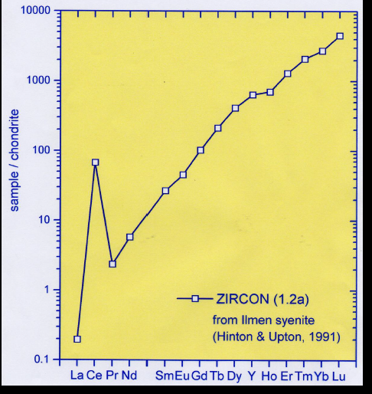
A Positive Ce anomaly in Zircon
The structure of zircon favours the incorporation of the HREE, commonly due to a coupled substitution of REE³⁺ + P⁵⁺ for Zr⁴⁺ and Si4+. Ce3+ (115 pm) is too large to substitute into the lattice but as Ce⁴⁺ (101 pm) is very similar in size to Yb (100.8 pm)

Slide 9
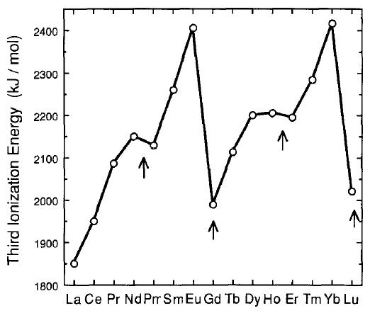
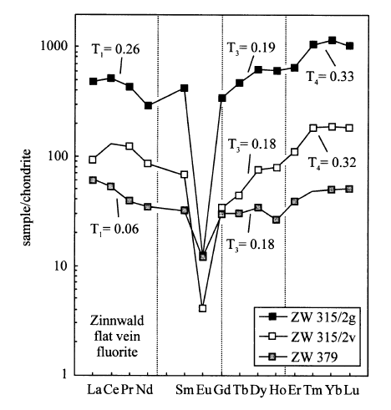
Tetrad Effect
An increase in the stability of lanthanides representing ¼, ½, ¾ and complete filling of the f-orbitals, i.e., Nd/Pm, Gd, Ho/Er, and Lu.
Third ionization energy showing the increased stability of Pr, Gd, Er and Lu.

Slide 10
Pearson’s HSAB Principles and Aqueous Metal Complexes
Hard acids (large Z/r) bond with hard bases (ionic bonding) and soft acids (small Z/r) with soft bases (covalent bonding).
Hard
Borderline
Soft
Acids
H⁺, Na⁺>K⁺
Al³⁺>Ga³⁺
Y³⁺,REE³⁺ (Lu>La)
Zr⁴⁺,Nb⁵⁺
Fe²⁺,Mn²⁺,Cu²⁺
Zn²⁺>Pb²⁺,Sn²⁺,
As³⁺>Sb³⁺=Bi³⁺
Au⁺>Ag⁺>Cu⁺
Hg²⁺>Cd²⁺
Pt²⁺>Pd²⁺
Bases
F⁻,OH⁻,CO₃²⁻ >HCO₃⁻
SO₄²⁻ >HSO₄⁻
PO₄³⁻
Cl-
HS⁻>H₂S
CN⁻,I⁻>Br⁻
Pearson (1963)

Slide 11
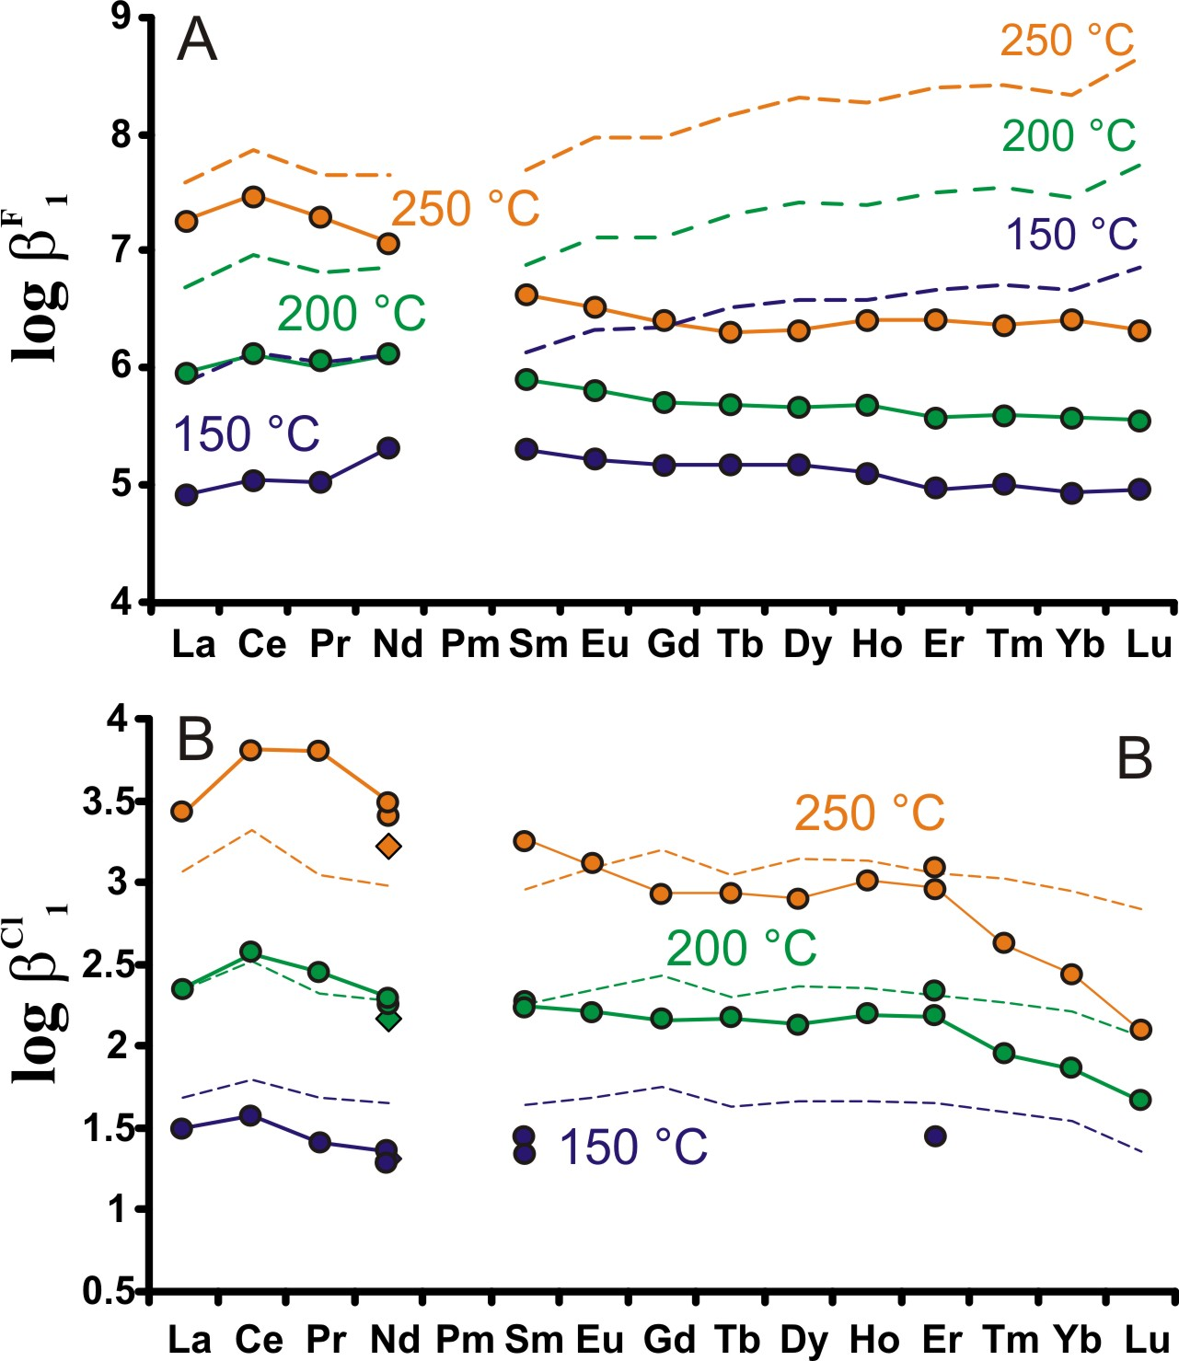
The Stability of REE-F & -Cl Complexes
Log K REEF²⁺
Stability of REEF²⁺ complexes high, decreases with increasing atomic number.
Log K REECl²⁺
Stability of REECl²⁺ complexes, moderate, decreases with increasing atomic number.
Solid lines – experimental data of Migdisov et al. (2009)
Dashed lines – theoretical predictions of Haas et al. (1995)
Migdisov et al. (2009))

Slide 12
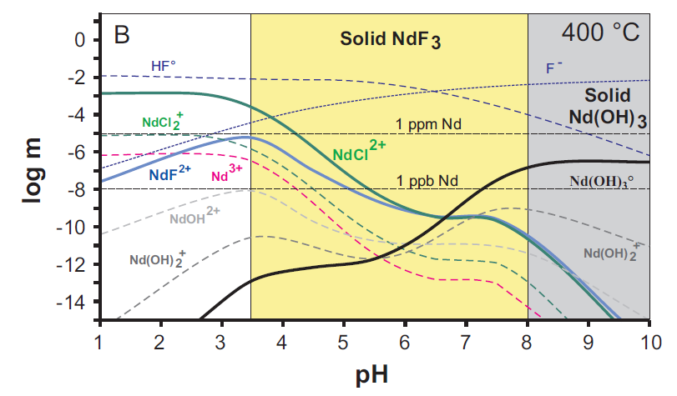
Nd Speciation and solubility in a Cl-F-bearing Fluid
Fluid contains 10 wt% NaCl, 500 ppm F, 200 ppm Nd.
Nd-chloride complexes predominate at low pH; at higher pH, NdF₃ (fluocerite-(Nd)) precipitates.
Migdisov & Williams-Jones et al. (2014)

Slide 13
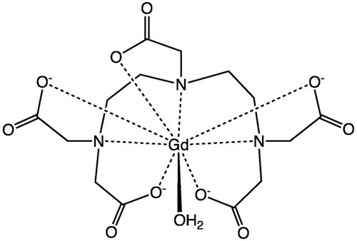
Gadopentetic acid
A complex of Gd with DTPA (diethylenetriaminepentacetate)

Slide 14
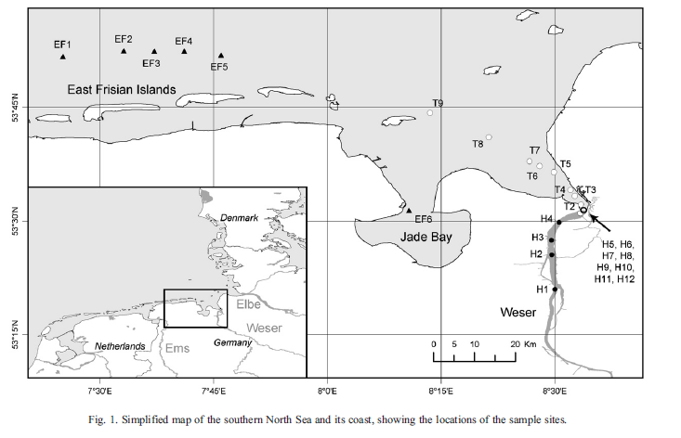

Slide 15
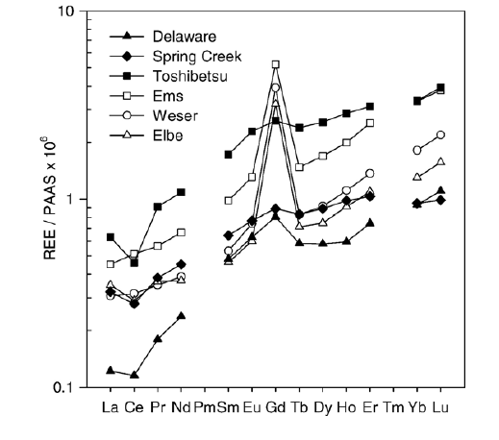
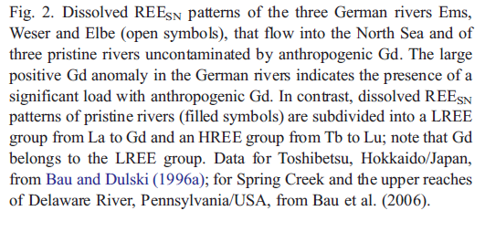

Slide 16
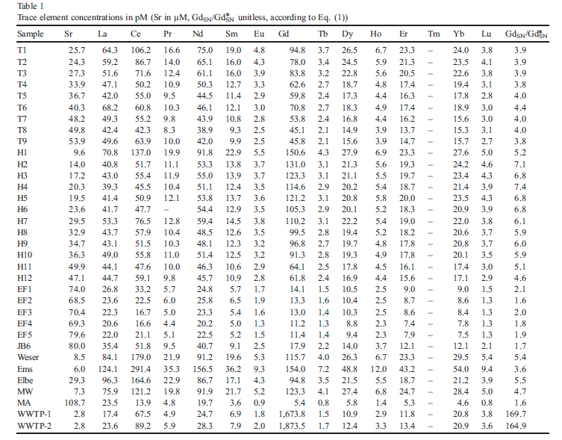

Slide 17
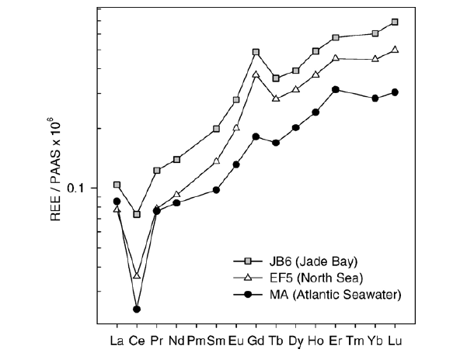
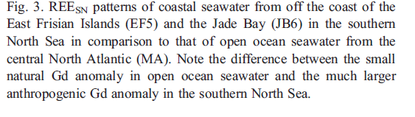

Slide 18
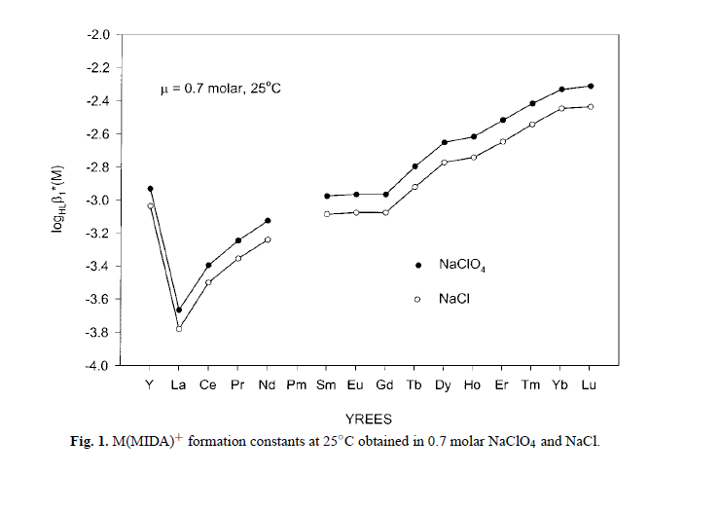
Luo and Byrne (2001)

Slide 19

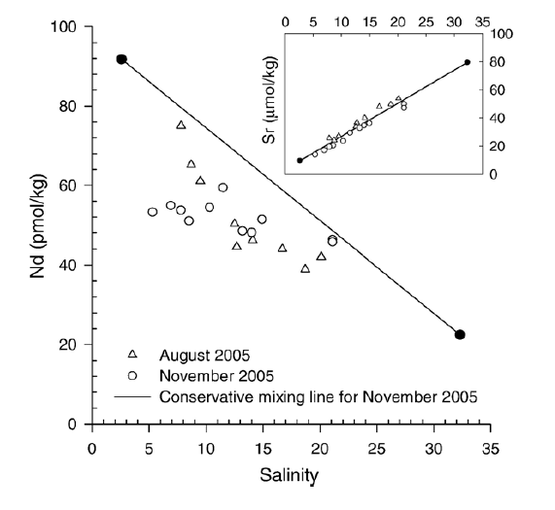
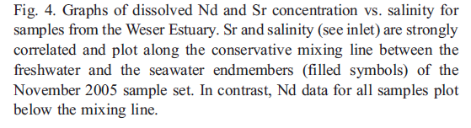

Slide 20
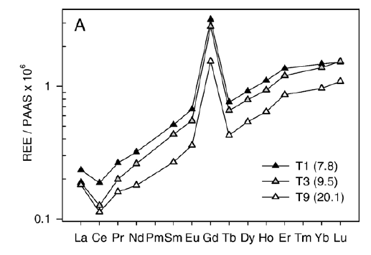
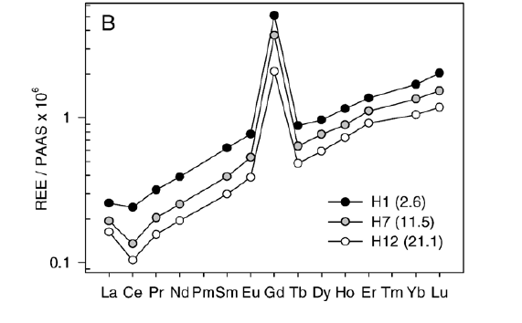


Slide 21
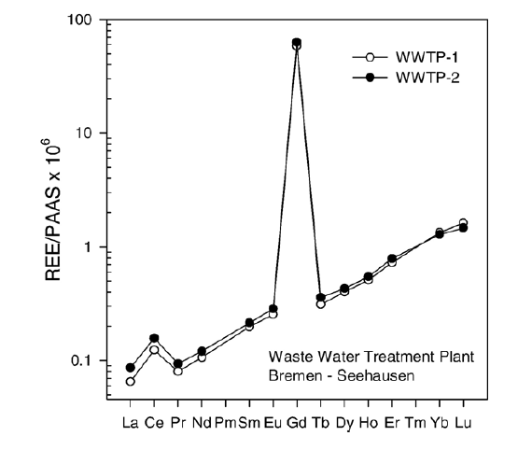
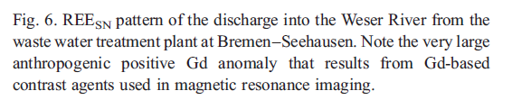

Slide 22
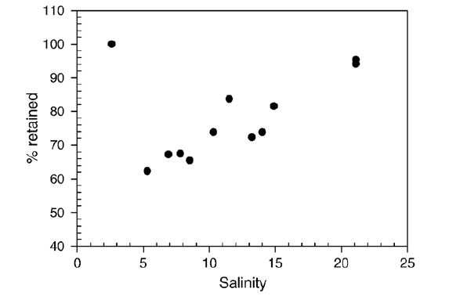
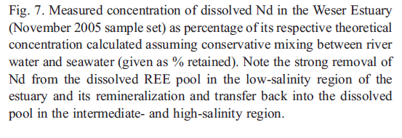

Slide 23
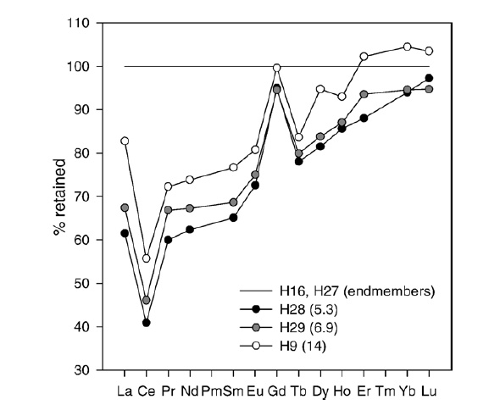
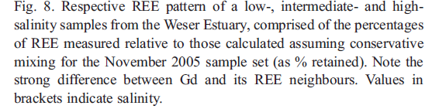

Slide 24
