Slide 1
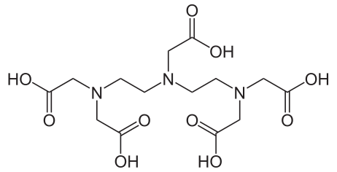
Pentetic acid or diethylenetriamine pentaacetic acid

Slide 2
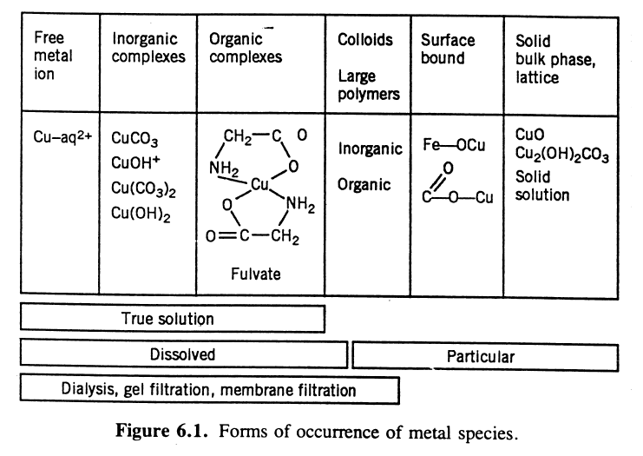
The make-up of a natural solution

Slide 3
The make-up of a natural solution
I – Particulate or solids
II- Colloidal material
III – Truly dissolved
a) non-associated (free)
b) associated (complexed)
i) Weak electrolytes
ii) Complexes
iii) Ion-pairs

Slide 4
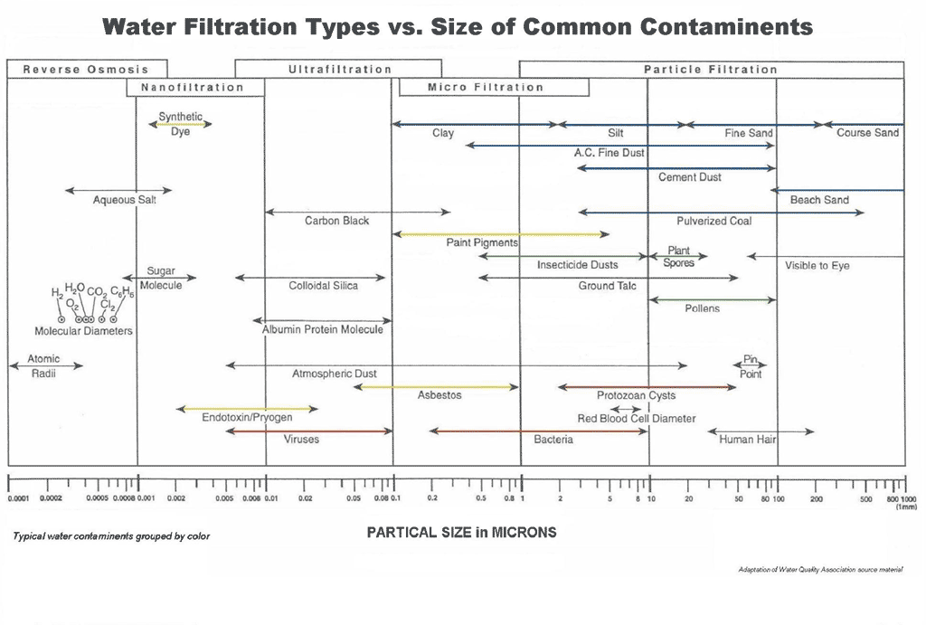
Operational definition of the dissolved fraction
0.45 µm

Slide 6
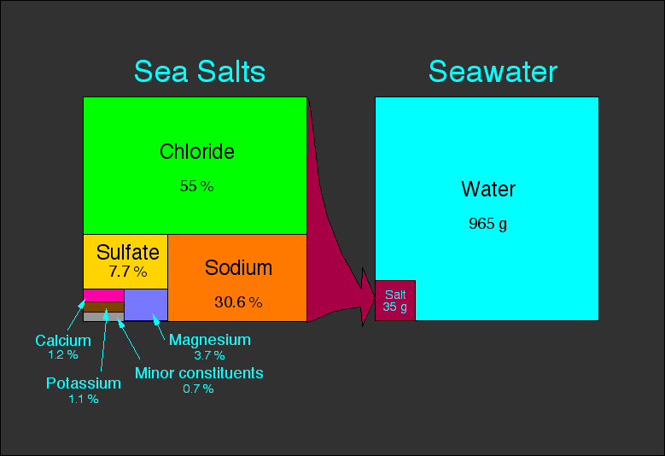
Seawater composition

Slide 7
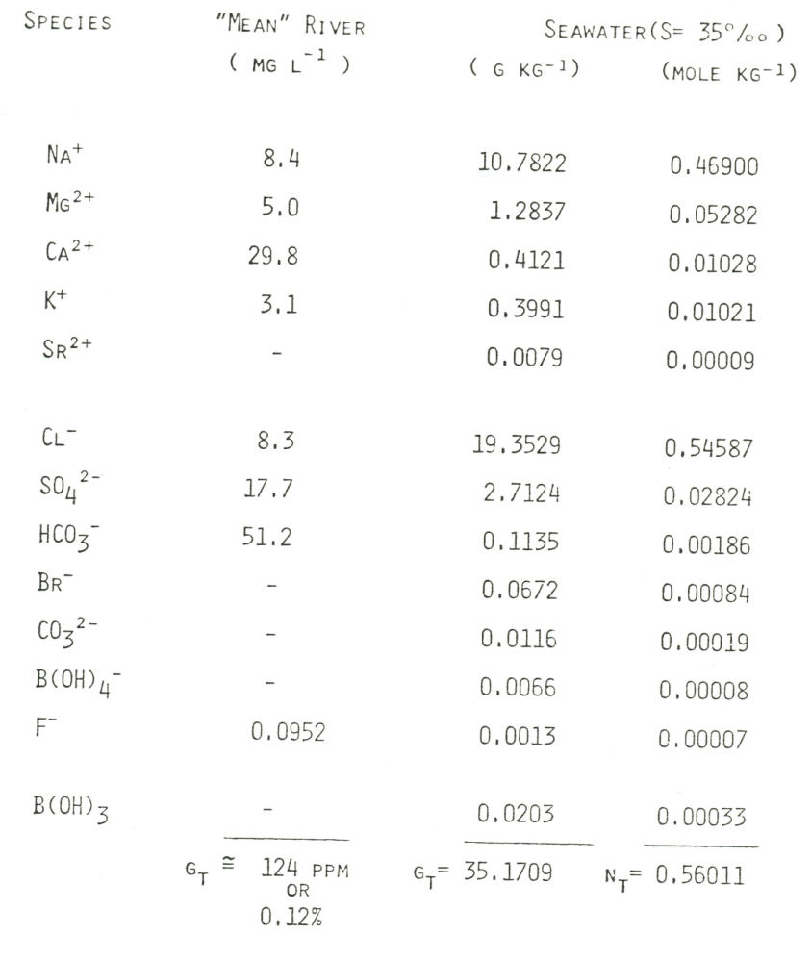
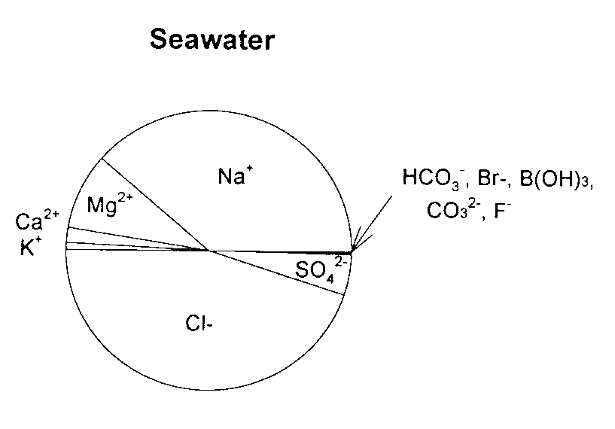
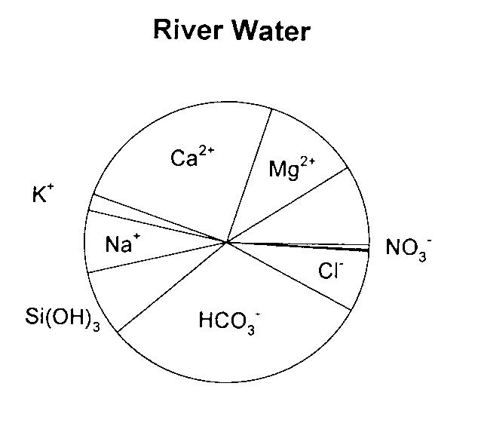
Seawater composition
Law of constant relative proportions (Marcet’s principle): the concentration ratio of major elements to each other or to the total salt content is a constant.

Slide 8
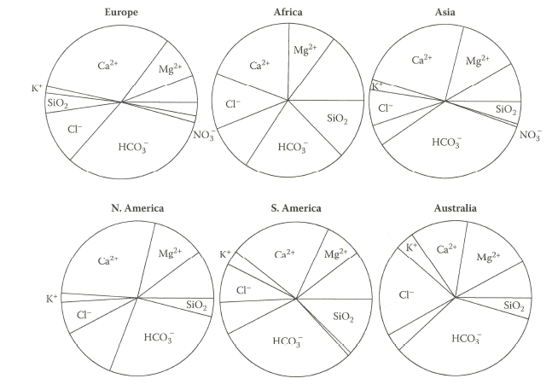
Major components of various rivers of the continents of the world

Slide 9
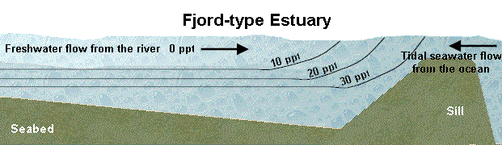
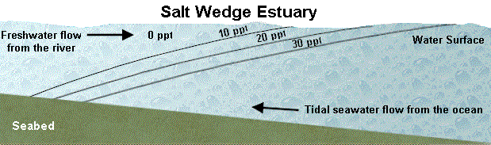
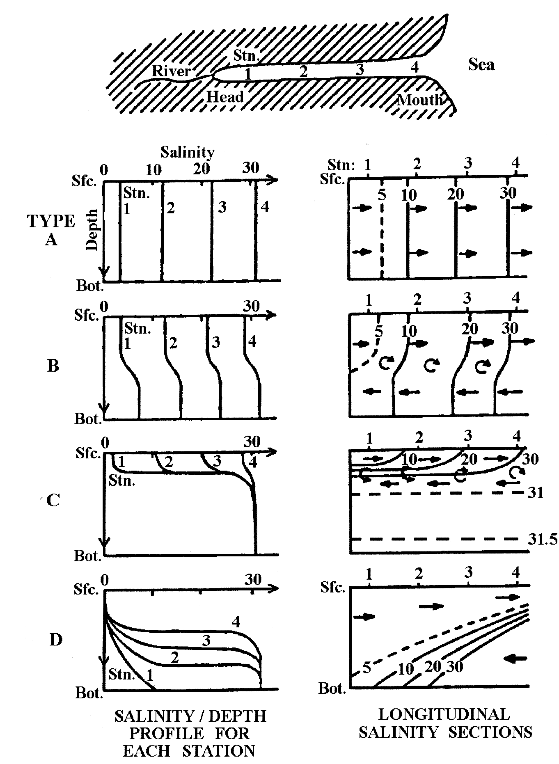
Salinity distribution in the Oceans
(stratified and mixed estuaries)

Slide 10
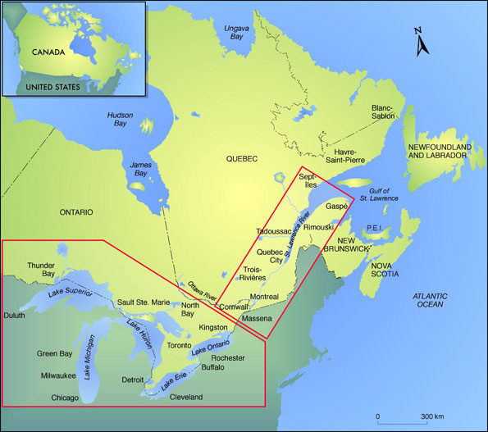
Strait of Belle-Isle
LOWER
UPPER
Cabot Strait
RIVER
Freshwater discharge = 11,900 m³ s⁻¹

Slide 11
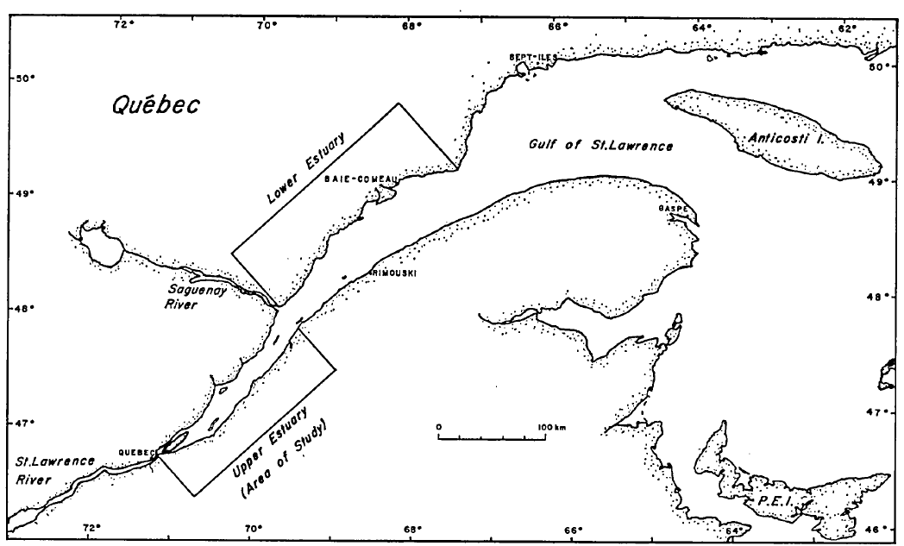
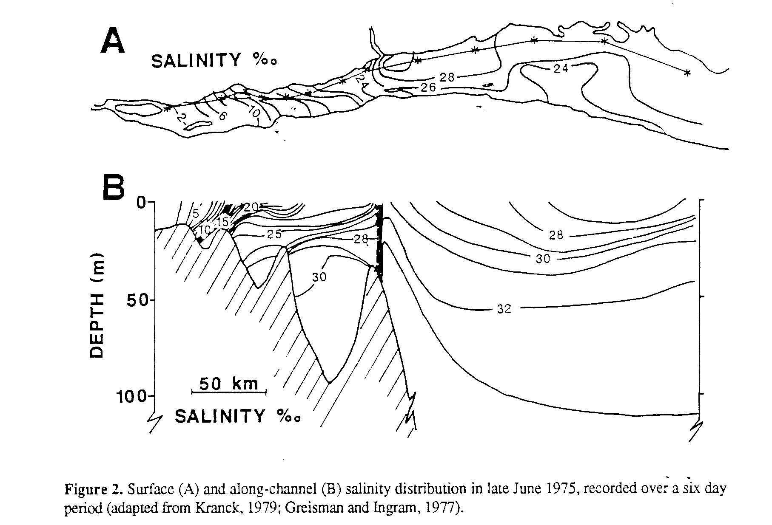
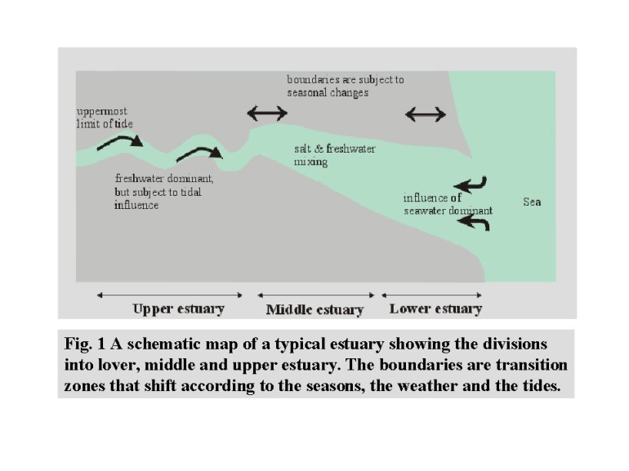
The St. Lawrence Estuary
(a partially stratified estuary)
2
2
1
1
1
2

Slide 13
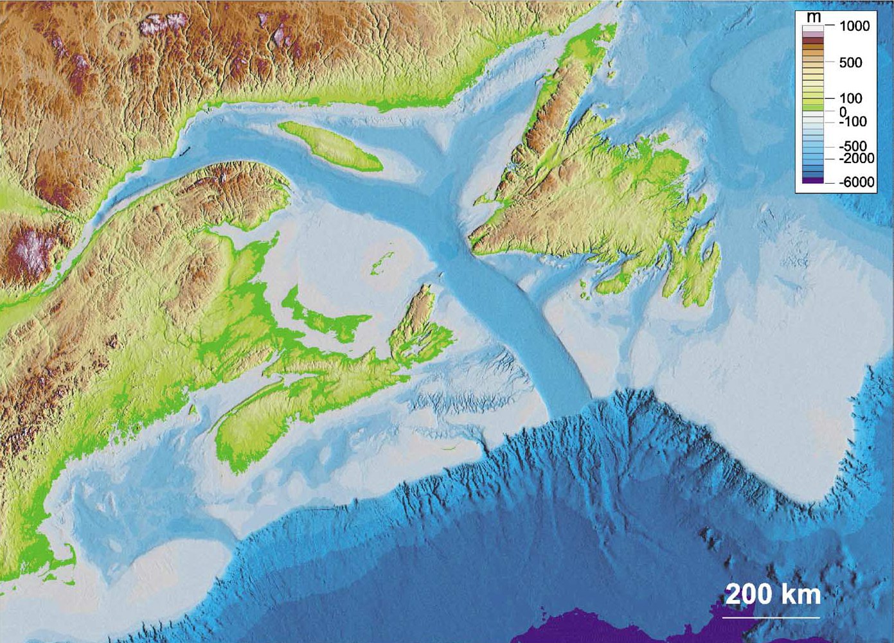
The St. Lawrence Estuary, Gulf and continental shelf
Belle-Isles Strait
Esquiman Channel
Anticosti Channel
Laurentian Trough
Tadoussac
Rimouski
Cabot Strait
Laurentian Trough

Slide 14
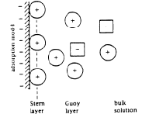
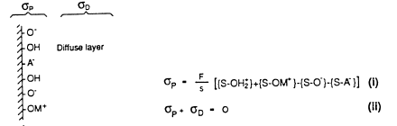
Net Total Particle Charge/Surface Potential
Different types of surface charge density contribute to the net total particle charge at the surface of a solid:
σ_{P} = σ₀ + σ_{H} + σ_{IS} + σ_{OS =} QFS⁻¹ (coulomb m⁻²)
where σ_{P} = total net surface charge
σ₀ = permanent structural charge (usually for a mineral) caused by isomorphic substitutions (or formation of solid solutions) in minerals.
σ_{H} = net proton charge, the charge due to binding of protons or the binding of OH⁻ ions.
σ_{IS} = inner-sphere complex charge
σ_{OS} = outer-sphere complex charge

Slide 15
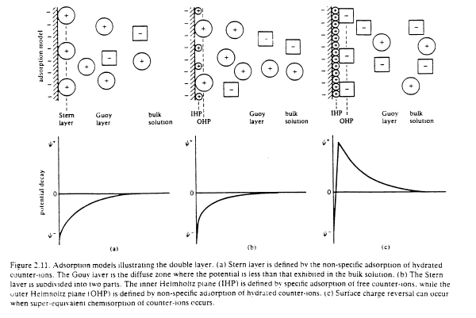
Electrical double layer models
The electric state of a surface depends on the spatial distribution of free (electronic or ionic) charges in its neighborhood. The distribution of charges is usually idealized as an electric double layer : one layer is envisaged as a fixed charge or surface charge attached to the solid surface (the Stern layer), while the others are distributed more or less diffusely in the liquid in contact (the Gouy layer).

Slide 16
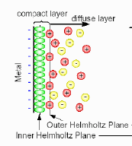
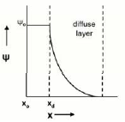
Electrostatic models of the surface
The Guoy-Chapman or diffuse double layer model (DDLM)
In the DDLM, the counter-ions are assumed to form a diffuse layer extending from the surface out into the solution. The Stern layer is subdivided into two parts: the inner Helmholtz plane (IHP) defined by specific adsorption of free (inner-sphere) counter-ions and the outer Helmholtz plane (OHP) defined by non-specific (outer-sphere) counter-ions.
+
[cations]
charge
-
[anions]
X
X
According to the Gouy-Chapman theory, the surface charge density σ_{P} is related to the potential at the surface ψ₀ (volt) according to:
σ_{P} = (8 RTεε₀ C x 10³) sinh (Z ψ₀ F/2RT)
which, at low potentials, reduces to: σ_{P} = εε₀ k ψ₀ ~ 2.3 I^{1/2} ψ₀ at 25ºC
In this model the capacitance of the double layer is a function of the solution composition. In principle, this model should be appropriate for solutions of low ionic strength and low concentrations of adsorbing ions.

Slide 17
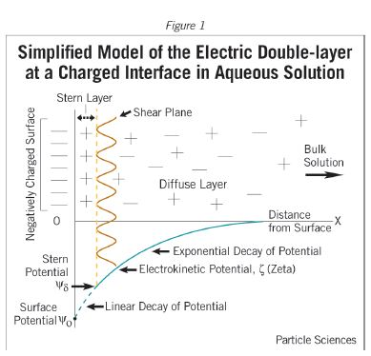
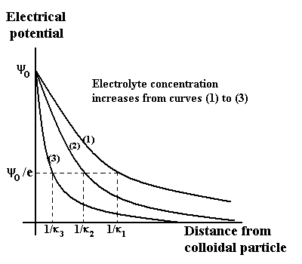
K = (2 F² I x 10³/(RTεε₀ ))^{0.5}

Slide 18
