Slide 1
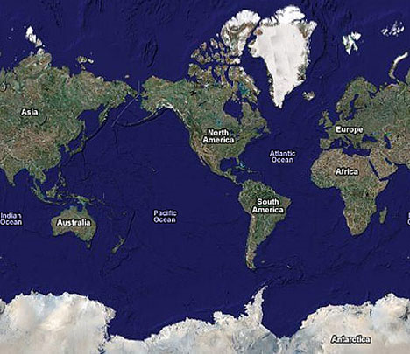
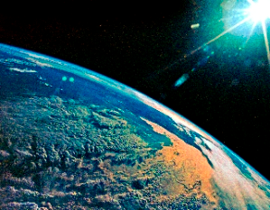
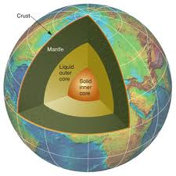

Understanding Planet Earth
Introduction to Geology and Geological Processes
Professor: Olivia Jensen ( course e-mail | web service | short bio )
Notes:
1
1

Slide 2
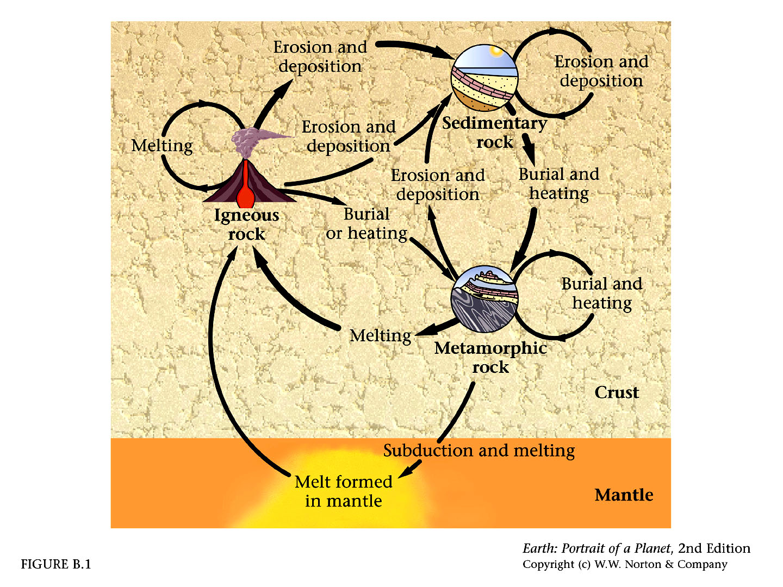
Earth’s story is in its rocks
those we can see and map
and those we can't
Notes:
2
2

Slide 3
The Rock Cycle
Notes:
3
3

Slide 4
Most of our Earth is hidden from
our direct view
Notes:
4

Slide 5

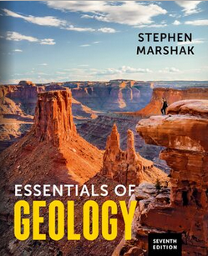
I shall follow this text
Notes:
5

Slide 6
To purchase the current Edition 7 of the Text
The textbook (paperback) should be available at the McGill Bookstore (680 Sherbrooke Street West.)
Essentials of Geology (Seventh Edition)
by Stephen Marshak
Publisher: W. W. Norton & Company
Print: ISBN 9780393882728, 0393882721
eBook: ISBN-13: 978-0393883015
Edition: 5th
Look to the Course Syllabus for more direct links to purchase the textbook in hard copy or in digital version. The textbook is not required!

Slide 7
How the course will be lectured
This course will be presented in-person or exceptionally online via pre recorded PowerPoint lectures or substituted ZOOM sessions on Tuesdays and Thursdays at 16h30 when/if required.
You are asked to preview the online materials (PowerPoint, Video or PDF lectures) before attending the in-person sessions which are held during the scheduled course times. Lectures should be recorded.
The PowerPoint lectures will follow a highly edited version of Norton's (the textbook’s) lecture slide set that closely corresponds to the textbook. They will form the content and style of the lectures.
Notes:
7

Slide 8
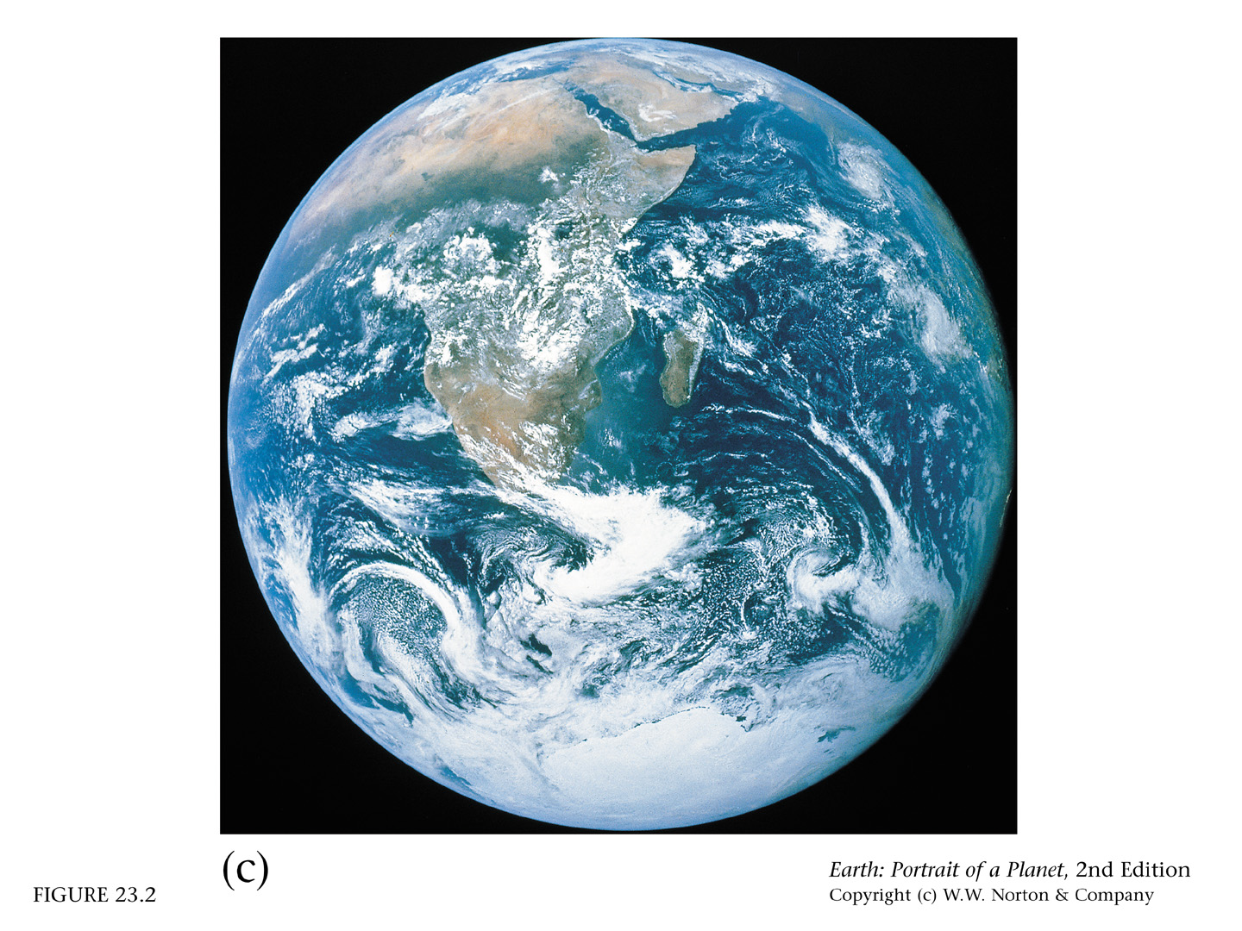
Planet Earth
Photo by NASA Apollo 17 crew, December 7, 1972
Notes:
8
8

Slide 9
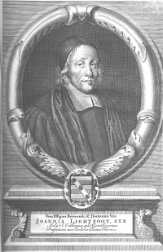
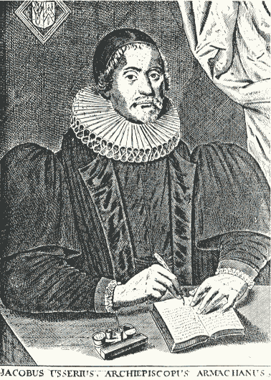
When did Earth form?
Religious doctrine! Euro-Christian?
John Lightfoot (1602 –1675) was an English churchman, rabbinical scholar, Vice-Chancellor of the University of Cambridge and Master of St. Catharines College
3929BCE
James Ussher (1581–1656) was Church of Ireland Archbishop of Armagh and Primate of all Ireland between 1625–1656
26 October 4004 BCE at 9AM.
Notes:
9
9

Slide 10


When did Earth form?
Religious doctrine! Other?
Muslims do not believe that the Earth is 6,000 years old but Islam does not specify how long it has been since the creation of the Earth. Age of Earth is left ambiguous – to be determined by science!
Earth came into being with the god Brahma; the Universe is 155.5 trillion years old. The age of the Earth was calculated by Indian scholars in the 5th century CE to be 4.3 billion years!
Other creation stories.
Notes:
10
10

Slide 11
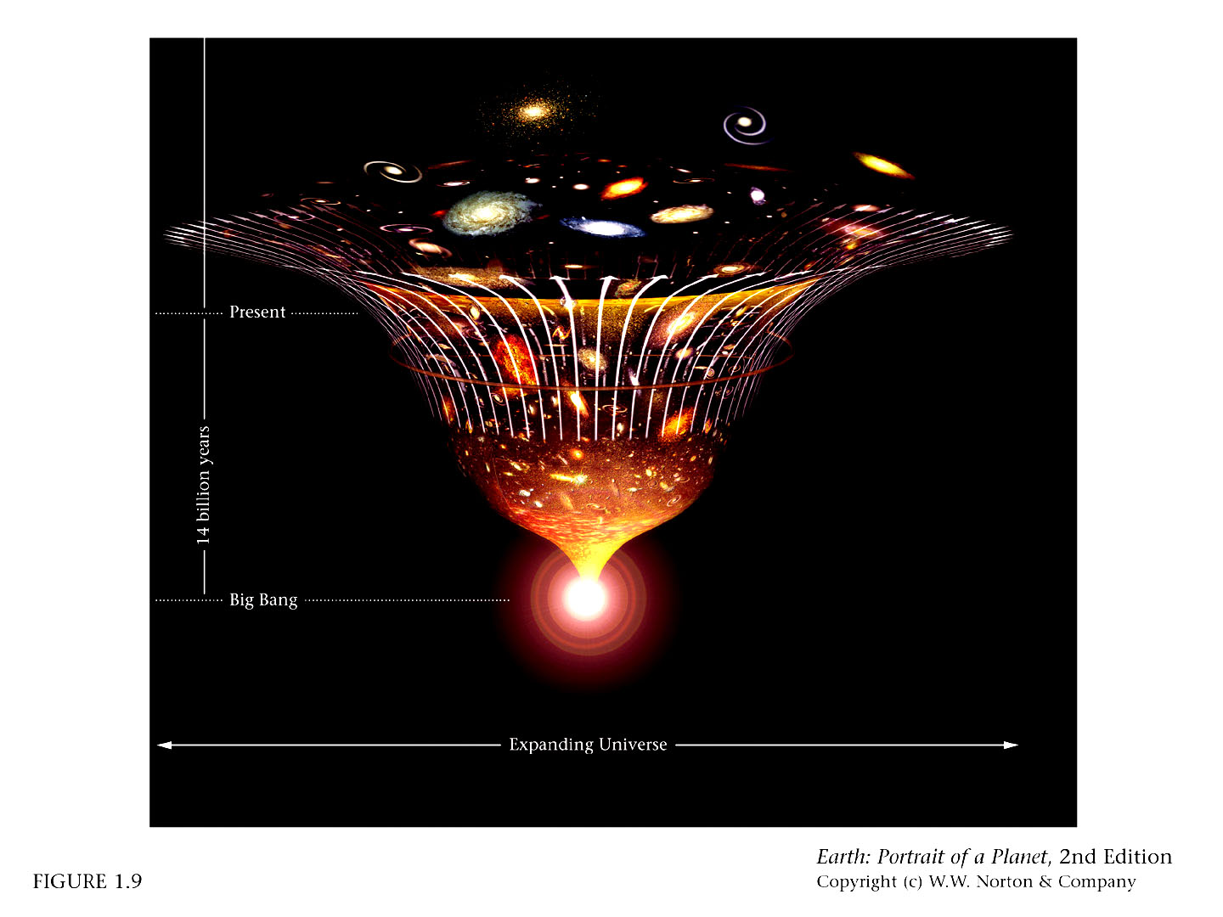
Current cosmological models!
The “Big Bang” was originally proposed by Georges LeMaître
in 1927. He was a physicist and priest in the Jesuit order!
Notes:
11
11

Slide 12
Supporting evidence for an
Old Universe
Looking into distance is to look into the past: the speed of light is a constant through the emptiness of space.
c = 299 792 458 m/s
It takes light about 8 minutes to travel from the Sun (150 million km distant) to Earth. We see the Sun 8 minutes ago.
When we look to very distant galaxies of stars, we see their past. When we look to the most distant galaxies and objects in the Universe, we see the most distant (observable) past.
That most distant past is now best estimated to be 13.798 billion years ago. Caveat: still, as always, under debate!
Notes:
12

Slide 13
Supporting evidence for an
Expanding Universe
When we measure the speed of the distant galaxies, we find that they are retreating from us at a speed that is closely proportional to their distance. The most distant we can see are retreating from us at almost the speed of light.
This makes sense if all the galaxies started their retreat from us and us from each of them 13.798 billion years ago. That is, all these pieces of the Universe would seem to have been in one place, right here or we, right there, 13.798 billion years ago.
Notes:
13

Slide 14
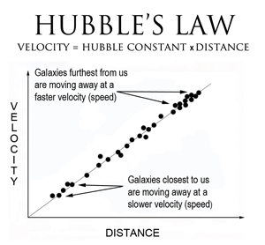
Supporting evidence for an
Expanding Universe
Notes:
14

Slide 15
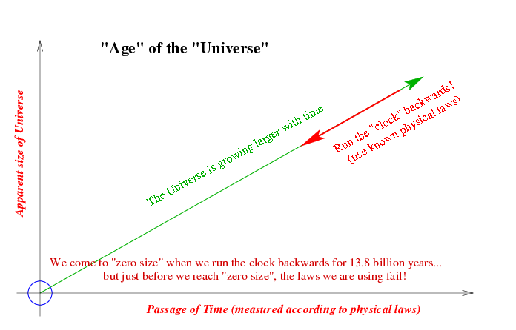
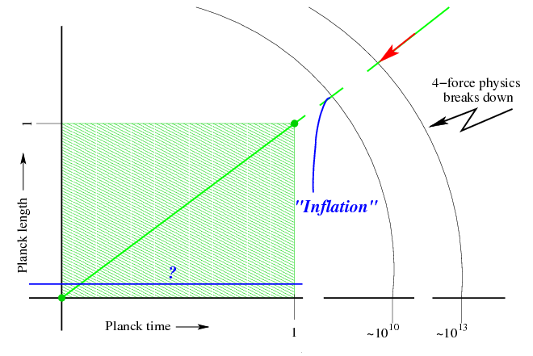
Backing up to the beginning
Using our known physics, we reverse the direction of time to back up toward the beginning of expansion
Notes:
15

Slide 16
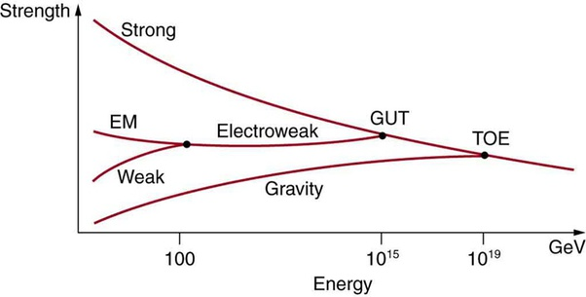
Backing up to the beginning
Using our known physics, we reverse the direction of time to back up toward the beginning of expansion but our physics breaks down at very high energy densities that must have existed shortly following the Big Bang.
LHC
Li
Energy
Time
e
GUTs and TOEs
Temperature equivalence:
1ev ~ 11000 KN
Notes:
16

Slide 17
Backing up to the beginning II
Note that in the previous diagrams, physics points to a “time zero”.
Was there anything prior to this time?
While this model is compatible with our current understanding of physics, we know it cannot describe the very earliest moments of the Universe.
During the 10⁻³⁰ seconds following our time zero, we know our physics just doesn't work.
There may well have been a “something” before our “time zero” beginning. We can only speculate.
Was there a “before” the Big Bang?
Notes:
17

Slide 18
Next day, we start the formal in-person lectures
You might make a habit of visiting the course website as it is there that I shall keep you up-to-date on what we are doing and where we are going.
You might preview the pre-recorded weekly PowerPoint lectures before attending the lecture sessions.
Access to course materials is available through MyCourses
Notes:
18

