Slide 1
Terrestrial Planets
Winter 2020
Week 7
Professor Olivia Jensen
Earth and Planetary Sciences
FD Adams 131C

Slide 2
Meteoroids, asteroids, comets
Meteroids, asteroids and comets are the left-over remnants that were not assembled into planets. The divisions between them and dwarf planets is “colloquial” .
My colloquial definitions:
Meteoroids are rocky-to-metallic bodies that are not as large as what we might call asteroids. Those that manage to survive a fall through the atmosphere to Earth’s surface are called meteorites.
Asteroids are large equivalents of meteoroids some scaling large enough to be considered “dwarf planets” (e.g. Ceres).
Comets are bodies largely composed of water and other ices and dusts.

Slide 3
Meteorites
Meteorites, small meteoroids that fall on Earth, provide the best information we have about the minerals, ices and elements of the inner Solar System and the original proto-solar nebula.
Our model for the composition of Earth, itself, is based on the elemental and mineral composition of meteorites, in particular a class of meteorites called chondrites.
We presume such bodies provided the elemental building blocks of the Earth and terrestrial planets.

Slide 4
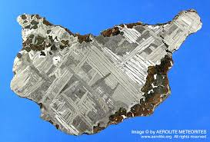
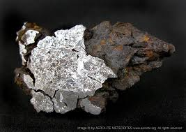
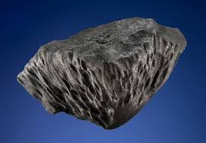
Meteorites -- Iron
These images show iron meteorites which are comprised largely of metallic iron and nickel. They are probably remnants of a core-like interior of large asteroids that have broken up through collisions in the asteroid belt. These asteroidal cores typically cooled slowly under an insulating later of mantle-like rock.
Evidence for that slow cooling is seen in the left-most image which is a polished surface showing large crystalline Widmanstätten pattern.

Slide 5
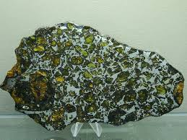
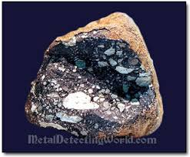
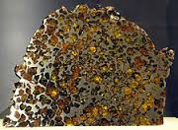
Meteorites – Stony-Iron
Stony-iron meteorites are thought to form from fragments of asteroidal iron and rocky materials re-cemented into a breccia-like matrix.
The matrix may be iron with rocky inclusions, Pallasites, or rock-like with metallic inclusions, Mesosiderites.

Slide 6
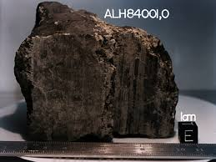
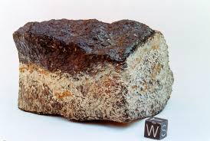
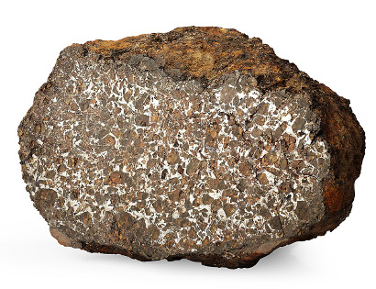
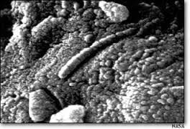
Meteorites – Stony: Achondrite
These Achondrites might easily pass for an ordinary rock if seen on the ground. Those shown here are highly evolved and probably much younger than the oldest meteorites we find.
The one on the right is the famous ALH84001 meteorite that was collected in a glacial outwash in the Allen Hills of Antarctica in 1984. It became famous, and brought some fame to McGill in 1996, when it was “discovered” that structures inside this meteorite seemed to show “nanofossils”. We know that this meteorite was splashed off Mars some 30 million years ago.

Slide 7
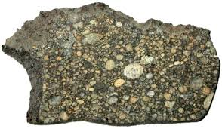
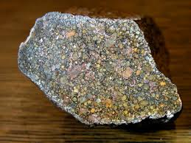
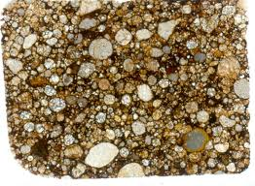
Meteorites – Stony: Chondrite
Chondrites form from small beads of glassy rock materials cemented together. The beads are called chondrules, clearly seen in the right-most image.
They are glassy because they have cooled too quickly to form a crystalline structure; they may have formed of molten materials splashed from energetic collisions between asteroid-sized bodies or, perhaps, drops from the equivalent of a “rain” in the proto-solar nebula.

Slide 8
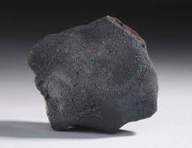
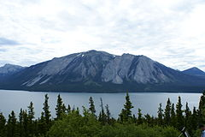
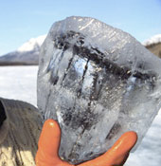
A Carbonaceous Chondrite: Tagish Lake Meteorite
Carbonaceous chondrites contain substantial organic material, namely carbon. Carbon, combined with other elements, namely N, P, S and O is often found already formed into organic molecules, the base amino acids and sugars necessary to the construction of RNA and DNA molecules.
The building blocks of life are contained in these meteorites. Perhaps they only need fall into empathetic environments that form primitive life.

Slide 9
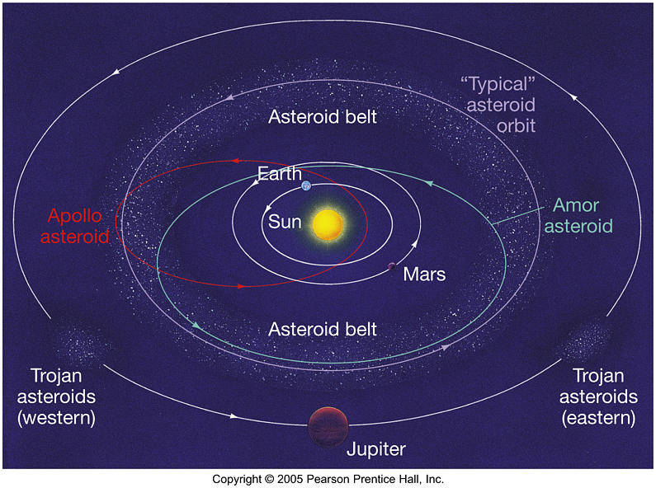
Orbits of Asteroids
Main belt: orbit between Mars and Jupiter near the ecliptic plane in relatively low eccentricity orbits.
Apollos and Atens: orbits cross Earth distance (1AU)
Trojans: orbits are guided by Jupiter
Amors: approach near Earth but don’t cross Earth’s orbital distance

Slide 10
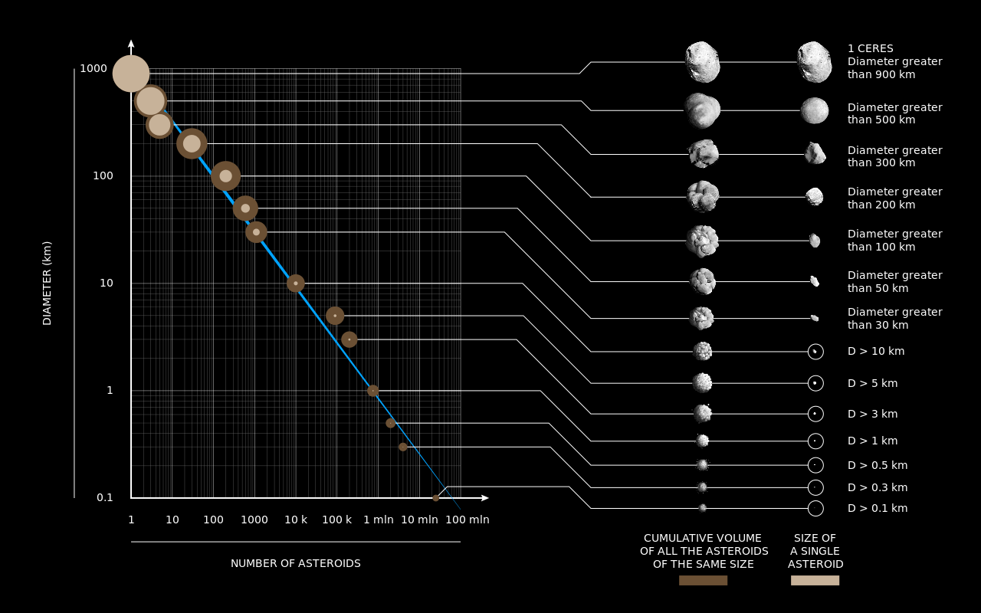
Asteroids size and number
https://commons.wikimedia.org/wiki/File%3AAsteroids_by_size_and_number.svg

Slide 11
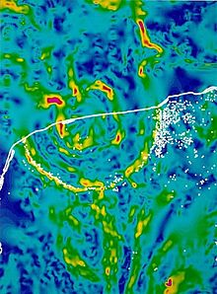
Asteroidal Impacts
Chicxulub impactor: 66 million years ago, an asteroid at least 10km in diameter struck the Earth on the northern edge of the Yucutan Pennisula. It left a crater 100km in diameter, a hole punched in a platform of carbonate rocks.
Molten rock fragments were sprayed into the atmosphere, falling worldwide to light fires in all the forests and lands of Earth. It vapourized the carbonates filling the atmosphere with a high concentration of CO₂. The age of the dinosaurs ended.
This was the great K/Pg (previously designated K-T) extinction event that eliminated most of land-animal life.

Slide 12
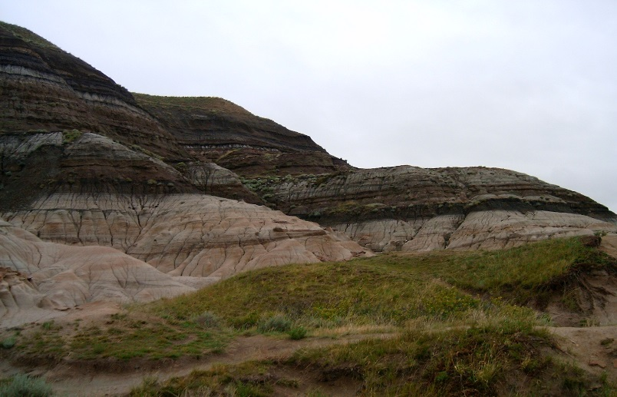
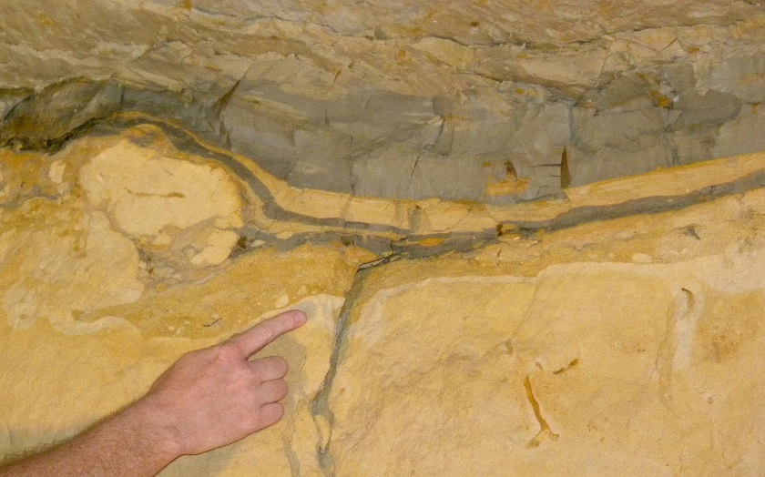
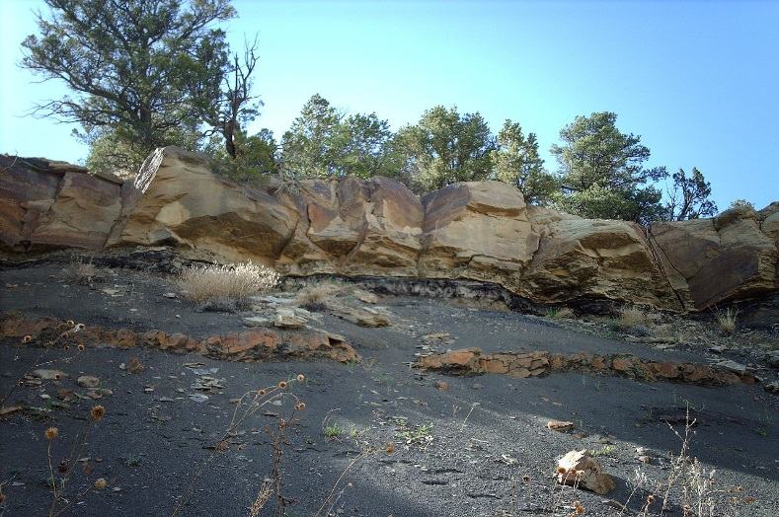
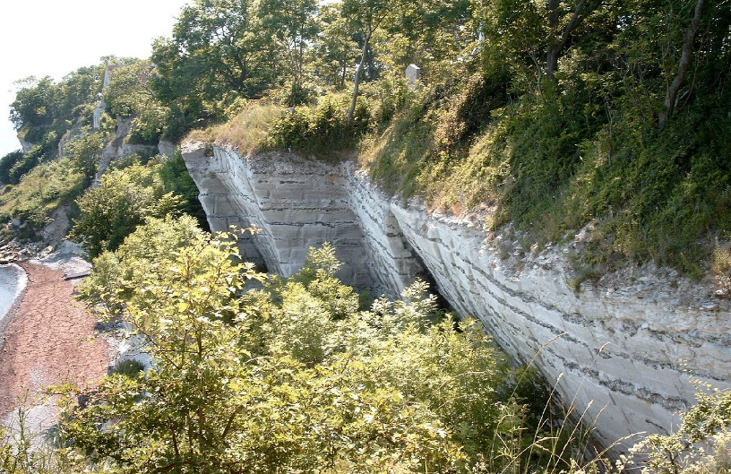
Chicxulub Event
Evidence of the global scale of the Chicxulub Event: a globally distributed layer of sediments with anomalous Ir (iridium).
Drumheller, Alberta
Geulheim, Netherlands
Trinidad Lake, Colorado
Stevns Klint, Denmark
Images from: https://en.wikipedia.org/wiki/Cretaceous-Paleogene_boundary

Slide 13
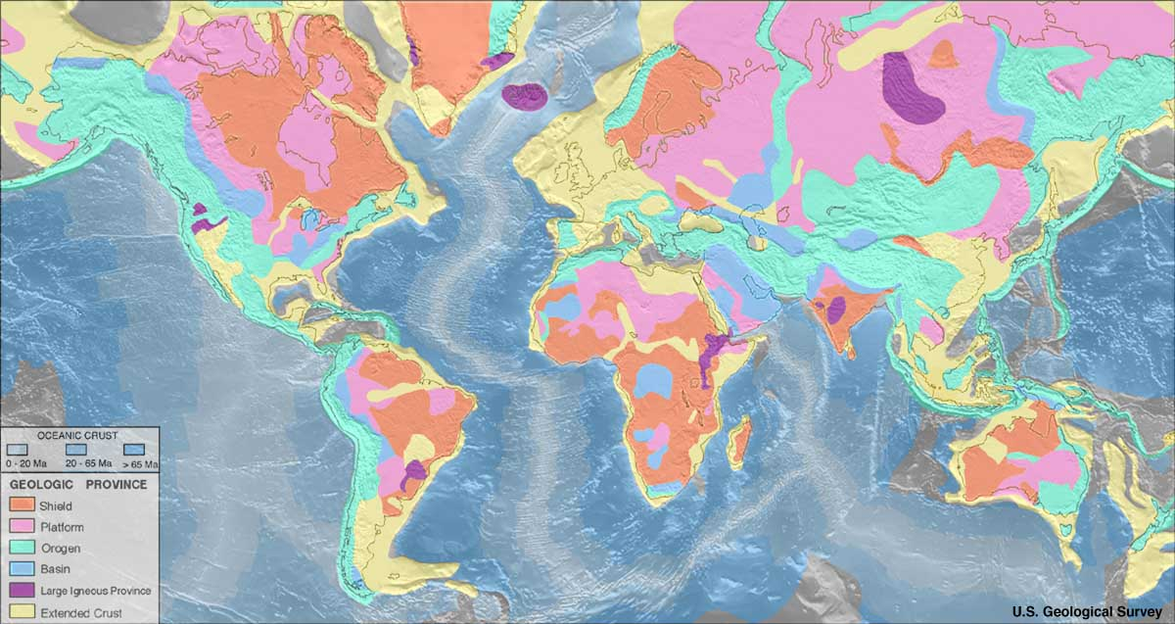
Deccan Traps?
A massive volcanic eruption in what is now India about 250,000 years before the cataclysmic Chicxulub asteroid impact may have played a role in the extinction of dinosaurs, say scientists who have dated rocks from the Deccan Traps, east of Mumbai.
http://earthquake.usgs.gov/data/crust/maps.php: [USGS], via Wikimedia Commons

Slide 14
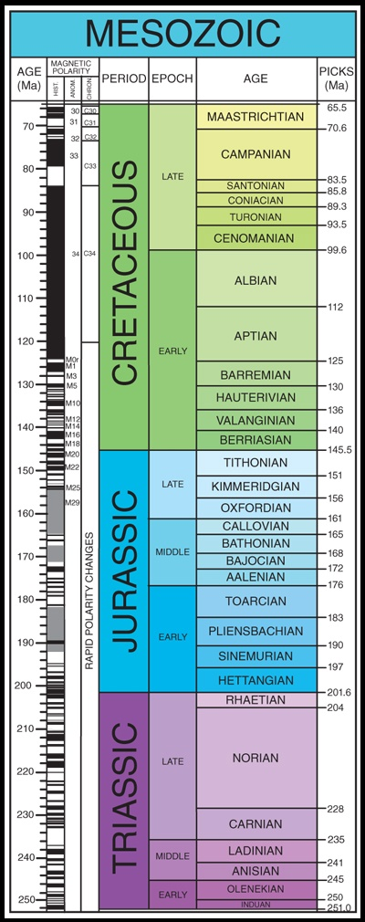
“Geological Clock”
Chicxulub impactor and Deccan volcanism: within a few centimetres of the K/Pg boundary, we find no fossils of the great dinosaurs.
Age of the Dinosaurs
Siberian flood volcanism may have ended the Permian period with the greatest single extinction in the geological record

Slide 15
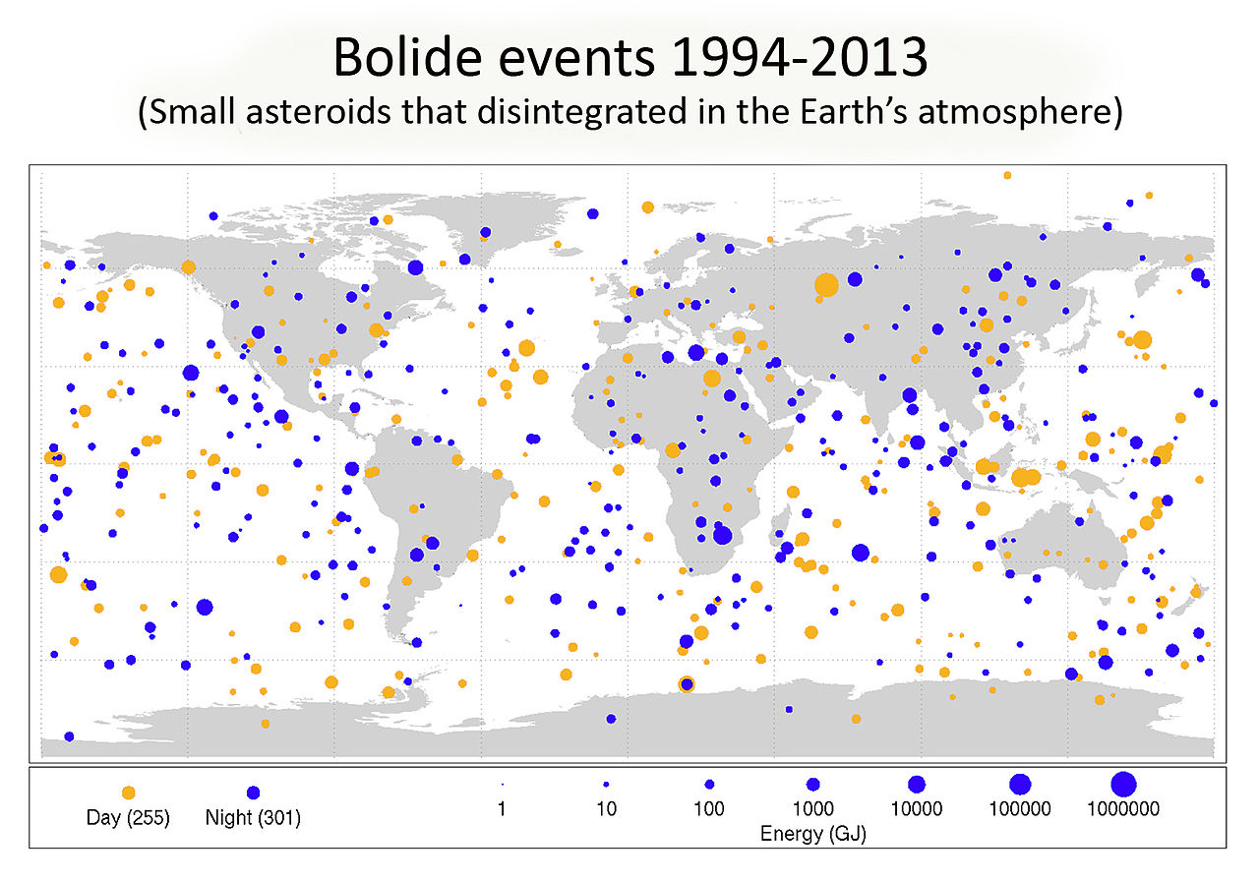
Bolide events (1994-2013)
By NASA/Planetary Science [Public domain], via Wikimedia Commons
$$Energy equivalence: 1000000 GJ ≈250 kton nuclear explosion$$

Slide 16
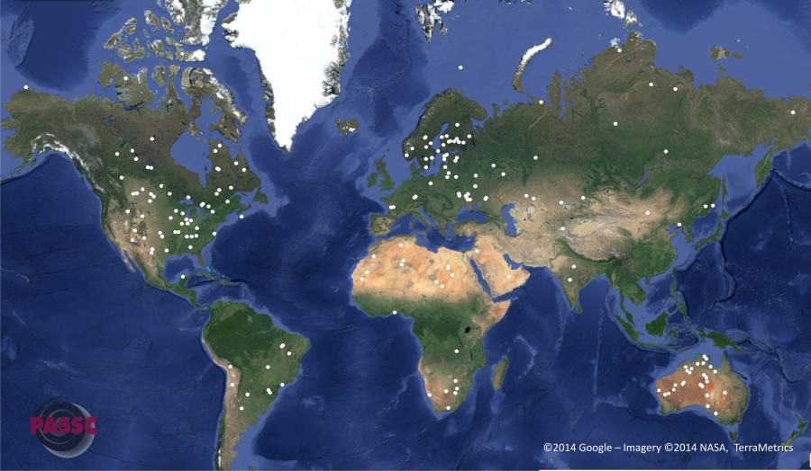
A history of large impacts
North America
Russia/Asia
Africa
http://www.passc.net/EarthImpactDatabase/New%20website_05-2018/Index.html

Slide 17
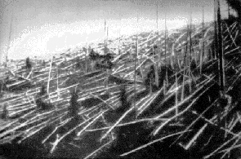
Comets too? Tunguska Event
On the morning of 30 June 1908 an explosion over the sparsely populated Eastern Siberian Taiga flattened 2,000 km² of forest but caused no known human casualties. It may have been a comet strike.
Comets are made of low density dusts and ice but because their orbits are so eccentric, they may pass by (or strike) Earth with incredible speeds, up to 80000 km/hr.
Photo by Leonid Kulik
Even though they may not carry much mass, the energy they bring to collision is high because of their high impact speeds.

Slide 18
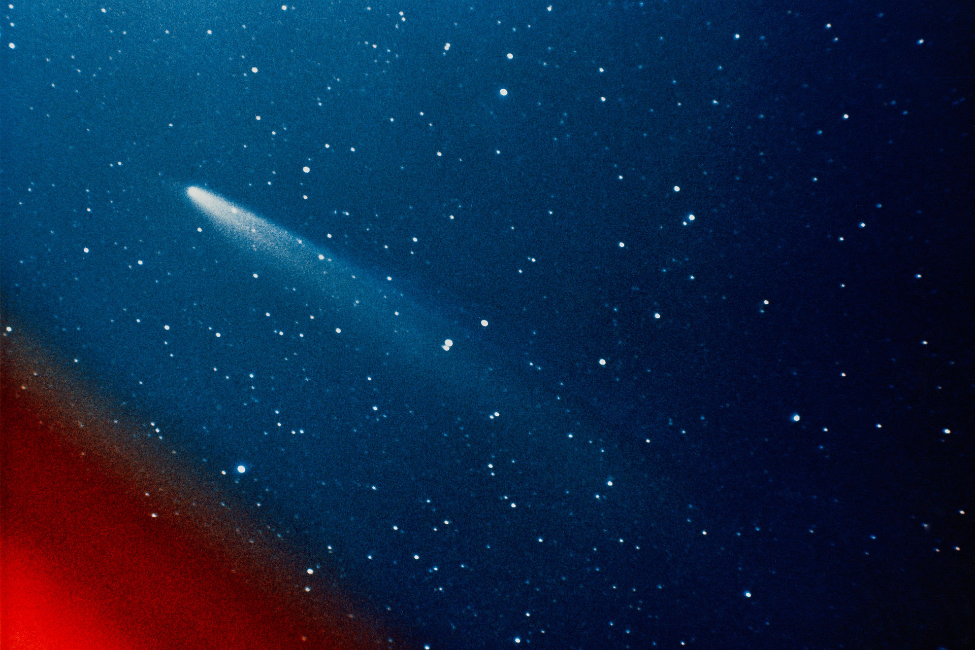
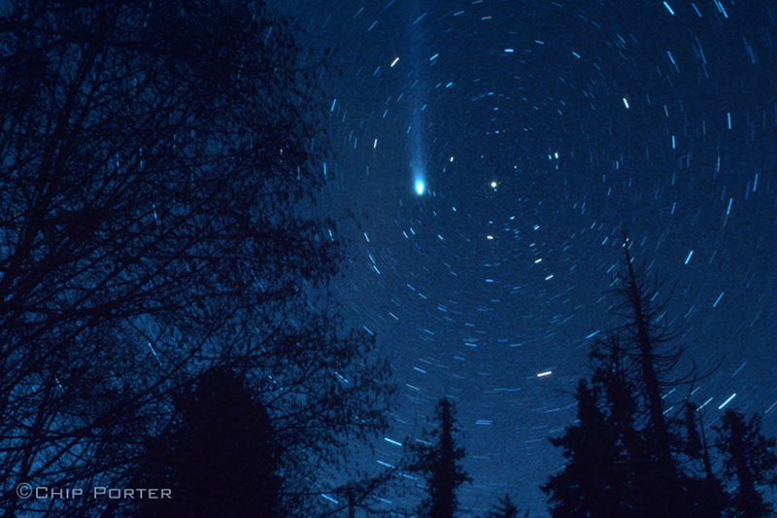
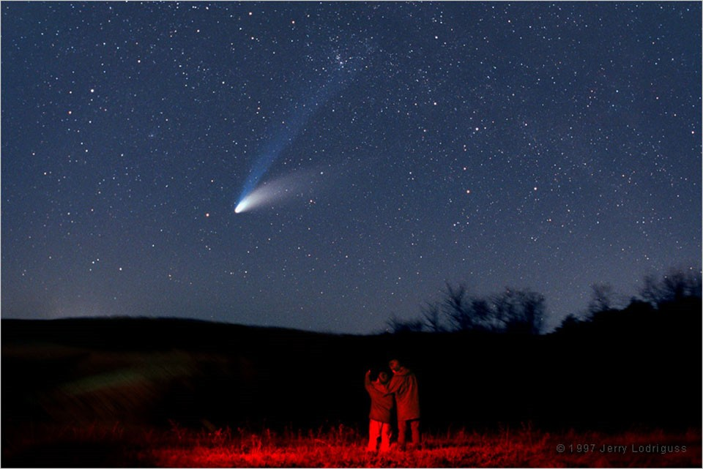
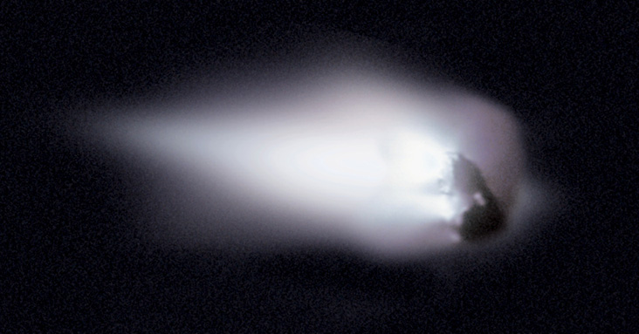
Some recent Comets
Hale-Bopp (1997) Comet of the century
Hayakutake (1995)
Halley’s (1910 and 1986)
Kohoutek (1973)

Slide 19
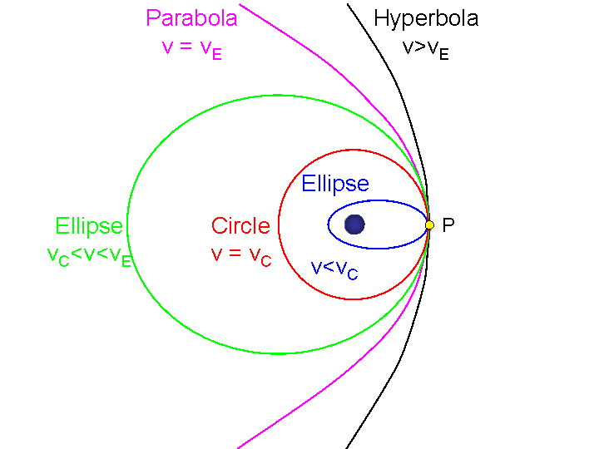
Orbits and eccentricity
$$e=1$$
$$e>1$$
v_{E} = $\sqrt{\frac{2GM}{r}}$
$$0<e<1$$
$$e=0$$
v_{C} = $\sqrt{\frac{GM}{r}}$

Slide 20
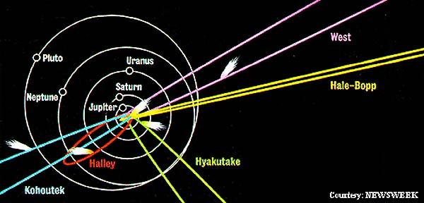
Orbits of Comets
Halley’s comet (1910 and 1986) has a relatively short, 76-year, period orbit confined to the Solar System. Most of the recent spectacular comets enter the inner regions of the Solar System on highly eccentric (some on nearly parabolic) orbits.
e ≈ 0.99997, T > 250000yr
e ≈ 0.995, T = 2025yr
e ≈ 0.967, T = 76.3yr
e ≈ 0.9998946, T > 70000yr
e ≈ 1.000008, T = ∞

Slide 21
Meteor showers – comet debris
Perseid shower (August): Earth’s orbit takes us through the debris-filled orbital path of comet Swift-Tuttle in July-August each year. Peak shower: August 11, 12.
Leonid shower (November): The debris path of comet Temple-Tuttle. Peak shower: November 17,18
Draconid shower (October): The debris path of comet Giacobini–Zinner. Peak shower: October 21±
Quadrantid shower (January): Unknown extinct comet. Peak shower: January 1,3.

