Slide 1
Terrestrial Planets
Winter 2020
Week 5
Professor Olivia Jensen
Earth and Planetary Sciences
FD Adams 131C

Slide 2
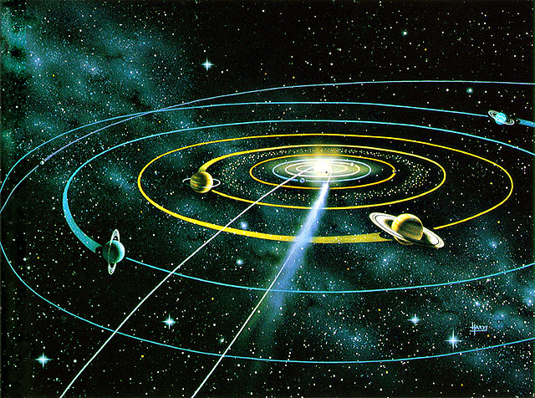
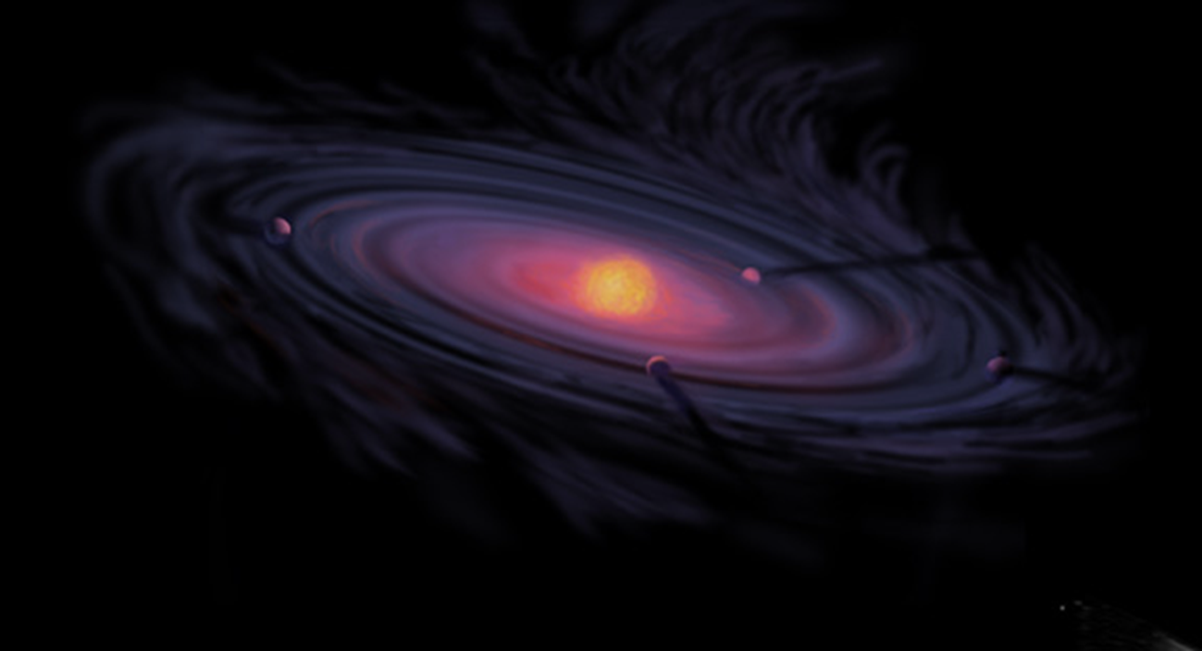
Planets of our Solar System
Artist’s image of protoplanetary nebula: By NASA [Public domain], via Wikimedia Commons
https://www.eso.org/public/outreach/eduoff/vt-2004/Background/Infol2/EIS-C1_pf.html
Let us learn something of these planets and their orbits.

Slide 3
The planetary system: orbital parameters
Planet | Period (yr) | Distance (AU) | Eccentricity | Inclination º
Mercury | 0.2408 | 0.39 | 0.206 | 7.0
Venus | 0.6152 | 0.72 | 0.007 | 3.4
Earth | 1 | 1 | 0.017 | 0
Mars | 1.881 | 1.52 | 0.093 | 1.9
Ceres* | 3.63 | 2.36 | 0.237 | 7.1
Jupiter | 11.86 | 5.2 | 0.049 | 1.3
Saturn | 29.46 | 9.54 | 0.056 | 2.5
Uranus | 84.01 | 19.19 | 0.047 | 0.8
Neptune | 164.79 | 30.0 | 0.009 | 1.8
Pluto* | 248.5 | 39.48 | 0.25 | 17.2
* Dwarf planets

Slide 4
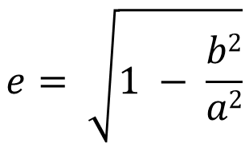
Orbital eccentricity
$$e= \sqrt{1 − \frac{b2}{a2}}$$
Planet
b
Sun
a
Aphelion
X
Perihelion
a is the semi-major axis,
b is the semi-minor axis

Slide 5
Orbital inclination
Inclination angle
X
Planet
Sun
Ecliptic plane (Earth’s orbital plane)

Slide 6

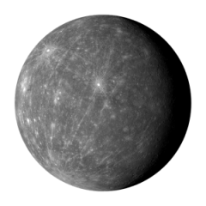
Mercury
Diameter: 4,879 km
Mass: 3.30 x 10²³ kg (5.5% Earth)
Moons: None
Orbit Distance: 57,909,227 km (0.39 AU)
Orbit Period: 88 days
Rotation Period: 58.7 days (3:2 spin-orbit couple)
Surface Temp: -173 to 427°C
First Record: 14th century BC
Recorded By: Assyrian astronomers
http://space-facts.com/mercury/

Slide 7

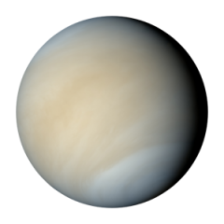
Venus
Diameter: 12,104 km
Mass: 4.87 x 10²⁴ kg (81.5% Earth)
Moons: None
Orbit Distance: 108,209,475 km (0.73 AU)
Orbit Period: 225 days
Rotation Period: 243 days (retrograde)
Surface Temp: 462 °C (almost constant)
First Record: 17th century BC
Recorded By: Babylonian astronomers
http://space-facts.com/venus/

Slide 8

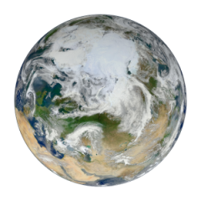
Earth
Equatorial Diameter: 12,756 km
Polar Diameter: 12,714 km
Mass: 5.97 x 10²⁴ kg
Moons: 1 (The Moon)
Orbit Distance: 149,598,262 km (1 AU)
Orbit Period: 365.26 days
Rotation Period (solar): 86 400 seconds = 1 day
Rotation Period: (sidereal): 23.93 hours
Surface Temperature: -88 to 58°C
http://space-facts.com/earth/

Slide 9

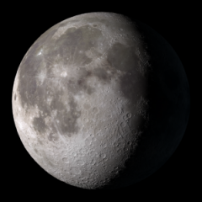
Moon
Diameter: 3,475 km (0.27 Earth’s)
Mass: 7.35 × 10²² kg (0.01 Earth’s)
Orbital eccen.: 0.055
Orbit Distance: 384,400 km
Orbit Period: 27.3 days (Tropical month)
29.53 days (Synodic month)
Surface Temp: -233 to 123C
http://space-facts.com/the-moon/

Slide 10

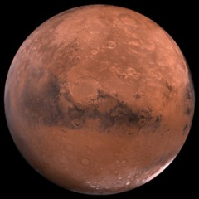
Mars
Equatorial Diameter: 6,792 km
Polar Diameter: 6,752 km
Mass: 6.42 x 10²³ kg (11% Earth)
Moons: 2 (Phobos & Deimos)
Orbit Distance: 227,943,824 km (1.52 AU)
Orbit Period: 687 days (1.9 years)
Rotation Period: 24.62 hours
Surface Temp: -153 to 20 °C
First Record: 2nd millennium BC
Recorded By: Egyptian astronomers
http://space-facts.com/mars/

Slide 11
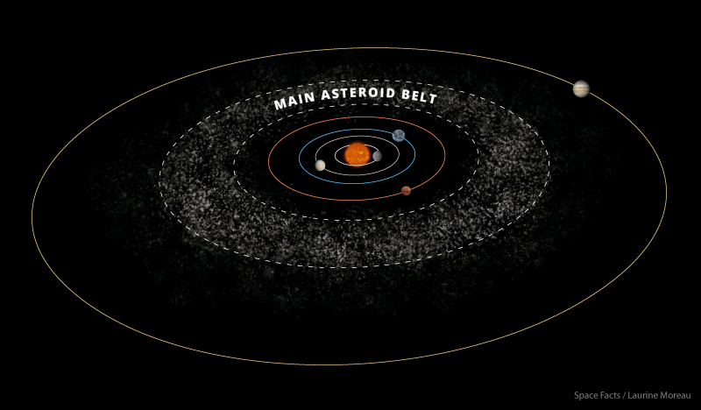
Asteroids
Asteroid Belt – artwork: laurinemoreau.com

Slide 12
The Major Asteroids
Name | Size (km) | Mass x 10¹⁵ kg | Distance (AU)
Ceres | 960x932 | 870000 | 2.767
Pallas | 570x525x482 | 318000 | 2.774
Juno | 240 | 20000 | 2.669
Vesta | 530 | 300000 | 2.362
Eugenia | 226 | 6100 | 2.721
Siwa | 103 | 1500 | 2.734
Kleopatra | 217x94 | 4640 | 2.79
Orbits in the solar system and other stellar systems:
http://janus.astro.umd.edu/SolarSystems/

Slide 13

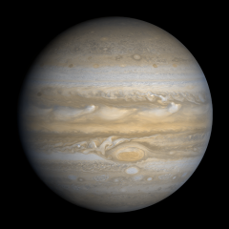
Jupiter
Equatorial Diameter: 142,984 km (11.2 Earth’s)
Polar Diameter: 133,709 km
Mass: 1.90 × 10²⁷ kg (318 Earths)
Moons: 67 +
Galilean Moons: Io, Europa, Ganymede, Callisto
Rings (number): 4
Orbit Distance: 778,340,821 km (5.20 AU)
Orbit Period: 4,333 days (11.9 years)
Rotation Period: 9.925 hours
Effective Temp: -148 °C
First Record: 7th or 8th century BC
Recorded By: Babylonian astronomers
http://space-facts.com/jupiter/

Slide 14

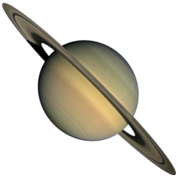
Saturn
Equatorial Diameter: 120,536 km (9.45 Earth’s)
Polar Diameter: 108,728 km
Mass: 5.68 × 10²⁶ kg (95 Earth’s)
Moons: 62 +
Titan, Enceladus, Iapetus, Rhea
Rings: 30+ (7 Groups)
Orbit Distance: 1,426,666,422 km (9.54 AU)
Orbit Period: 10,756 days (29.5 years)
Rotation Period: 10.55 hours
Effective Temp: -178 °C
First Record: 8th century BC
Recorded By: Assyrians
http://space-facts.com/saturn/

Slide 15

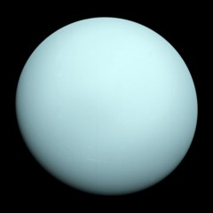
Uranus
Equatorial Diameter: 51,118 km (4.0 Earth’s)
Polar Diameter: 49,946 km
Mass: 8.68 × 10²⁵ kg (15 Earth’s)
Moons: 27 +
Titania, Miranda, Ariel, Umbriel
Rings: 13
Orbit Distance: 2,870,658,186 km (19.19 AU)
Orbit Period: 30,687 days (84.0 years)
Rotation Period: 17.2 hours
Effective Temp: -216 °C
Discovery Date: March 13th 1781
Discovered By: William Herschel
http://space-facts.com/uranus/

Slide 16
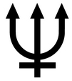
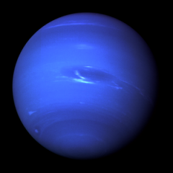
Neptune
Equatorial Diameter: 49,528 km (3.89 Earth’s)
Polar Diameter: 48,682 km
Mass: 1.02 × 10²⁶ kg (17 Earths)
Moons: 14 (Triton)
Rings: 5
Orbit Distance: 4,498,396,441 km (30.10 AU)
Orbit Period: 60,190 days (164.8 years)
Rotation Period: 16.1 hours
Effective Temp: -214 °C
Discovery Date: September 23rd 1846
Discovered By: Urbain Le Verrier, Johann Galle
http://space-facts.com/neptune/

Slide 17
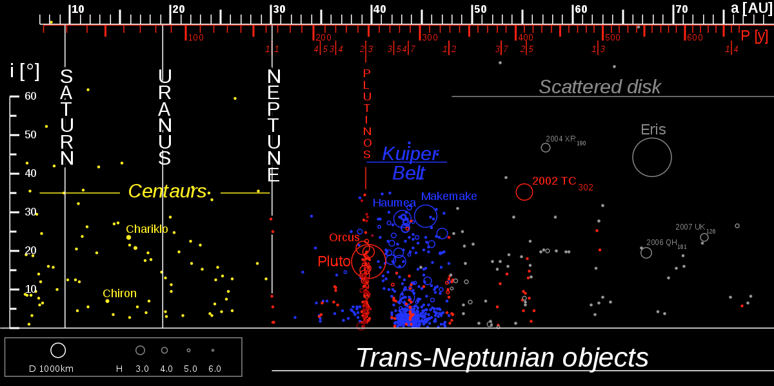
Outer regions
https://commons.wikimedia.org/wiki/File:TheTransneptunians_73AU.svg

Slide 18
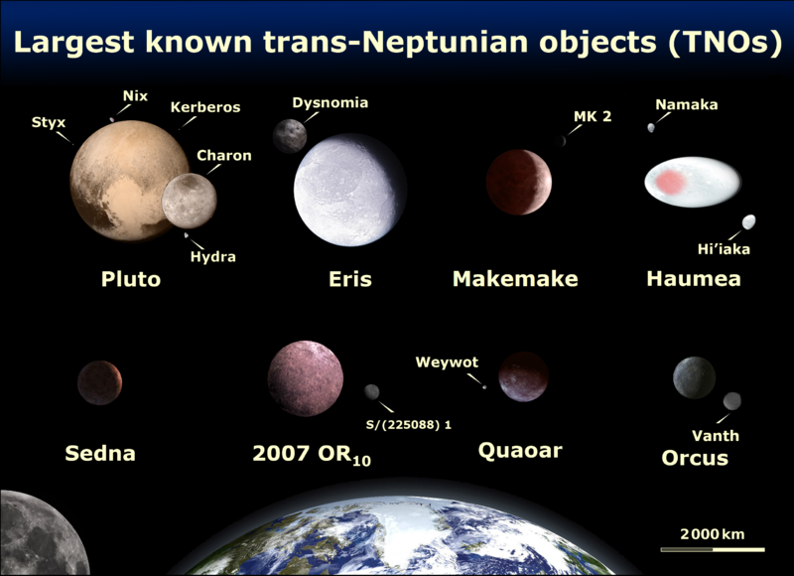
https://en.wikipedia.org/wiki/File:EightTNOs.png

Slide 19
*Transneptunian Ice Dwarf Planets
Name | Size (km) | Mass (kg) | a Distance (AU)
Pluto | 2375 | 1.30×10²² | 39.48
Eris | 2326 | 1.66×10²² | 67.78
Makemake | 1502x1430 | < 4.4 × 10²¹ | 45.72
Haumea | 1,920 × 1,540 × 990 | 4.00×10²¹ | 43.22
Sedna | ~ 1000 | No satellites | 506.2**
Quaoar | 1110 | 1.4×10²¹ | 43.37
“Snow White" | 1535x1280 | ~1.5 × 10²¹ | 66.99
* https://en.wikipedia.org/wiki/Trans-Neptunian_object
**eccentricity 0.855 (presently near perihelion)

Slide 20
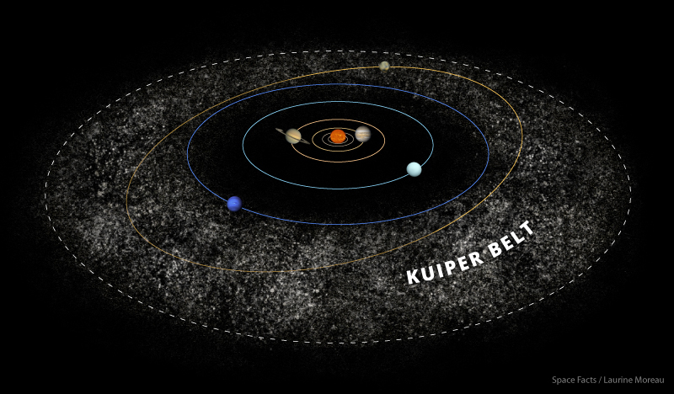
Kuiper belt
Kuiper Belt – artwork: laurinemoreau.com

Slide 21
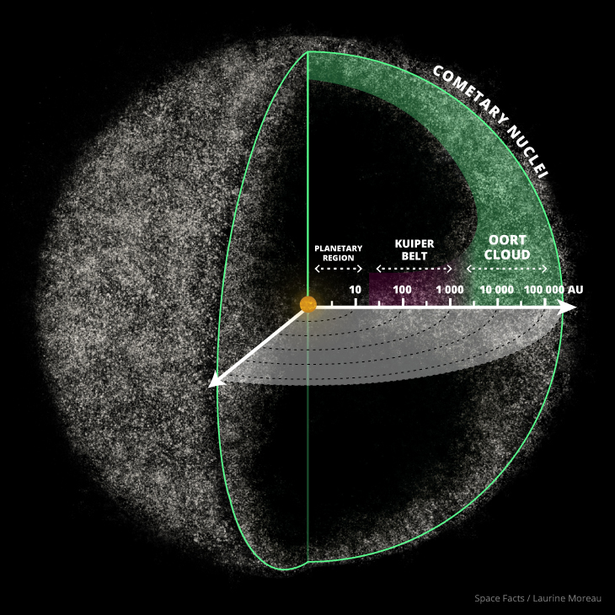
Oort cloud
Oort Cloud – artwork: laurinemoreau.com

