Slide 1
Terrestrial Planets
Week 3
Professor Olivia Jensen
Earth and Planetary Sciences
FD Adams 131C

Slide 2
Scaling the Universe
But first, let’s look to a brief history of astronomical measurement.
Our current understanding of the universe is importantly dependent upon our models and our understanding of the scales inherent in those models.
Astronomy is an old science in that astronomical models were already being introduced at the dawn of recorded civilization.
We have learned that materials in the Solar System condensed as long ago as 4.567 × 10⁹ years ago.
We know that our Solar System comprises elements that must have been formed in earlier phases of solar evolution. How have we actually measured the age, and hence size, of our universe?
We require a methodology for determining distance scales of the universe.
We shall see how distance scales relate to the age of the universe.
We shall bootstrap a scaling method for measuring distances that reach to the edge of the “observable” Universe.

Slide 3
A brief history of Astronomical Science
The ancient Druids of Britain, the Inca of Peru, the Mayans of Central America, the Aztecs of Mexico and all the peoples of the Middle East looked to the sky for order and predictability... Stonehenge
The ancient Babylonians were keen observers of the stars and planets.
The Phoenicians, the Greeks, the Indians, the Chinese, the Persians, the Mesopotamians ... navigation (the astrological signs)
The Polynesians almost surely navigated by the stars, Sun, Moon and planets as they sailed the Pacific Ocean a thousand years ago.
The ancient Sumerians (before 3000 BCE) studied the heavens.
The Sumerian Animal Round is the first known astronomical “instrument” – their Signs of the Zodiac
Babylon: En Hedu’anna (circa 2354 BCE), high priestess of the Moon Goddess is, perhaps, the first known name in all of Astronomical science. She is also regarded as the first poet!

Slide 4
What did the ancients know?
By 2000 years BC, the Babylonians already had obtained an accurate measurement of the length of the year.
Anaximander (611-546BC) and the Ionians, developed a primitive cosmology which attempted to describe a universe as consequent to the basic element, water.
Pythagoras (570-500BC) discovered that the planet Earth was a sphere and that the heavenly bodies moved in circular paths, though as Plato (428-347BC), followed in believing about the central Earth.
One may argue that the advent of Christianity and its fundamentalist adherence to the ancient writings of Biblical myth retarded the development of astronomy and of our understanding of nature for the next 1500 years.
Christianity adopted the elaborate epi-cyclic theory of Ptolemy, (CE 100-200) with an Earth-centred (geocentric) universe, the Amalgest.
The pre-Christian-era knowledge of the Solar System was preserved in the cultures of the Middle East; it was, there, refined, especially in the area of mathematics, and improved upon by the Persians and Arabs.
Anaxagoras (500-428BC) already knew that the Moon’s light was reflected from the Sun. He had a “correct” explanation for both Lunar and Solar Eclipses.
Eudoxus (408-356BC) developed a mathematical-geometrical cosmology based upon a nesting of celestial spheres.
Aristotle (384-322BC) obtained proof that the Earth was a sphere and described a more complex basic chemistry based on earth, air, fire and water. The chemistry of the universe exterior to Earth was made of a fifth element: the aether.
Aristarchus (310-230BC) was the first to adopt the Sun as the centre of the universe and Solar System. Still, the Aristotelian view that the Earth centred everything would hold until the Renaissance in Europe in the 1500s.
Aristarchus’ measurements of the relative sizes of the Earth whose actual size was later accurately measured by Eratosthenes (273-?BC), and of the Moon and Sun were refined by Hipparchus (200-100BC). He also determined the precession of equinoxes.

Slide 5
A Renaissance in Astronomy
A century after Copernicus, Galileo (1564-1642) provided supporting evidence of his and Kepler’s work. The intolerant Christian church repudiated this challenging science, sentencing Galileo to house arrest for the last decade of his life. The Lutherian Christian Reformation in Northern Europe saved Kepler from a similar fate.
The work of these great scientists allow us to scale the solar system. Later in the course, we shall learn more of the detail of Kepler’s Laws and of Newtonian Mechanics which explains them.
Johannes Kepler (1571-1630), Brahe’s student assistant, used his precise measurements to discover Kepler’s laws of planetary orbital motion which he published in 1609 in a book The New Astronomy: Commentaries on the Motions of Mars. We know the paths of the planetary motions.
Tycho Brahe (1546-1601), a Danish astronomer made the important measurements of planetary positions through years.
Still, at his death in 1601, he had not embraced the Copernican heliocentric model even though his data allowed for the first accurate relative scalings of distances in the Solar System
Two thousand years ago, we knew that the Earth was round. We knew its size. We had measured the relative sizes of and distances to the Moon and the Sun. We had discovered the simplicity of the heliocentric reference frame. Five hundred years ago, we rediscovered this knowledge.
Copernicus (1473-1543): The great Polish thinker, Niklas Koppernigk precipitated the scientific renaissance in astronomy with the publication of a manuscript called Commentariolis. He recovered the Aristarchian heliocentric viewpoint. The Sun becomes the reference point in the Solar System.

Slide 6
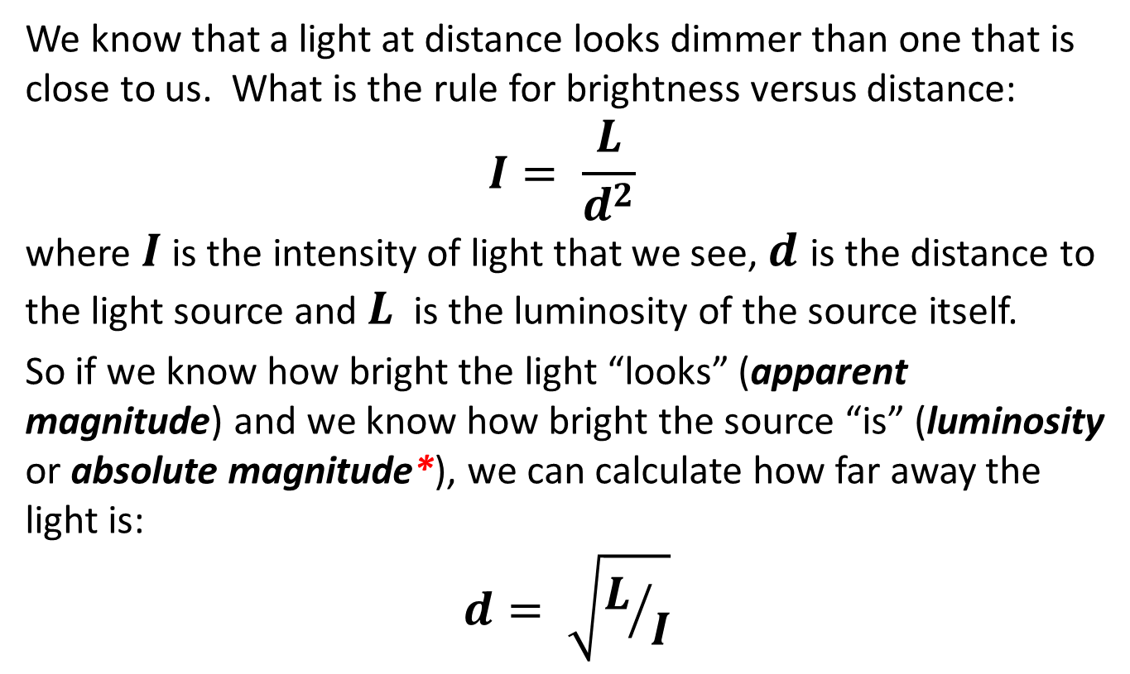
Distance to Stars and Galaxies
We know that a light at distance looks dimmer than one that is close to us. What is the rule for brightness versus distance:
$$I= \frac{L}{d^{2}}$$
where $I$ is the intensity of light that we see, $d$ is the distance to the light source and $L$ is the luminosity of the source itself.
So if we know how bright the light “looks” (apparent magnitude) and we know how bright the source “is” (luminosity or absolute magnitude*), we can calculate how far away the light is:
$$d= \sqrt{L/I}$$
*𝑴_{𝒂𝒃𝒔}= 𝟒.𝟖𝟑 −𝟐.𝟓 𝒍𝒐𝒈_{𝟏𝟎} (𝑳⁄𝑳_{𝒐})

Slide 7
The Brightness of Stars
Hipparchus of Nicaea (190-120BCE) was a Greek astronomer, geographer, and mathematician.
He is credited as the founder of trigonometry and with the discovery of the precession of the equinoxes. One of his greatest accomplishments was to measure the distance from Earth to the Moon!
He also gave us the Magnitude Scale by which we measure the brightness of stars. His magnitude scale separated stars into classes according to how bright they appeared in the night sky. His scale offered 7 classes: magnitudes 0 (brightest) to 6 (dimmest). It is a subjective scale.
Now we know that approximately, each increase of number class by 1 unit represents a “dimming” of brightness by a factor of 2.5 .

Slide 8
Magnitudes

Slide 9
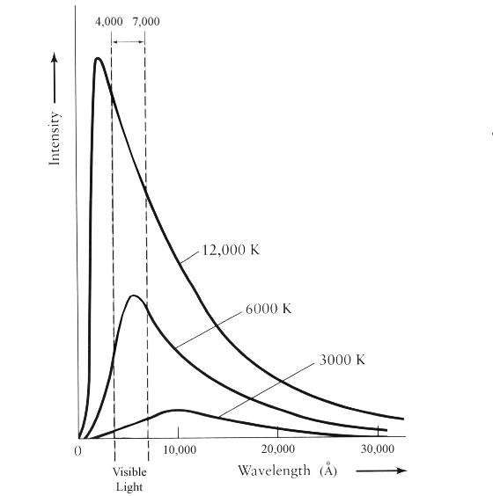
Colours of stars and luminosity
Stellar luminosities “correlate” with the colour of the light emitted by a star. The distribution or spectrum of colours or wavelengths of light emitted by a star relates to the temperature of its surface
Intensity

Slide 10
Spectral type – colour of stars
Astronomers classify stars according to Spectral Type (colour).
Spectral Type | Temperature | Characteristics
O | 30,000 - 60,000 K | Blue stars
B | 10,000 - 30,000 K | Blue-white stars
A | 7,500 - 10,000 K | White stars
F | 6,000 - 7,500 K | Yellow-white stars
G | 5,000 - 6,000 K | Yellow stars (like the Sun)
K | 3,500 - 5,000K | Yellow-orange stars
M | < 3,500 K | Red stars
L | ~ 2,000 K | Too cool for fusion?
T | 550 – 1300K | Methane Dwarfs
Oh Be A Fine Girl, Kiss Me Like That!
… song by Diane Nalini, the lyrics

Slide 11
Distance to Stars and Galaxies
For stars, if we know how far away they are and we know how bright they look (apparent magnitude), we know how bright they are… their intrinsic brightness or luminosity. We measure this in terms of absolute magnitude.
Rather than measuring the inherent luminosity, astronomers describe the intrinsic brightness of a star as the apparent magnitude a star would show if it were at a distance of exactly 10 parsecs; this defines the absolute magnitude.

Slide 12
Parallax triangulation
Recently, with high precision astronomical measurement using the Hipparcos satellite’s dual telescopes, we have determined the distance to most stars with distances of less than about 300 pc (~ 1000 light years) with an accuracy of 10%...
More recently, and with even greater accuracy, ESA’s Gaia satellite has taken on the mapping of the positions of one billion stars in our Milky Way galaxy along with a determination of their apparent brightness.

Slide 13
The 10 nearest Stars
Star | App. Mag. | Abs. Mag. | Distance (pC) | Spectral type
Sun (Sol) | -26.8 | +4.83 | 0.00000485 | G2
Proxima Cent. | +11.5 | +15.5 | 1.29 | M5
α Centauri A | +0.01 | +4.4 | 1.29 | G2
α Centauri B | +1.5 | +5.8 | 1.29 | K5
Barnard’s star | +9.5 | +13.2 | 1.81 | M5
Wolf 359 | +13.5 | +16.8 | 2.33 | M6
Lalande 21185 | +7.5 | +10.4 | 2.48 | M2
Luyten 726-8A | +12.5 | +15.4 | 2.52 | M5
Sirius A | -1.47 | +1.4 | 2.67 | A1
Sirius B | +7.2 | +11.5 | 2.67 | A0 (dwarf)

Slide 14
The 10 brightest Stars
Star | App. Mag. | Abs. Mag. | Distance (pC) | Spectral type
Sun (Sol) | -26.8 | +4.83 | 0.00000485 | G2
Sirius A | -1.47 | +1.4 | 2.67 | A1
Canopus | -0.72 | -3.1 | 30.1 | F0
Arcturus | -0.06 | -0.3 | 11.0 | K2
α Centauri A | +0.01 | +4.4 | 1.29 | G2
Vega | +0.04 | +0.5 | 7.36 | A0
Capella | +0.05 | -0.6 | 13.8 | G8
Rigel | +0.14 | -7.1 | 276 | B8
Procyon | +0.37 | +2.7 | 3.50 | F5
Betelgeuse | +0.41 | -5.6 | 159 | M2 (giant)

Slide 15
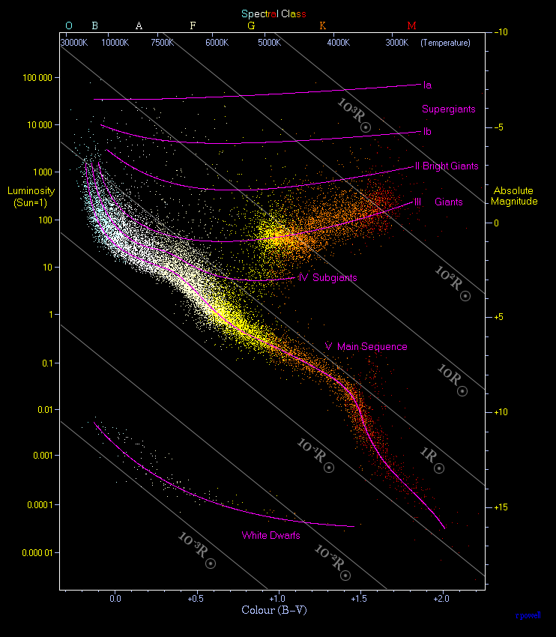
Hertzsprung-Russell Diagram
δ-Cephei
Knowing the apparent magnitude of a star and its distance, we can easily determine its absolute magnitude or “luminosity”.
If, then, we place each star into a plot of its luminosity vs. its colour temperature or “spectral type”, we obtain the famous Hertzsprung-Russell Diagram.
We can use this to calculate the distance to stars beyond the reach of our parallax triangulation.
The Hipparchos satellite has measured the distance to more than 20 000 stars. Let’s plot them: brightness vs. colour class. The Gaïa mission is now obtaining even more precise H-R diagrams.
← Our Sun
https://en.wikipedia.org/wiki/Hertzsprung%E2%80%93Russell_diagram#/media/File:HRDiagram.png

Slide 16
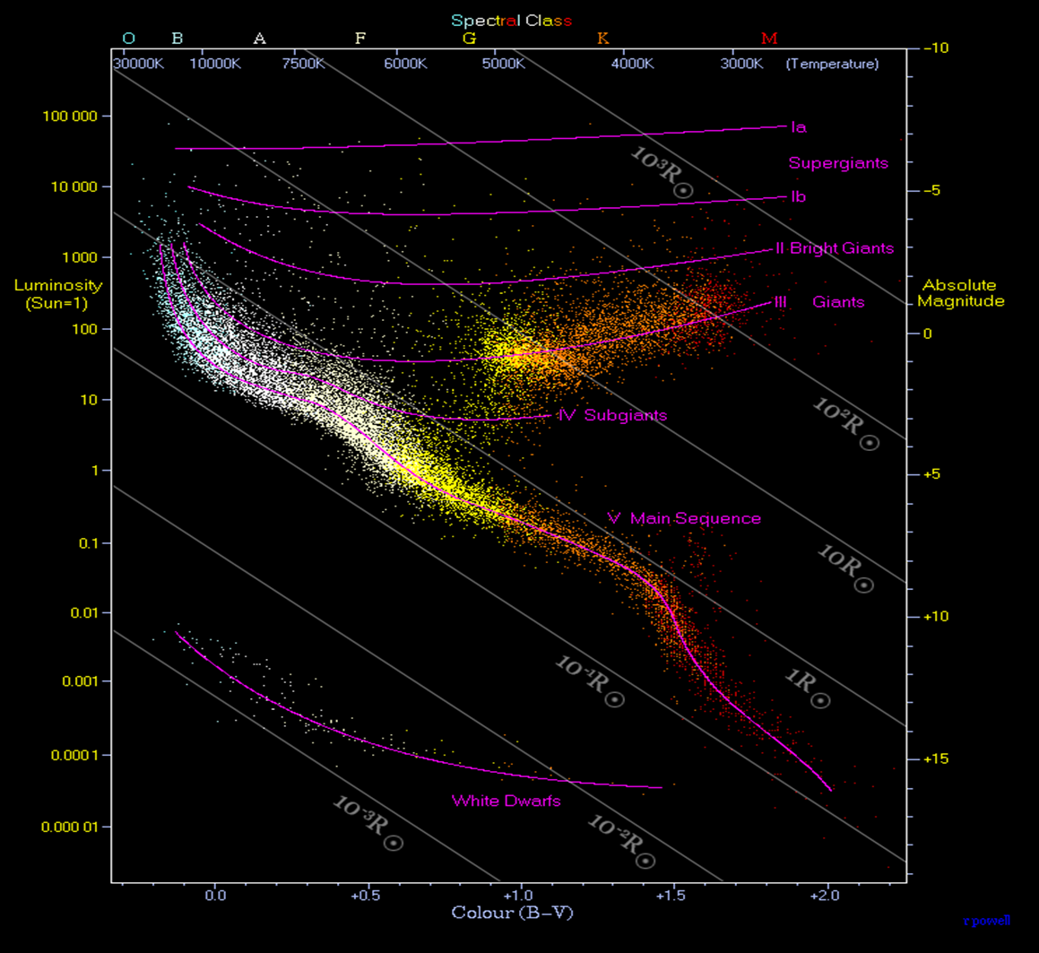
Distance by H-R plot
Colour class
We recognize that stars on the Main Sequence are in the H → He fusion stage. We can determine this by the details of the spectrum of their light which reveals the elemental content of their surface and atmospheres.
So if we know a star is Main Sequence and we know its class or colour temperature, we know how bright it is – it absolute magnitude or luminosity.
M_{abs}
Main sequence

Slide 17
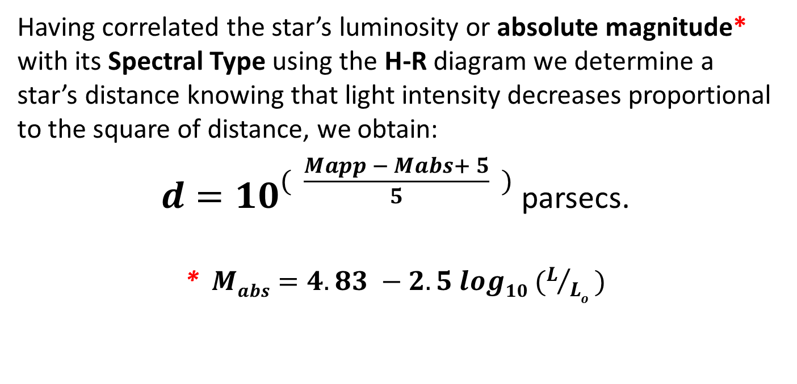
Distance by H-R plot
Having correlated the star’s luminosity or absolute magnitude* with its Spectral Type using the H-R diagram we determine a star’s distance knowing that light intensity decreases proportional to the square of distance, we obtain:
$d={10}^{( \frac{Mapp − Mabs+ 5}{5} )}$ parsecs.
*$Mabs=4.83 −2.5 log10 (L/{Lo}$ $)$

Slide 18
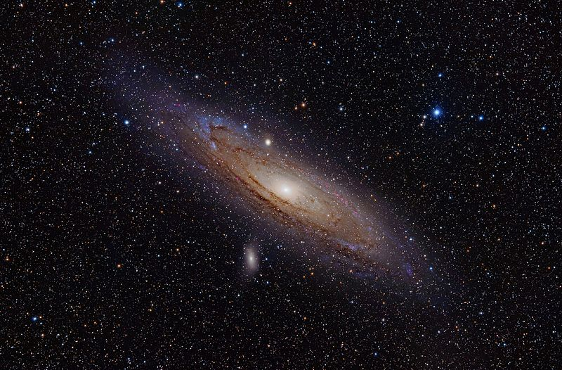
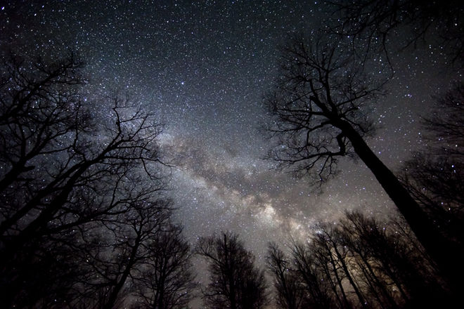
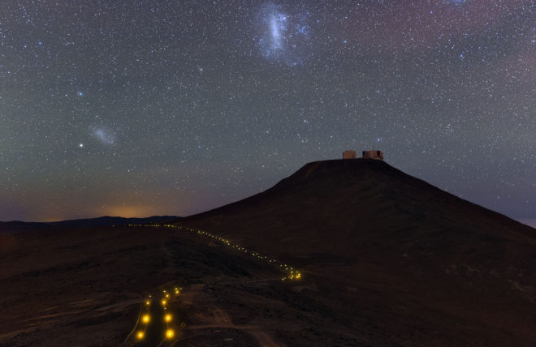
Beyond our Milky Way
Our large Milky Way galaxy has two small satellite galaxies which seem to be gravitationally bound to us – the Large and Small Magellanic Clouds. These are visible from the southern hemisphere.
We can resolve individual stars in these small satellite galaxies and so determine their distances to be 46 000 pC and 64 000 pC from the Sun. respectively.
Beyond this distance, to measure the distance to other galaxies in our local group, we employ the Cepheid variables.
Skywatcher Shawn Malone photographed the Milky Way during the weekend of April 28-29, 2012, from the shore of Lake Superior.
European Southern Observatory, Paranal Chile
By Adam Evans [CC BY 2.0http://creativecommons.org/licenses/by/2.0)], via Wikimedia Commons

Slide 19
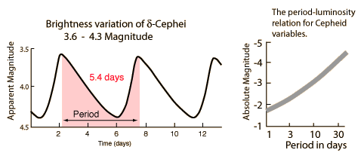
Cepheids take us to Galaxies
Henriette Leavitt working with Edwin Hubble in the 1920s recognized that a variable type of star called a Cepheid variable, changed brightness periodically and the periodicity was closely related to how bright the star was.
Cepheids are very bright stars (low absolute magnitude) and bright enough to be seen in our local group of galaxies.
http://hyperphysics.phy-astr.gsu.edu/hbase/Astro/cepheid.html

Slide 20
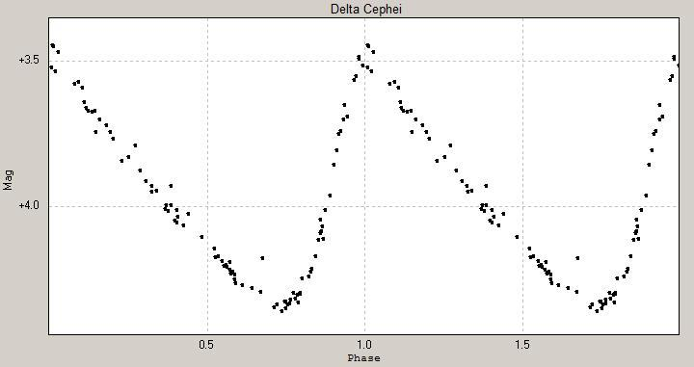
Cepheids take us to Galaxies
δ-Cephei light curve
3.5
Apparent Magnitude
4.0
5.4 days
http://hyperphysics.phy-astr.gsu.edu/hbase/Astro/cepheid.html

Slide 21
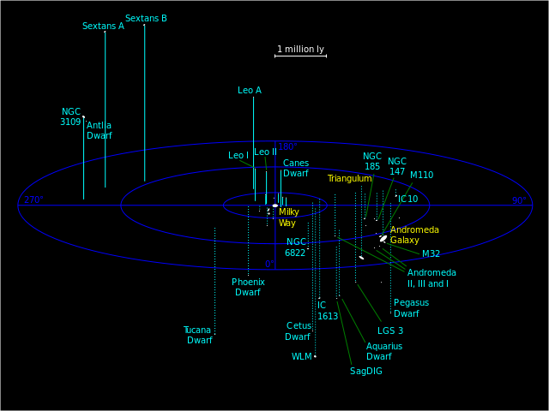
Our Local Group of Galaxies
By Local_Group.svg: Richard Powell derivative work: antropia (Local_Group.svg) [CC BY-SA 2.5 (http://creativecommons.org/licenses/by-sa/2.5)], via Wikimedia Commons

Slide 22
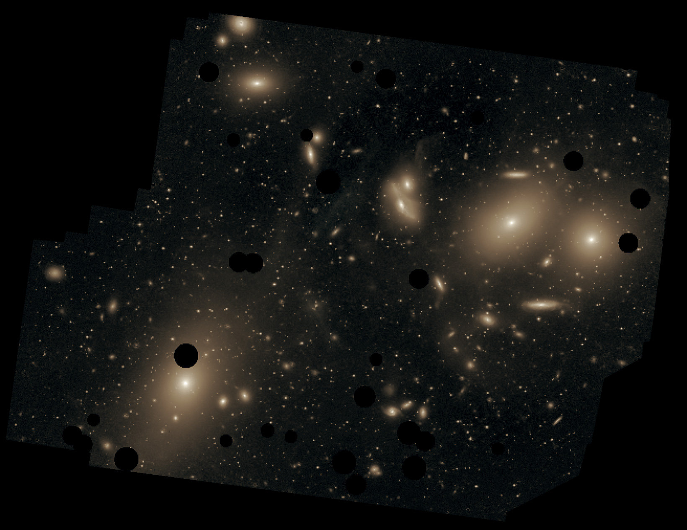

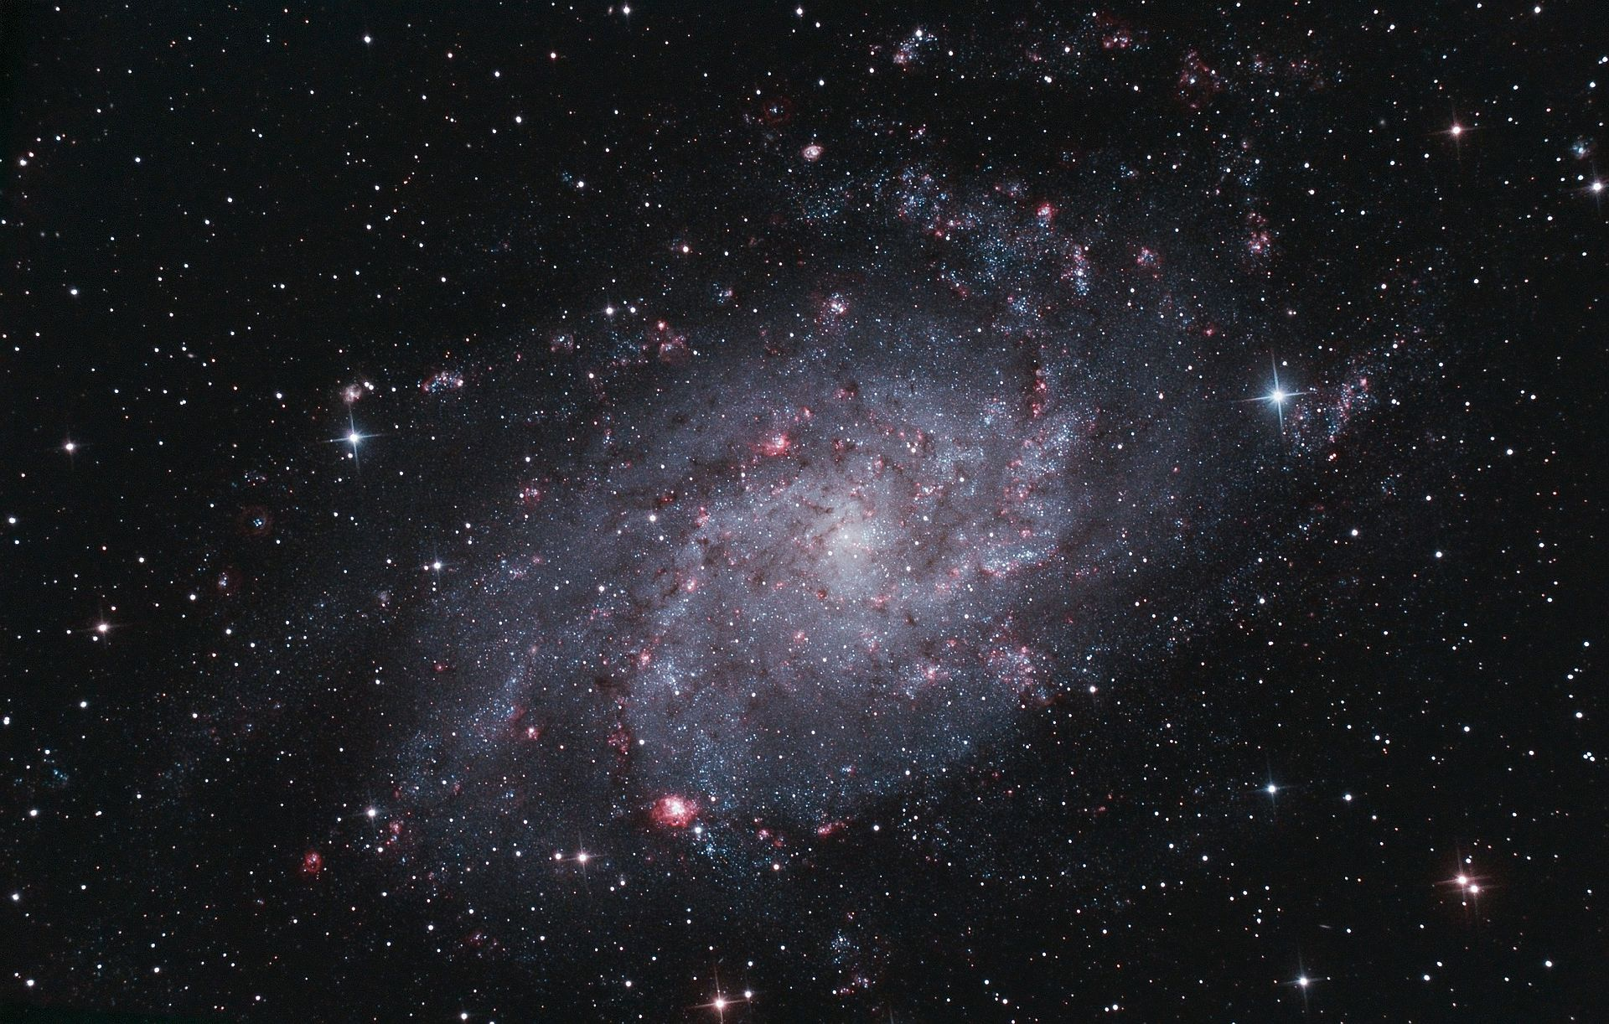
In our Local group
Andromeda: 2,500,000 ly
/Our Local Group is a member of the Virgo Cluster
Triangulum: 2,770,000 ly
By Chris Mihos (Case Western Reserve University)/ESO [CC BY 3.0 (http://creativecommons.org/licenses/by/3.0)], via Wikimedia Commons
By Alexander Meleg (Own work) [CC BY-SA 3.0 (http://creativecommons.org/licenses/by-sa/3.0)], via Wikimedia Commons
By Adam Evans [CC BY 2.0http://creativecommons.org/licenses/by/2.0)], via Wikimedia Commons

Slide 23
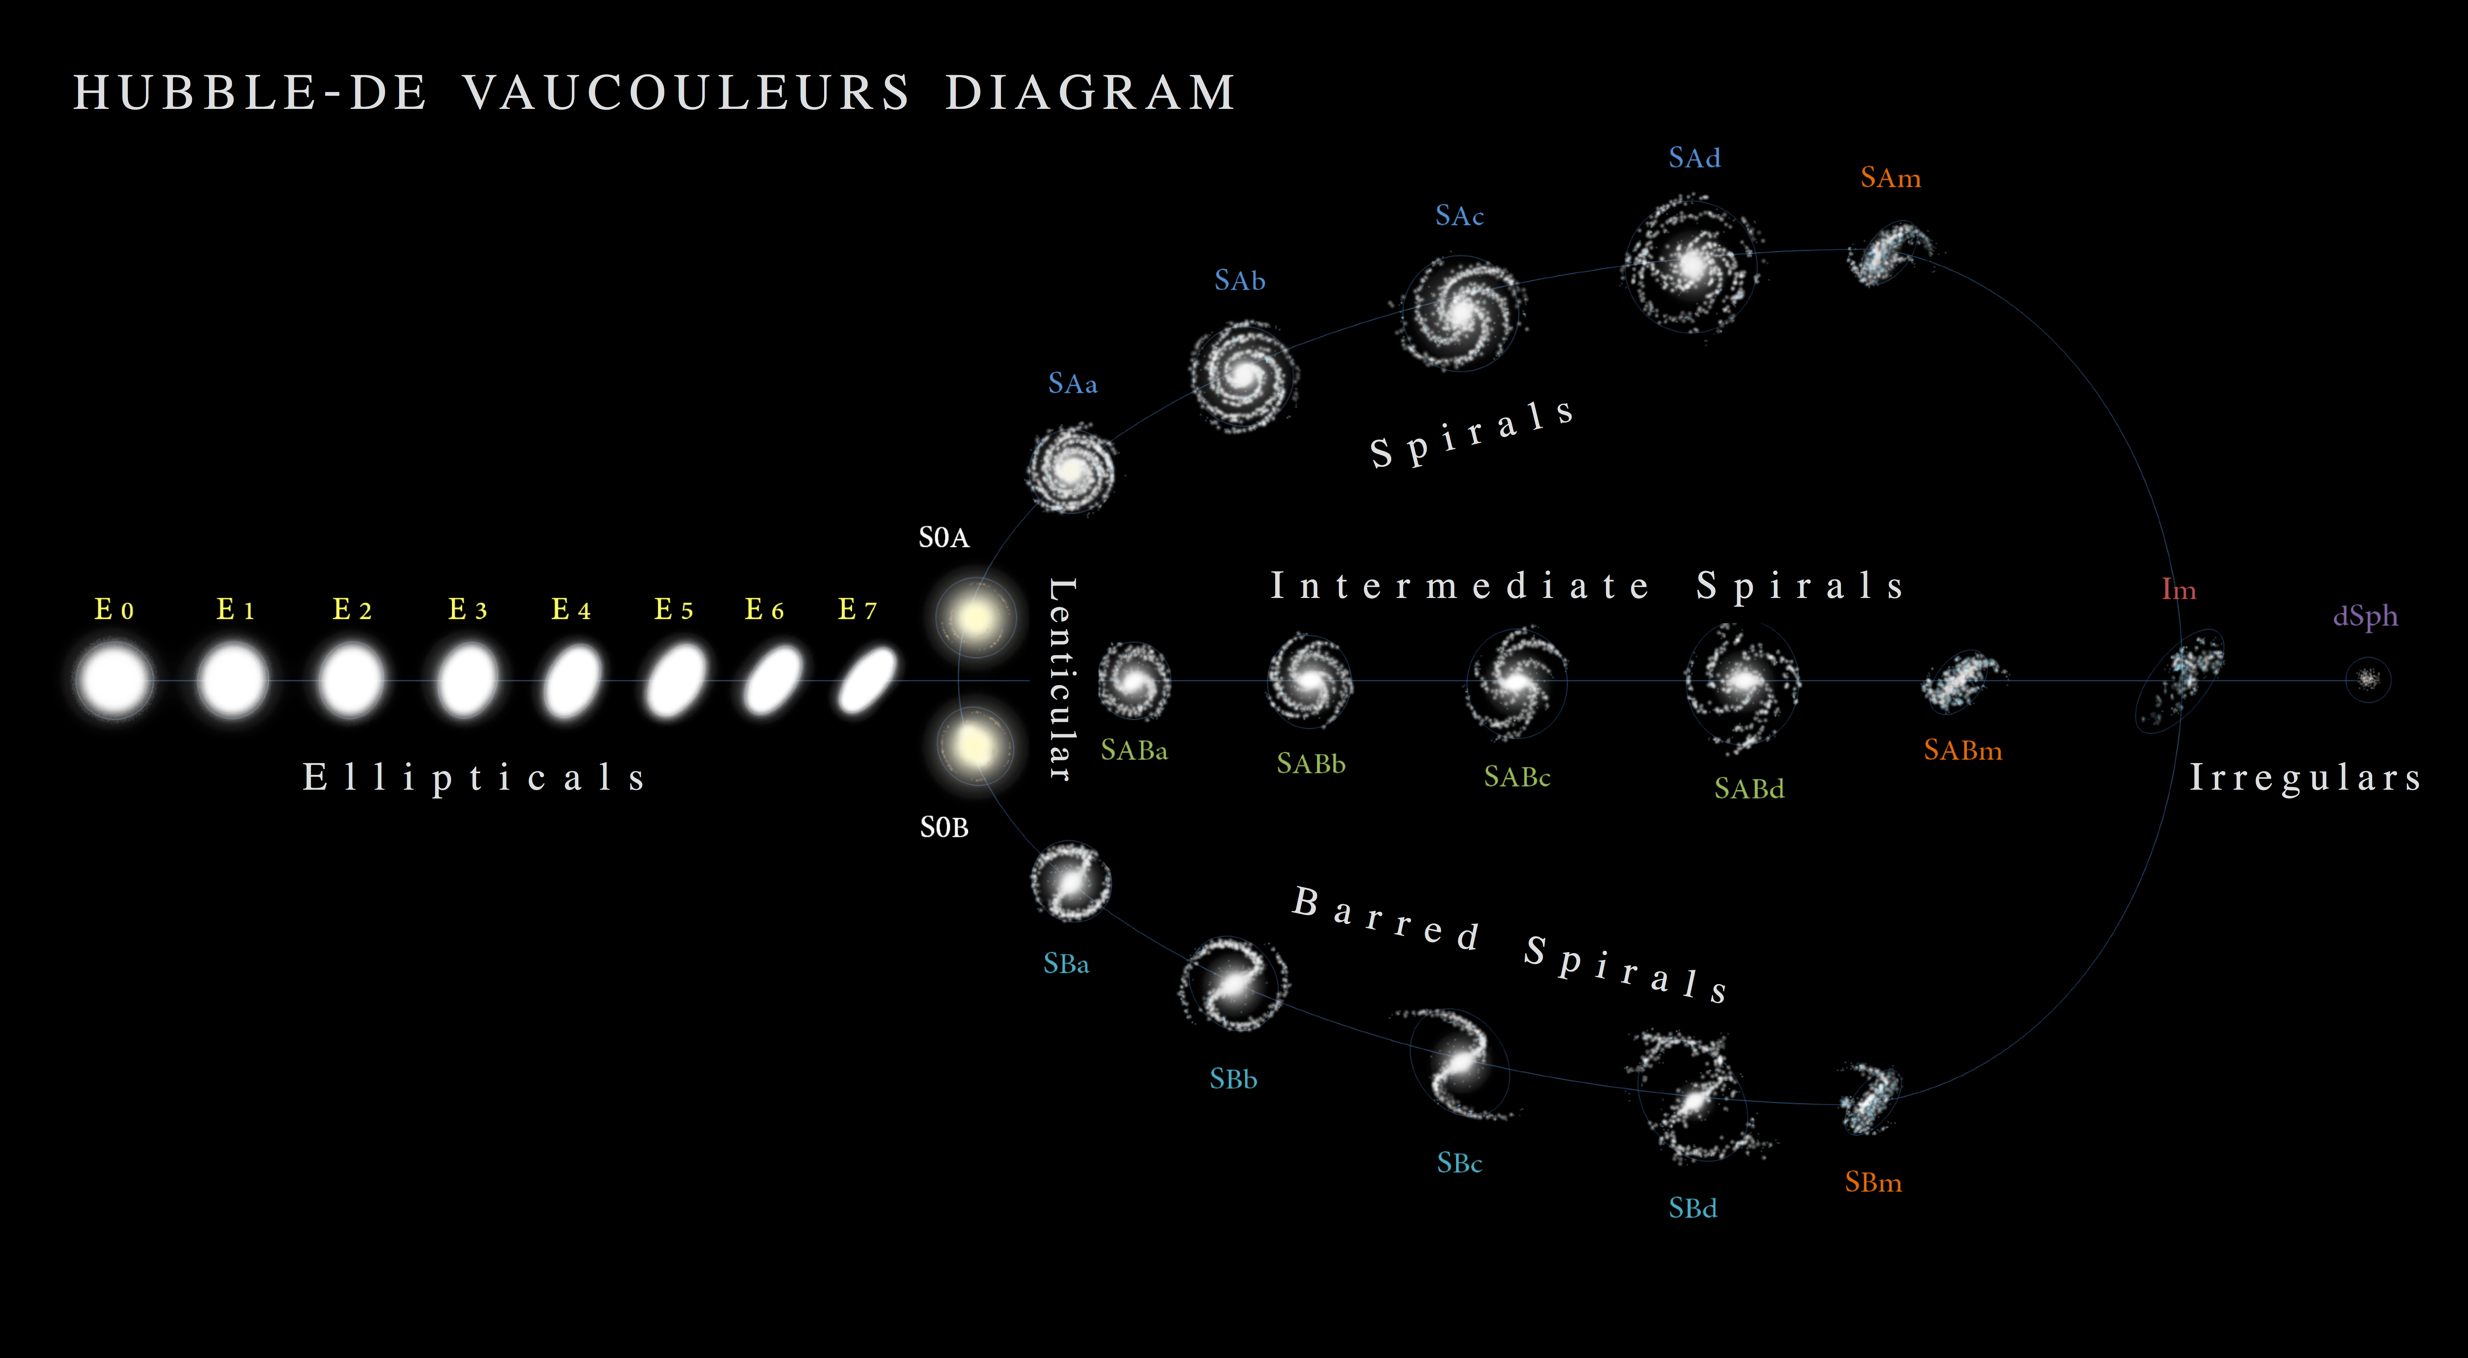
Virgo Cluster and beyond
Galaxies are classified by type just as are stars. Based on those relatively close to us, we assemble a statistics of their dimensions and their stellar composition.
If we recognize the class of a Galaxy, we have a good estimate of its dimensions, the number of stars within and its brightness or absolute magnitude.
We measure its “size” as seen from our perspective point in the Universe.
The apparent “size” of a galaxy, according to class, is inversely proportional to its distance.
Antonio Ciccolella / M. De Leo - https://en.wikipedia.org/wiki/File:Hubble-aucouleurs.png
Our Milky Way: http://news.nationalgeographic.com/content/dam/news/rights-exempt/nat-geo-staff-graphics-illustrations/2016/02/eso1606a.ngsversion.1456410119606.jpg?01

Slide 24
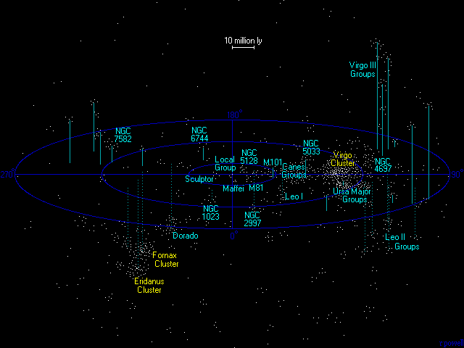
Virgo cluster and beyond
Image by Richard Powell: http://www.atlasoftheuniverse.com/me.html
http://www.atlasoftheuniverse.com/12lys.html

Slide 25
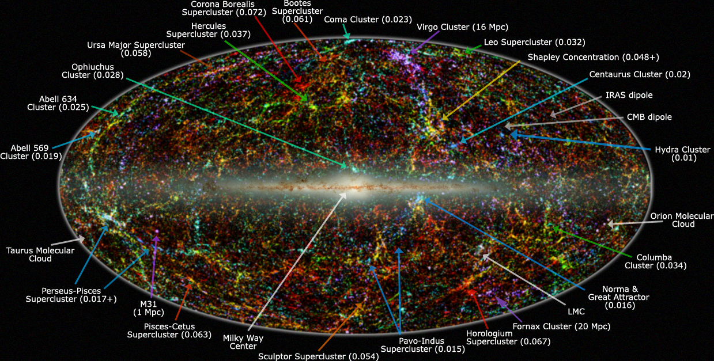

Supercluster of clusters
Redshift measures recessional velocity
Light emitted by a source that recedes from us is received with “redder” color than its emission. The wavelength $λ$ of the light is lengthened by $Δ$λ.
We define the reddening by the “Redshift” ratio:
$$Z= {Δ\text{λ}}/λ$$
The redshift ratio is proportional to the velocity of recession from us, the observer.
The numbers in parentheses show the redshift of each group. All groups (except for 2) are receding from our Local Group!
By IPAC/Caltech, by Thomas Jarrett [Public domain], via Wikimedia Commons

Slide 26
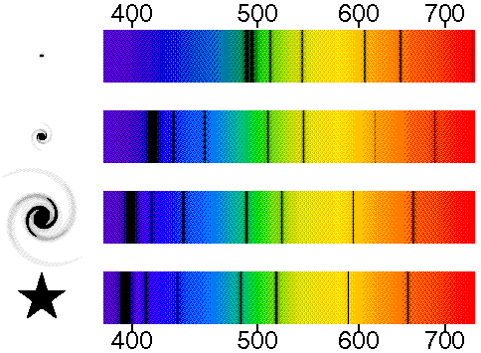

Cosmological vs. Doppler Redshift
Redshift measures recessional velocity… but what is the reason for the recession?
Our Big Bang cosmology describes an expansion of space. Anything “stuck” in that space that is distant from us is seen to be moving away: Cosmological Redshift:
$$v=cZ$$
Within expanding space, anything that is moving with velocity relative to local space also contributes to colour variation: Doppler Shift (relativistic redshift):
$$v=c{[\left(Z+1\right)2−1]}/{[\left(Z+1\right)2+1] }$$
http://www.astro.ucla.edu/%7Ewright/doppler.htm

Slide 27
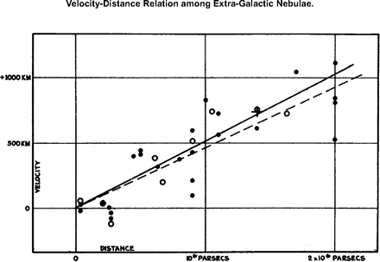
Hubble, redshift and age
In the 1910s, astronomers (Vesto Slipher) had already noticed that known spectral lines such as the lines of sodium vapour absorption lines in the light emanating from the distant nebular clouds (later to be known to be Galaxies) tended to be more shifted towards the red end of the spectrum as they appeared smaller in the field of vision.
Edwin Hubble used the luminosity-period relationship of Cepheid variable stars that he and Henriette Leavitt had discovered to measure distances to many galaxies.
He compared the redshift of their spectra to their distances and found a nearly linear relationship recognizing that they were moving away from us.
Hubble’s
plot
Jha, S. (2002) Ph.D. thesis (Harvard Univ., Cambridge, MA).
Hubble’s original plot
Hubble, E. P. (1929) Proc. Natl. Acad. Sci. USA 15, 168–173.

Slide 28
The Hubble Constant H_{o}
Determination of the current and recent value (that is, near the origin of diagram) of the slope gives us a Hubble constant of
H_{o} = 73.5 ± 1.4 km· s⁻¹/Mpc.
This constant has units of 1/time, its inverse units of time. That time is taken to be the “age” of the Universe:
12.717 ± 0.064 billion years.
Best fitting all astronomical observations to the Ʌ CDM Concordance model gives us a Hubble constant of
67.74 ± 0.46 km· s⁻¹/Mpc,
and the “age” of the Universe:
13.799 ± 0.021 billion years.
This accords with a “radius” (how far we can see from our perspective) of the “Observable Universe” of 4200 Mpc.

Slide 29
The Hubble Constant H_{o}
You might recognize that the line that best fits the recession of galaxies is not a straight line – it curves. In the early region (farthest from us) of the Universe, expansion seems to have been slower that it is recently. This gives us two views of the expansion rate and hence the time since the beginning of observable expansion. Our current models of the Universe recognize an accelerated rate of expansion.
This leads us to offer different “age” of the Universe depending upon where we weight the data. The Ʌ CDM Concordance model weights early, from the CMB and evolves to the present (age ~13.799 billion years). Another community of astrophysicists weights late and locally (age ~12.717 billion years).
The Hubble constant: a mystery that keeps getting bigger

Slide 30
Our Milky Way
http://news.nationalgeographic.com/content/dam/news/rights-exempt/nat-geo-staff-graphics-illustrations/2016/02/eso1606a.ngsversion.1456410119606.jpg?01

