Slide 1
Terrestrial Planets
Week 2
Professor Olivia Jensen
Earth and Planetary Sciences
FD Adams 131C

Slide 2
The matter of the Universe
We know the Earth is old… 4.567 billion years old! We know that it is made up of minerals and rocks and water and atmosphere but we may reasonably ask, “Where did all the elements and isotopes that make up this stuff of the Earth come from?”.
  In 1957, Burbidge, Burbidge, Fowler and Hoyle (B²FH) described a sequence of development for the origin of all normal elements and materials: Nucleosynthesis.
  In an infinitesimal moment of time after some initiating process, an incredibly hot (perhaps more than 10²⁷K) extremely compressed ball of pure energy exploded forth our universe... Big Bang...
  As this explosion expands, it cools by adiabatic expansion.

Slide 3
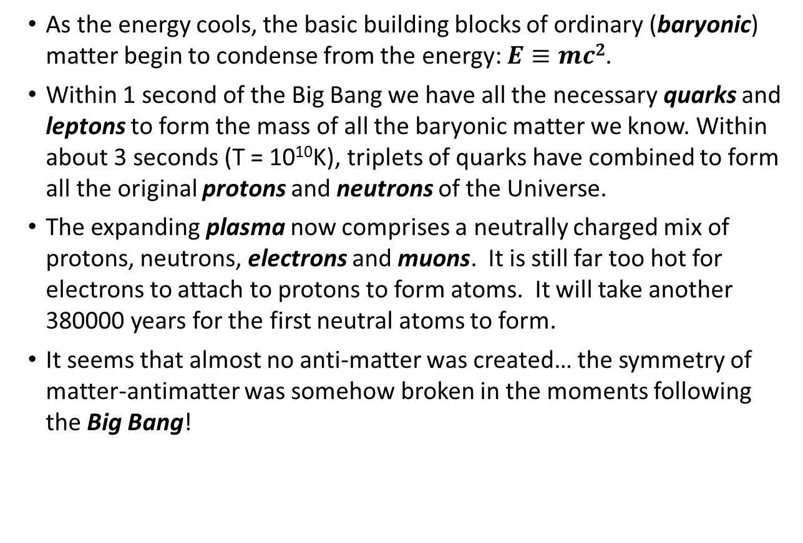
Energy condenses matter
  As the energy cools, the basic building blocks of ordinary (baryonic) matter begin to condense from the energy: $E≡mc2$.
  Within 1 second of the Big Bang we have all the necessary quarks and leptons to form the mass of all the baryonic matter we know. Within about 3 seconds (T = 10¹⁰K), triplets of quarks have combined to form all the original protons and neutrons of the Universe.
  The expanding plasma now comprises a neutrally charged mix of protons, neutrons, electrons and muons. It is still far too hot for electrons to attach to protons to form atoms. It will take another 380000 years for the first neutral atoms to form.
  It seems that almost no anti-matter was created… the symmetry of matter-antimatter was somehow broken in the moments following the Big Bang!

Slide 4
The matter reassembles
During the next 500 or so seconds, hydrogen fusion!
¹H + ¹H → ²H + β⁺
¹H + ²H → ³He + γ
³He + ³He → ⁴He +¹H + ¹H + γ
³He + ⁴He → ⁷Be + γ
⁷Be → ⁷Li + β⁺ + γ
⁷Li + ¹H → ⁴He + ⁴He + γ
  The net result of these reactions:
  8 ¹H → 2 ⁴He + 3 γ + 4 β⁺ ,
  At this time, the composition of the Universe is 95% hydrogen (¹H and ²H) and 5% (⁴He) with some ³He and traces of ⁷Li and ⁷Be by nuclear (atom) count.

Slide 5
The matter disperses
  After about 500 seconds of these fusion reactions, the density and temperature of the involved particles is too low to sustain the reaction. What has been created now disperses into the ever expanding volume of the Universe.
  In another 380000 years, the expanding plasma will cool sufficiently (T ~ 3500K) allowing free electrons to attach to these nuclei forming neutral atoms of H, He, Li and Be. The previous 380000 years are hidden by the CMB.
  The Universe becomes transparent to the passage of light and electromagnetic radiation.

Slide 6
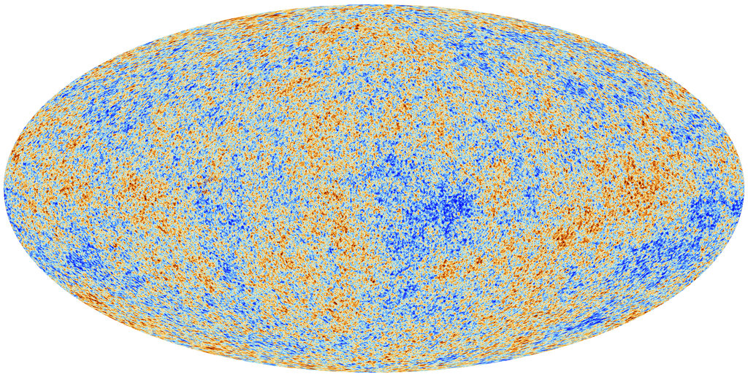
The “Baby Picture”
Image from the ESA (European Space Agency) Planck Mission. For a story:
http://www.nytimes.com/2013/03/22/science/space/planck-satellite-shows-image-of-infant-universe.html

Slide 7
The “Baby Picture”
We can see back in time to that moment of transparency. This is the CMB, the Cosmic Microwave Background that limits our view of earlier times in the Universe using electromagnetic wave radiation (e.g. light, X-rays, microwaves, etc.).
Image from the ESA (European Space Agency) Planck Mission. For a story:
http://www.nytimes.com/2013/03/22/science/space/planck-satellite-shows-image-of-infant-universe.html

Slide 8
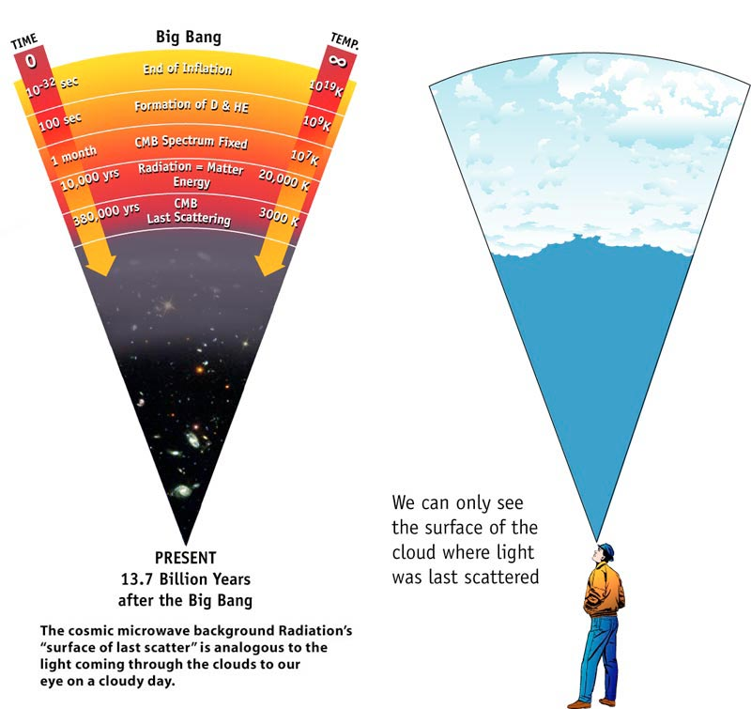
The “CMB” veil
Image by NASA/WMAP: https://map.gsfc.nasa.gov/media/990053/990053sb.jpg

Slide 9
The Universe quietly expands
Nothing much happens for the next 100 – 200 million years. There are no stars, there is only an expanding mass of gases composed of the primitive elements.
After about 100 million years, though, gravity has had time to start pulling volumes of the mass of gases together.
As the gases assemble and compress under gravitational force, they heat up (adiabatically) and in these concentrated, dense contracting volumes, temperatures reach levels (T > 10¹⁰K) that allow hydrogen fusion to re-ignite locally in the first gigantic “stars”.
It is in these stars that the nucleosynthetic reactions that give us our rich chemistry now begins.

Slide 10
Stellar nucleosynthesis
All elements beyond ⁷Be in the periodic table have been formed by nucleosynthetic reactions within stars.
Elements up to ⁵⁶Fe are largely produced in fusion reactions.
Elements beyond ⁵⁶Fe are almost entirely produced in supernoval explosions of large stars.
Our Sun is a late-forming star (about 4.6 billion years ago and almost 9 billion years after the Big Bang), formed of materials that have gone through many cycles of stellar nucleosynthesis. Our Sun’s composition is somewhat richer in He than the original Big Bang plasma: ~ 93% H, ~ 7% He by atom count with all other elements contributing less than 1%.

Slide 11
Stellar nucleosynthesis
Life cycle of a Sun-like star
Our Sun, sometimes called Sol, is a very ordinary star in terms of mass and size. It radiates 3.84×10²⁶ J · s⁻¹ or 384 000 000 000 000 000 000 000 000 W, as bright as 4 sextillion 100W light bulbs.

Slide 12
Stellar nucleosynthesis
Life cycle of a Sun-like star
4.6 billion years ago, a gravity assembled mass of H (93%) and He (7%) ignited fusion reactions.
While there is a mixing of all the trace elemental nuclei that form the periodic table of elements throughout the Sun, density differentiation formed a predominantly He core and H mantle.

Slide 13
Stellar nucleosynthesis
Life cycle of a Sun-like star
This fusion “fire” has been burning continuously for the past 4.6 billion years but as the He core (the cinder of the fusion) grows, the fusion shell grows in volume and the Sun radiates ever more heat. It is 40% more radiant now that it was 4.6 billion years ago.

Slide 14
Stellar nucleosynthesis
Life cycle of a Sun-like star

Slide 15
Stellar nucleosynthesis
Life cycle of a Sun-like star
Helium (denser than hydrogen) sinks into a core. There, it can be ignited into the helium burning stage if the star is large enough that its overlying mass compresses this core to temperatures exceeding about 10¹⁰K.
⁴He fusion synthesizes more lithium, Li, and beryllium, Be, as well as B, terminating with the synthesis of carbon, ¹²C. In this stage, the star expands into a “red-giant” star.

Slide 16
Stellar nucleosynthesis
Life cycle of a Sun-like star

Slide 17
Stellar nucleosynthesis
Life cycle of a Sun-like star
If the star is large enough (Our Sun is, barely large enough!), it will even bring this ¹²C to burn through the “CNO process” fusing substantial quantities of ¹³C, ¹³N, ¹⁴N, ¹⁵N and ¹⁵O

Slide 18
Stellar nucleosynthesis
Life cycle of a Sun-like star
This is not the endpoint for our Sun but stars only slightly less massive that our Sun do not evolve beyond this point. For them, the fusion fires eventually burn out and the star collapses under gravity to form a “white dwarf” star.

Slide 19
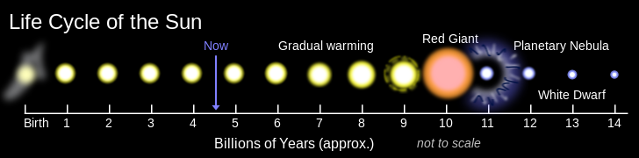
Stellar nucleosynthesis
Life cycle of a Sun-like star
By Oliverbeatson (Own work) [Public domain], via Wikimedia Commons

Slide 20
The heavy elements

Slide 21
The heavy elements
Fusion processes in large stars, up to 3 or 4 times the mass of the Sun, can fuse all elements and isotopes up to and including those of iron ⁵⁶Fe... but, then, nothing!
Nothing?

Slide 22
The heavy elements
Life cycle of a star 10x the mass of our Sun.
Hydrogen fusion (from H, produce He and traces of Li and Be): ≈ 10,000,000 years.
Helium burning (produce Li, Be, B and C): ≈ 1,000,000 years.
Carbon burning (produce N and O): ≈ 300 years.
Oxygen burning (produce F, Ne, Na, Mg, Al and Si): ≈ 8 months.
Silicon burning (produce P, S, Cl, Ar, K, Ca, Sc, Ti, V , Cr, Mn and isotopes of Fe of atomic mass 56 or less): ≈ 2 days...
Then nothing?

Slide 23
The heavy elements
Supernoval explosion

Slide 24
Supernovae
So far, we have described the life-cycle of a very large star that eventually explodes as a core-collapse or massive-star supernova. These are designated Type II
Early in the Universe, the largest of the stars (100 – 300 M) that formed in the first few hundred million years explode as what we call hypernovae. These are even more exotic explosions that result from what is called Quantum pair-production.
Some of these super-sized stars left “neutron star” cinders following explosion. Coalescing pairs of such neutron stars explode with incredible energy as kilonovae. One such explosion has just recently been observed with gravitational waves, gamma rays and visible light.

Slide 25
Type II Supernovae
The Crab Nebula (SN 1054) is the remnant of such a supernoval explosion that was seen on Earth in 1054 AD. It is 6000 light years from Earth. At the center of this bright nebula is a rapidly spinning neutron star, or pulsar that emits pulses of radiation 30 times a second.
The remnant core of a massive star that explodes as Type II usually forms as an extremely compressed neutron star.
https://commons.wikimedia.org/wiki/File%3ACrab_Nebula.jpg

Slide 26
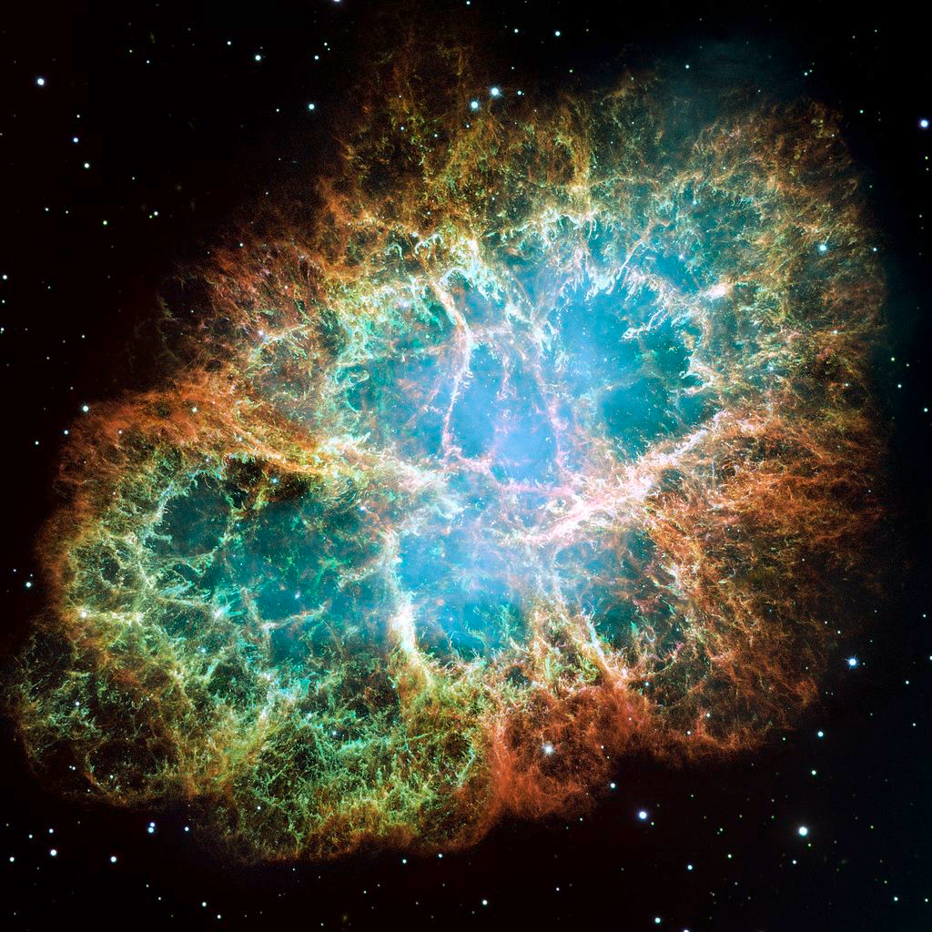
SN 1054
https://commons.wikimedia.org/wiki/File%3ACrab_Nebula.jpg

Slide 27
Type Ia Supernovae
There are other events that produce supernoval explosions. Even an ordinary star like our Sun might become involved in one such explosion.
After our Sun’s nuclear fires are burnt out and there is not enough energy being produced within the aged Sun to hold it up against gravitational collapse, it becomes a white dwarf.

Slide 28
Type Ia Supernovae
If a star comes close enough to our now white-dwarf Sun, its intense gravity field can tidally rip materials off the passing star. If the mass of material is sufficient to bring the Sun’s mass to about 1.4x its present mass, it reaches the Chandrasekar limit and explodes. It explodes because the new overlying mass is sufficient to compress and heat the inner layers of our aged Sun to bring explosive thermo-nuclear fusion.

Slide 29
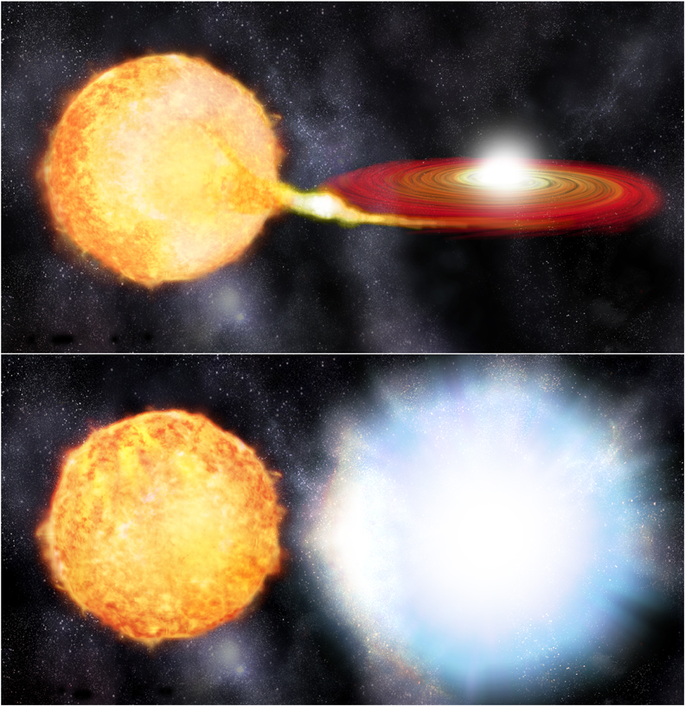
Type Ia Supernovae

Slide 30
SN 1006
In 1006 CE, the brightest supernoval explosion in recorded history occurred. The peak brightness of the explosion was more than 7x the maximum brightness of Venus in our night sky. It was a Type Ia explosion.
Type Ia explosion remnants tend to be nearly circular and symmetric.

Slide 31
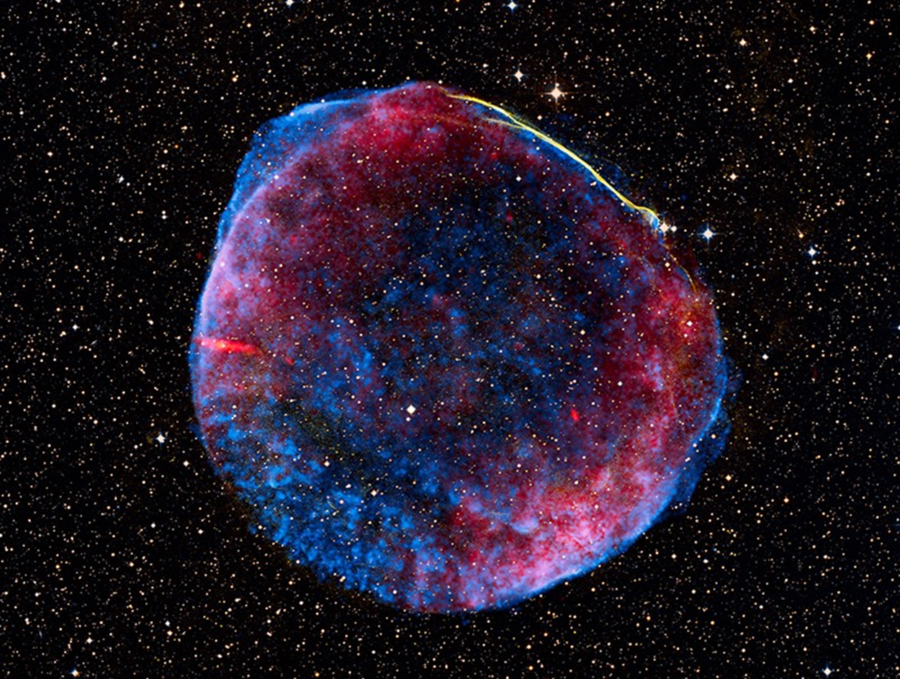
SN 1006
SN 1006 Supernova Remnant
Image Credit: NASA, ESA, Zolt Levay (STScI)

Slide 32
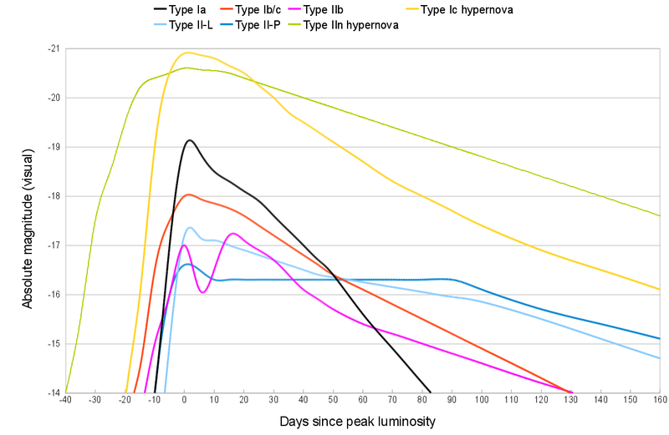
Light curves of Supernovae
The various types and subtypes of supernovae each show characteristic light curves. The rapid onset (often missed) and decay over many following days distinguishes the type.
If we can distinguish the type, especially for Type Ia, we can determine just where it is in its evolution as we are observing it and so how bright it is and was at maximum.
Type Ia form the “standard candles” used in measurement to the greatest distances in the Universe.
3 500 000 000 L
_{Theoretical maximum luminosity}
https://en.wikipedia.org/wiki/Pair-instability_supernova

Slide 33
Beyond ⁵⁶Fe
Almost all the elements beyond isotope 56 of iron are produced by the prodigious neutron/proton flux in supernoval, hypernoval or kilonoval explosions forcing them into lighter nuclei: r-process.
Why are other naturally occurring isotopes of Fe relatively plentiful? Substantial quantities of ⁵⁷Co and ⁵⁸Co are produced in supernoval explosions; these are radioactive isotopes that decay via β-capture to ⁵⁷Fe and ⁵⁸Fe.
It is now thought that the very heavy elements like Au and Pt are largely produced by kilonova.
As well, in any star, small-to-trace quantities of all elements are continuously produced by the non-fusion endothermic s-process.

Slide 34
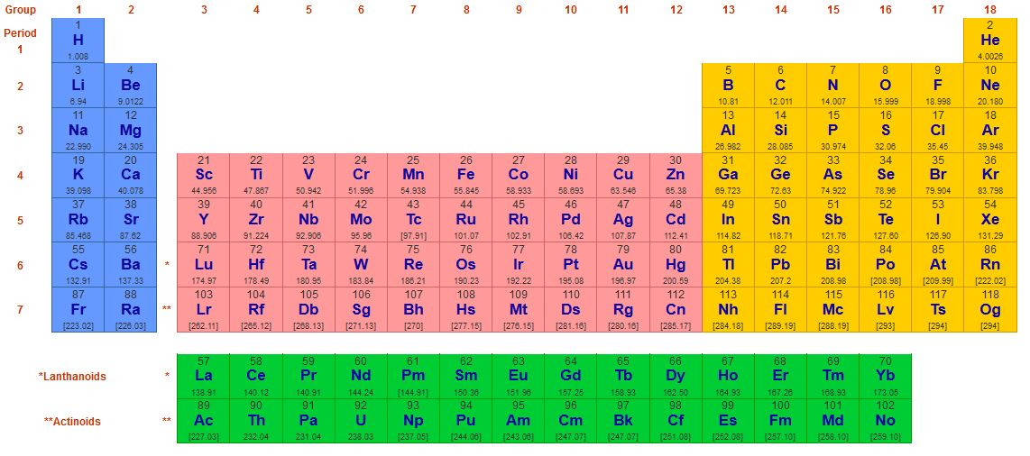
Beyond ⁵⁶Fe
From webelements.com

Slide 35
Light curve of Kilonova AT 2017gfo
Kilonova AT 2017gfo was discovered as a gravitational wave radiator 17 August 2017 at 12:41:04 UTC. Now, with 3 gravitational wave detectors operational, it was localized in the sky near NGC 4993. Immediately, several optical, X-ray and infrared telescopes were trained on the location. This was the first combined GW-EM observation of a Gwave source.
The decay in several bands of electromagnetic radiation obtained this first empirical light curve from a kilonova.
https://www.nature.com/articles/nature24291?WT.feed_name=subjects_physics

Slide 36
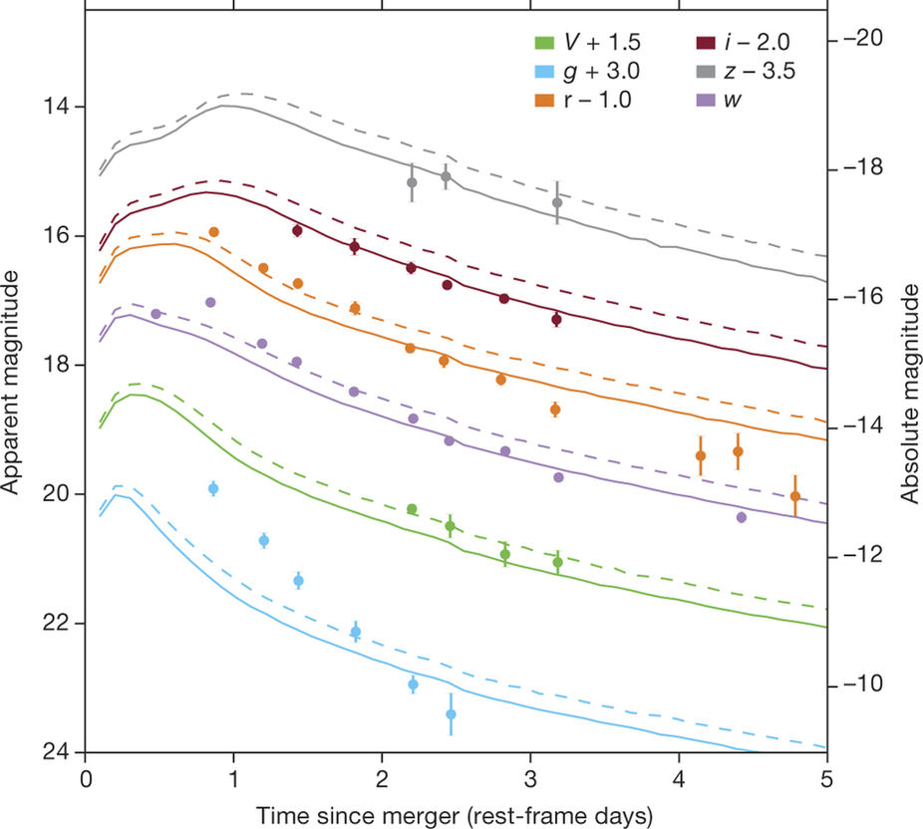
Light curve of Kilonova AT 2017gfo
https://www.nature.com/articles/nature24291?WT.feed_name=subjects_physics

Slide 37
Unravelling the story of the
“Big Bang”
Our best evidence for a Big-Bang origin of the universe is that it is presently expanding in every direction from every place within.
The rate of expansion corresponds to a single event, 13.799 ± 0.021 × 10⁹ years ago when every piece of the present universe existed at the same place.
Where was that place? Right here!

Slide 38
Unravelling the story of the
“Big Bang”
Using our contemporary physics, which comprises two great theories: Quantum Mechanics and Gravitation (General Relativity), we recognize the Universal space and the passage of time.
We determine that there are some Universal constants and expect that they hold everywhere and “everywhen” (or, at least since 10⁻³³ seconds following the Big Bang) in the Universe.

Slide 39
Unravelling the story of the
“Big Bang”
Some Universal constants of physics
c 299 792 458 m / s (speed of light in vacuo)
G 6.67408 × 10⁻¹¹ m³ kg⁻¹ s⁻² (Cavendish constant of gravitation)
h 6.62607004 × 10⁻³⁴ m² kg / s (Planck’s constant – the quantum of action)

Slide 40
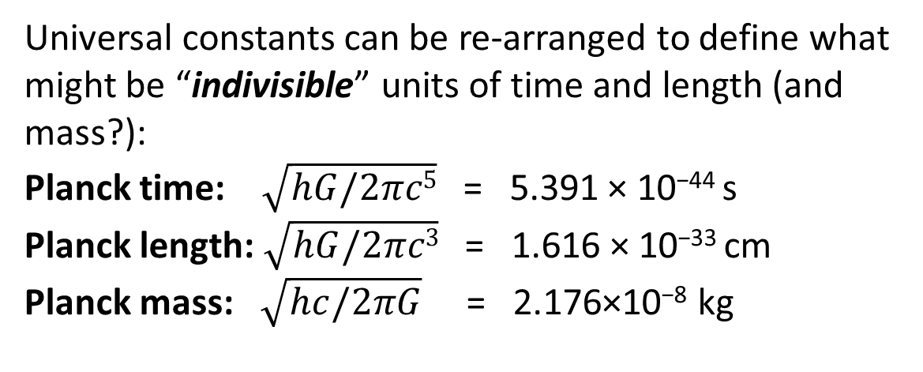
Unravelling the story of the
“Big Bang”
Universal constants can be re-arranged to define what might be “indivisible” units of time and length (and mass?):
Planck time: $\sqrt{hG/2πc5}$ = 5.391 × 10⁻⁴⁴ s
Planck length: $\sqrt{hG/2πc3}$= 1.616 × 10⁻³³ cm
Planck mass: $\sqrt{hc/2πG}$ = 2.176×10⁻⁸ kg

Slide 41
Unravelling the story of the
“Big Bang”
Our best evidence for a Big-Bang origin of the universe is that it is presently expanding in every direction from every place within.
The rate of expansion corresponds to a single event, 13.799 ± 0.021 × 10⁹ years ago when every piece of the present universe existed at the same place.
Where was that place? Right here!

Slide 42
Unravelling the story of the
“Big Bang”
CMB

Slide 43
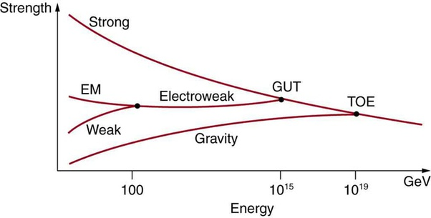
Backing up to the beginning
Using our known physics, we reverse the direction of time to back up toward the beginning of expansion but our physics breaks down at very high energy densities that must have existed shortly following the Big Bang.
LHC
Li
Energy
Time
e
GUTs and TOEs
Notes:
43

Slide 44
Unravelling the story of the
“Big Bang”

Slide 45
What of before?
Metaphysics, Philosophy, Theology
Our current understanding of Big Bang cosmology based on our knowledge of physics determines that time and space come into existence at a moment following the Big Bang.
Measuring by what we take to be the passage of time as we do and can, there was no precedent time.
Time begins with the Big Bang. Space emerges in the Big Bang.
Should we want to discuss “before”, we must abandon science and retreat into metaphysics, philosophy and theology.

