Slide 1
Terrestrial Planets
Winter 2020
Week 11
Professor Olivia Jensen
Earth and Planetary Sciences
FD Adams 131C

Slide 2
Geological Activity
Returning to Earth, how do we measure plate tectonic and other geological activity?
Measurement of plate motions
Thrust faulting and ridge spreading
Geomagnetic history
Volcanic styles
Seismic activity, earthquakes

Slide 3
Digital Tectonic Activity Map

Slide 4
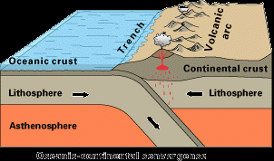
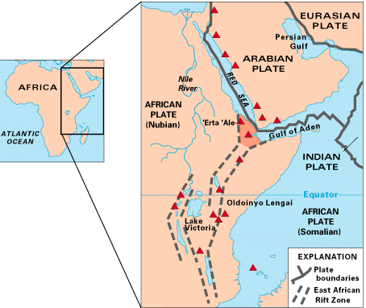
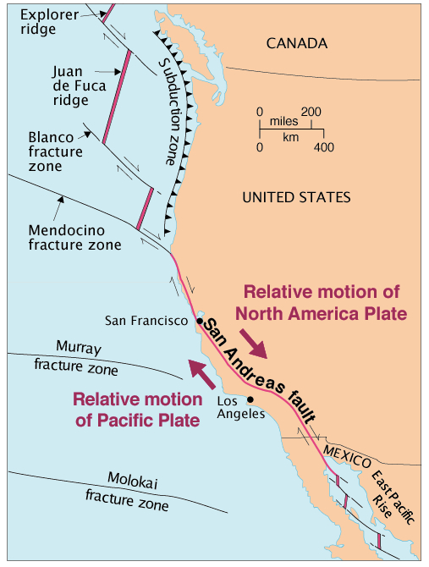
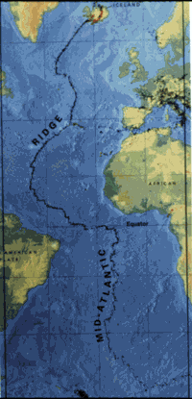
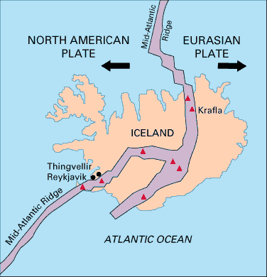
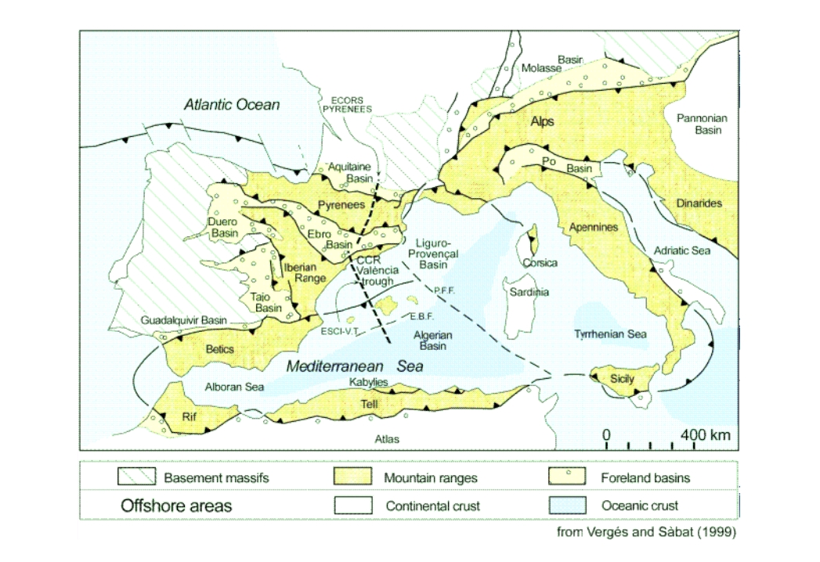
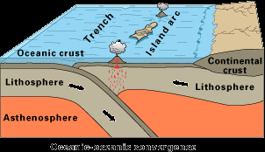
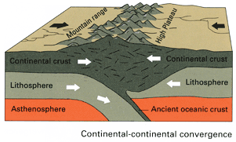
Tectonic Plate Boundaries
There are four types of plate boundaries:
Divergent boundaries -- where new crust is generated as the plates pull away from each other.
Convergent boundaries -- where crust is destroyed as one plate dives under another.
Transform boundaries -- where crust is neither produced nor destroyed as the plates slide horizontally past each other.
Plate boundary zones -- broad belts in which boundaries are not well defined and the effects of plate interaction are unclear.

Slide 5
Sea-floor spreading
L. Morley and A. Larochelle,
in 1962, recognized that a pattern of magnetic striping on the ocean floor southwest of British Columbia showed a symmetry across the ridge between the Juan de Fuca
and Explorer Plates. In 1963, F. Vine and D. Matthews published their landmark
paper in Nature magazine re-iterating the Larochelle-Morley findings for “Magnetic anomalies over ocean ridges”.

Slide 6
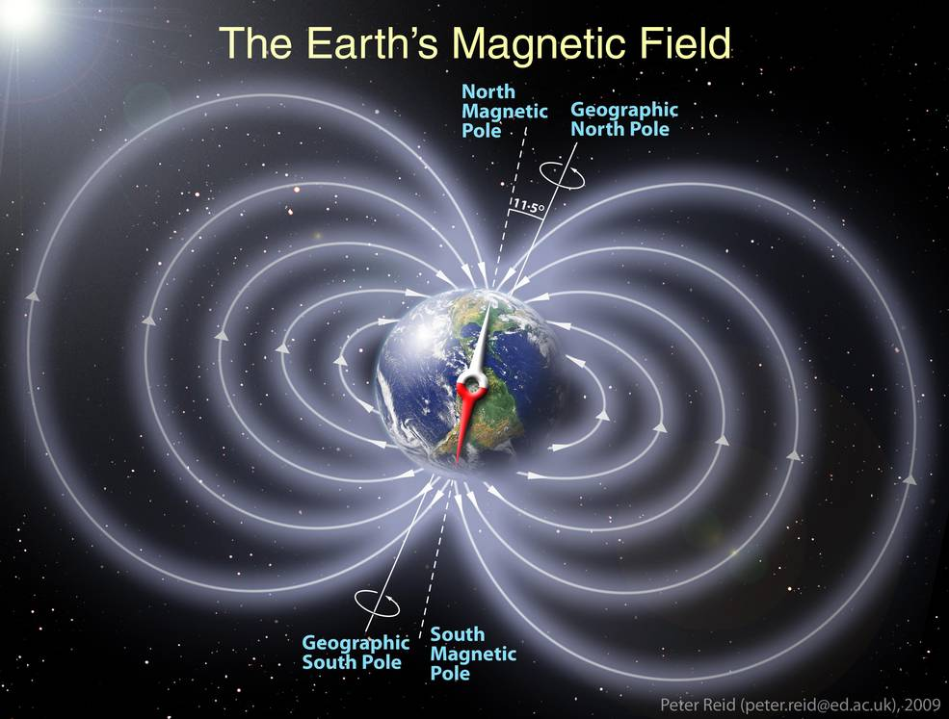
Earth’s Geomagnetic Field
The magnetic dipole field generated by Earth’s core dynamo aligns with the rotation axis within a few degrees. Since it became well established almost 4 billion years ago, it has undergone aperiodic polarity reversals.
We can use these reversals to determine the timing of lava freezings… Freezing lavas are imprinted by the field as they cool through the Curie Temperature

Slide 7
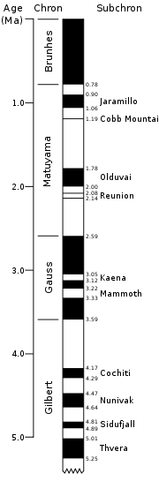
Magnetostratigraphy
Timing reversals and determining local latitude
Cores are first analyzed in their natural state to obtain their natural remnant magnetization (NRM). Taken to a lab, the NRM is then stripped away using thermal or alternating field demagnetization techniques to reveal the stable magnetic component which is that frozen in during deposition.
Magnetic orientation of the stable component is measured to determine a relative (to sample) latitude for the Virtual Geomagnetic Poles (VGP). Cores are age-dated to accord their VGP and polarity with time. Polarity data are reported as a magnetostratigraphic column (left).

Slide 8
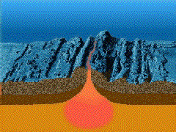
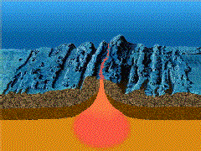

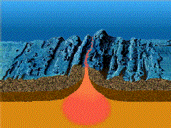
Magnetic imprinting of oceanic crust

Slide 9
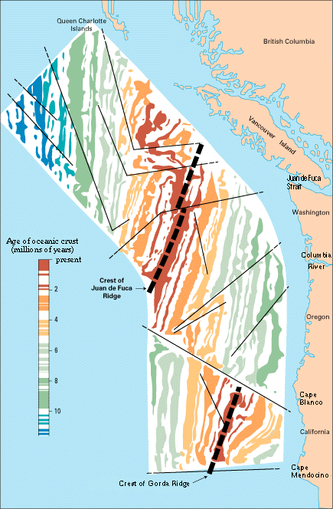
Juan de Fuca ridge
Sea-floor spreading from the Juan de Fuca ridge separates the Juan de Fuca and Gorda Plates (east side of ridge) from the Pacific Plate (west). The rate of spreading from the ridge is measured to be about 3 cm/year. The Juan de Fuca and Gorda plates collide with the North American Plate moving to the west at about 1.2 cm/year. At the Cascadia Subduction thrust fault, they collide at about 4 cm/year.
From ridge to the trench takes up to 10 million years.

Slide 10
Subduction zones
The oceanic crust and lithosphere that is created at the spreading ridge is recycled back into the mantle at subduction zones. The process is a stick-slip process that is evidenced by often large subduction earthquakes and chain volcanism.
If the lithospheric plate subducts under a continental plate (like the NA plate), the continental plate is up-lifted and foreshortened. Subduction under another oceanic lithospheric plate creates Island Arc Volcanism like Japan and the Aleutian Islands.
https://pubs.usgs.gov/gip/dynamic/understanding.html

Slide 11
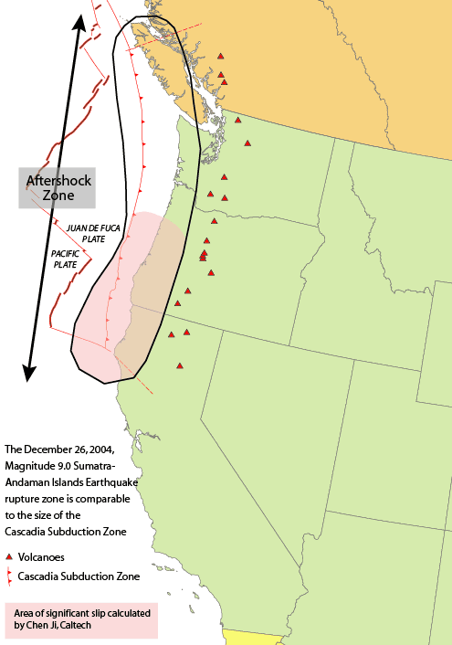
Cascadia Megathrust Event
At about 9:00PM on January 26, 1700, the Cascadia Thrust Fault fractured in what is one of the largest earthquakes known to have occurred on Earth. We have no instrumental records of the event but many indications of its occurrence and scale.
The Cascadia Subduction Zone (CSZ) Megathurst Earthquake M_{w} ~ 9+.
https://upload.wikimedia.org/wikipedia/commons/3/38/Cascadia_subduction_zone_USGS.png

Slide 12

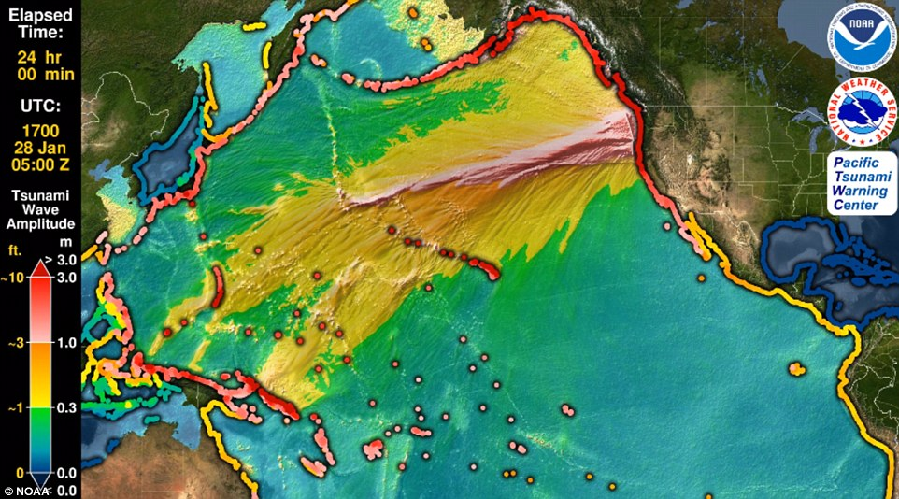
Tsunami
The tsunami generated by the 1700 CSZ event was first recognized as a “orphan tsunami”, one which was not caused by a local Japanese earthquake. Around midnight on January 27, 1700, a mysterious tsunami stole through several villages on the eastern coast of Japan.
The waves reached as high as 4 metres and flooded rice paddies, washed away buildings and damaged fishing shacks and salt kilns. Sleeping villagers awoke startled and wet and had to hastily scramble to high ground. The waters knocked down oil lamps and started a fire in one village and destroyed 20 houses in another.
The waves pounded the villages all through that night and into the late morning of the next day.
Local effects were later recognized on the coasts of BC, Washington and Oregon.
Simulations of what might be expected locally when the next Mw 9 CSZ event occurs: Low resolution, medium resolution.

Slide 13
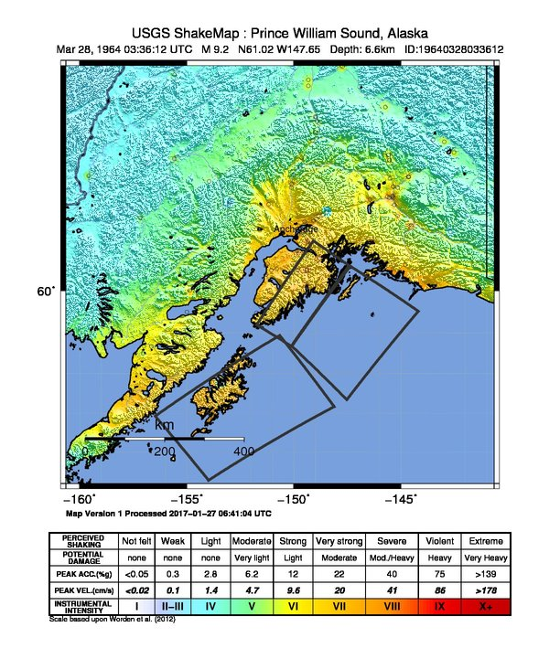
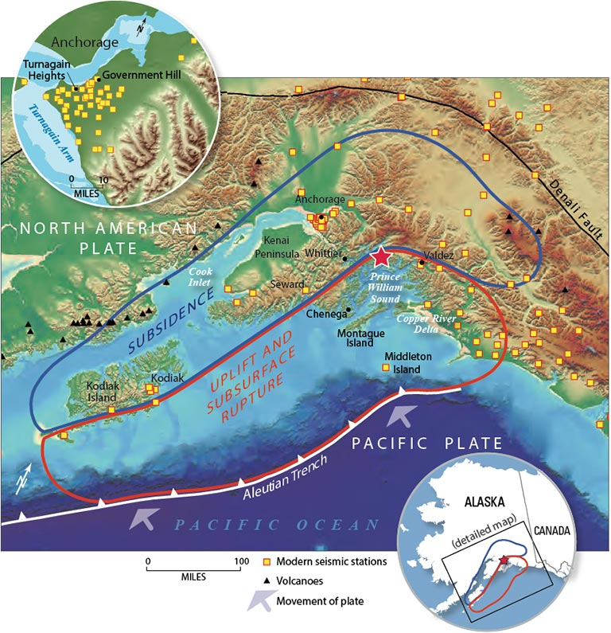
Alaska 1964
On Good Friday, March 27, 1964, the second largest (M_{w} 9.2) earthquake that we have so-far recorded with seismic instruments occurred in Prince William Sound, Gulf of Alaska.
Ground shaking devastated Anchorage. Tsunami spread worldwide, causing serious inundations in Hilo, Hawaii and along the west coast of North America. The hardest hit region of Canada was Port Alberni BC where the harbour infrastructure was devastated.

Slide 14
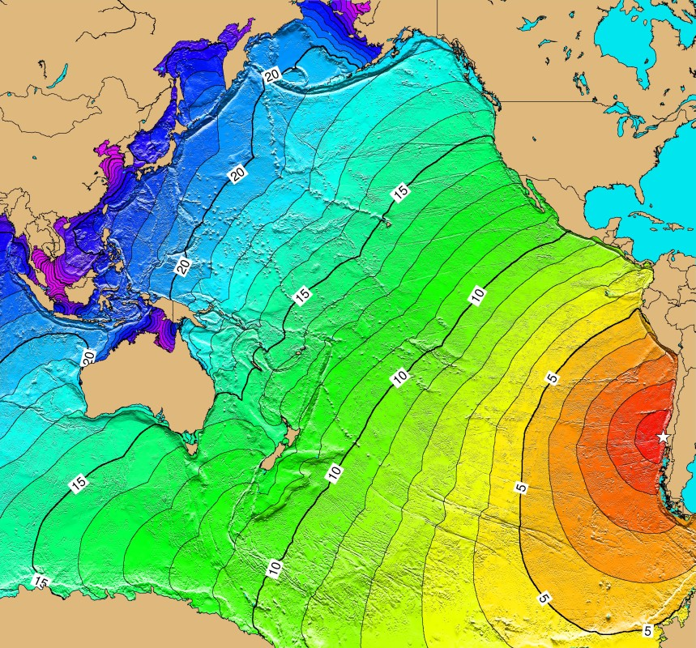
Nazca Plate – Chile-Peru 1960
Offshore from the west coast of South America, under Peru, Bolivia and Chile the Nazca Plate which is spreading away from the East Pacific Rise (a ridge) about 4000km to the west is subducting under the South American Plate.
Along this convergent margin, the largest earthquake, in terms of its magnitude ever instrumentally recorded on Earth, the M_{w} 9.5 1960 Chile-Peru (Valdiva) Megathrust event occurred along this convergent margin.
Tsunami spreading away from that earthquake travelled across the Pacific to Japan, reflected from the Asian coastline and then travelled back across the Pacific again to South and North America.
https://commons.wikimedia.org/wiki/File:Tsunami_travel_time_Valdivia_1960.jpg#filelinks

Slide 15
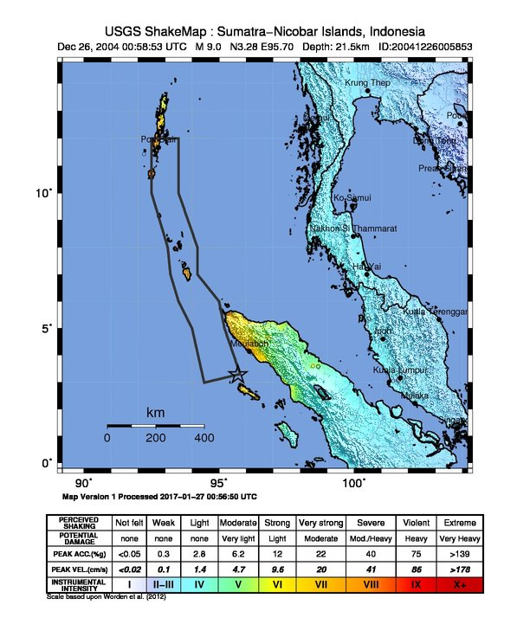
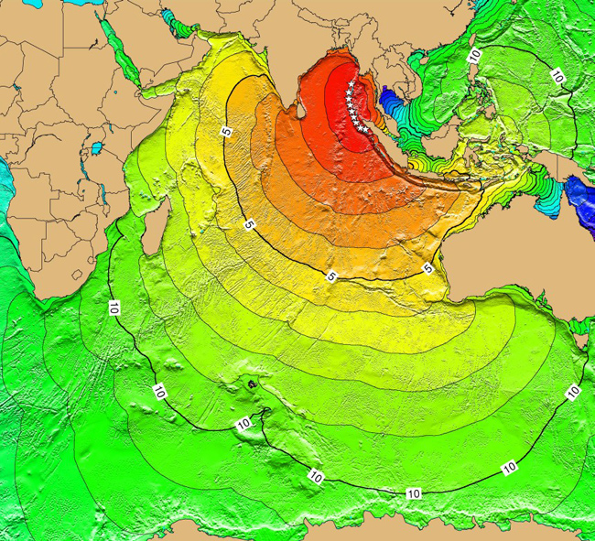
Sumatra (Andaman) 2004
On December 26, 2006, the Mw 9.2 Sumatra-Andaman subduction megathrust event occurred off the west coast of Sumatra, Indonesia.
Direct seismic shaking produced little damage but the tsunami caused by this event led to more deaths and casualties than any earthquake in the previous 50 years. More than 200000 people were killed along the coastal regions of the Indian Ocean with significant casualties as far away as Madagascar.

Slide 16
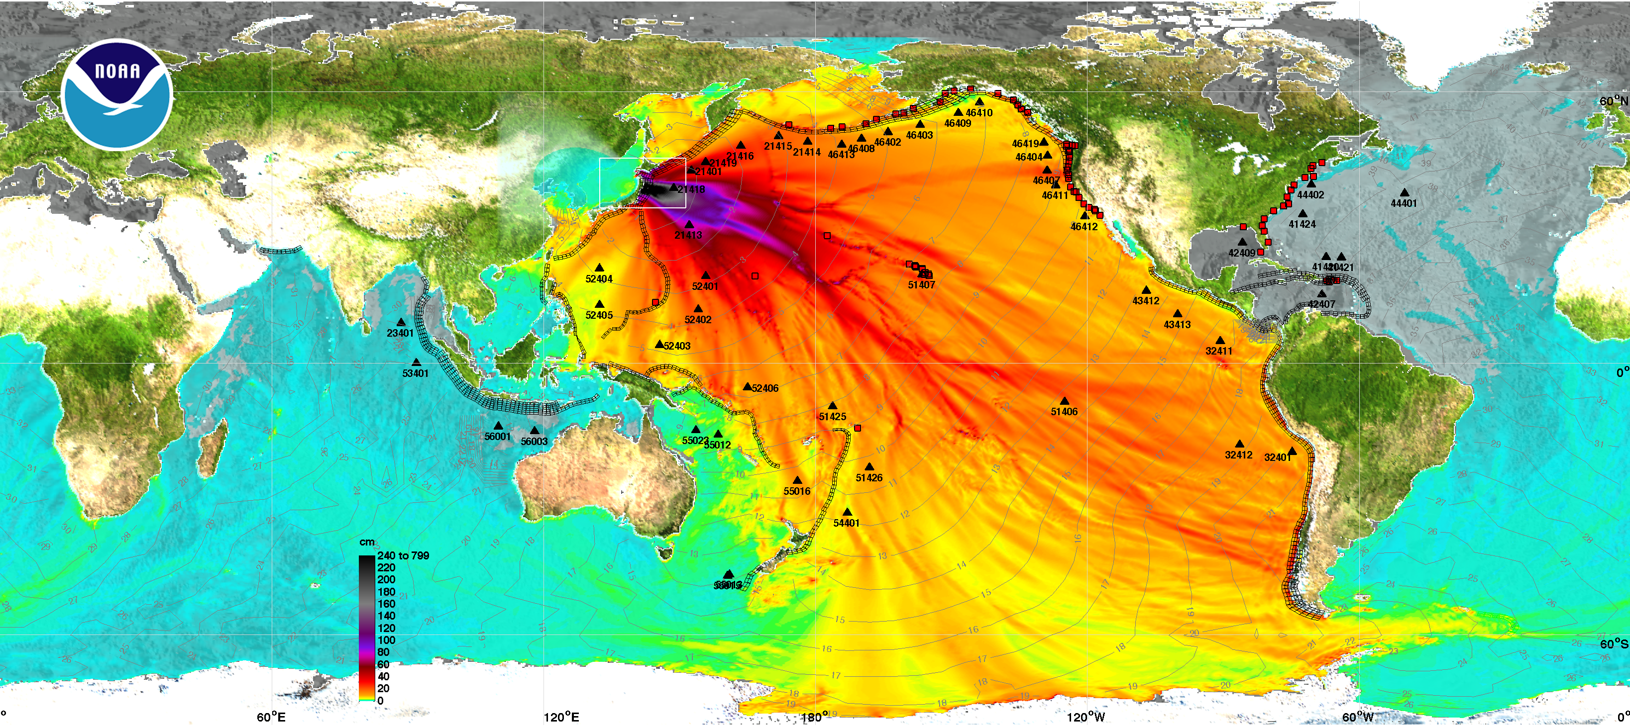
Tohoku, Japan 2011
The M_{w} 9.1 Tohoku earthquake of March 11, 2011 was, perhaps, that that produced the most structural damage so-far this century. The Tokyo Electric Company’s Fukishima Nuclear Reactor installation was destroyed and radioactive wastes distributed over a large region which remains closed to human habitation and agriculture.
The earthquake was a classical subduction zone megathrust event. It may be that this event produced more thrust slippage (50-70 metres) than any earthquake that we have observed since 1900. It produced Tsunami that was observed Pacific-wide and globally. Though most of the tsunami damage was restricted to Honshu Island, Japan, there was coastal damage as far away as Hawaii.

Slide 17
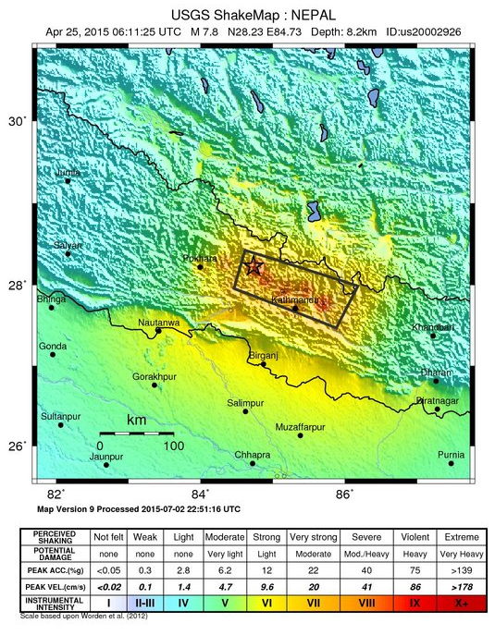
Nepal 2015
As the Indian subcontinental plate continues to intrude on the Eurasian plate, the continental-continental collision lifts the Himalayas. Large-to-major earthquakes occur relatively frequently along the southern arc of the Himalayas and within the Indian subcontinent. The M_{w} 7.8, Khudi, Nepal, April 25, 2015 earthquake was the most recent large event.
Kathmandu was devastated. Village populations in the high mountain valleys were isolated for months. While the total death toll has not been finally tabulated, it is estimated that between 10000 and 20000 fatalities were directly attributable to the earthquake and to subsequent isolation.

Slide 18
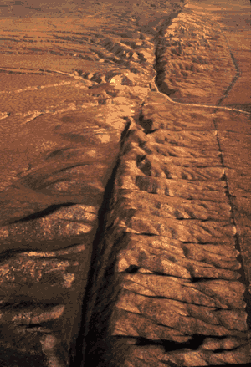
Transform Faults
Subduction zone megathrusts and some continental collision events produce the major earthquakes, those with M_{w} > 8.5.
There have been, however, many very large earthquakes that occur, largely restricted to the upper 30km of crust along transform faults. The 1906 Great San Francisco earthquake (M_{w} 7.8-8.0) is the best known of them.

Slide 19
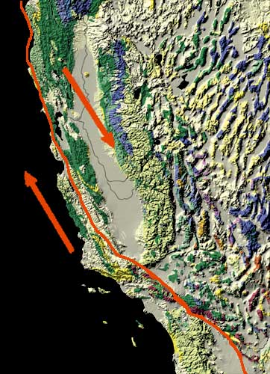
San Andreas Fault
Although it is not the largest nor most damaging earthquake of the past century, the Great San Francisco earthquake of 1906 was singularly important in alerting geophysicists to the threat of large events on the San Andreas Fault and elsewhere.
San Andreas is a transform fault, separating the Pacific Plate (sliding relatively NW) from the North American plate. It’s southern boundary is on the northward extension of the East-Pacific rise in the Gulf of California; its northern boundary at Cape Mendocino transform fault zone that forms the southern boundary of the Juan de Fuca system.
http://nationalatlas.gov/articles/geology/features/sanandreas.html

Slide 20
North Anatollian Fault
Across northern Turkey, the North Anatollian Fault shears the length of land. This fault is a dextral transform fault like the San Andreas.
Interestingly and historically, earthquakes have fractured this fault almost cyclically, starting in far eastern Turkey and then over a period of 60 years successively marching eastward toward Istanbul. The M_{w} 7.6 Ῑzmit Earthquake of 1999 was the last of the sequence. We might worry about another nearer Istanbul in the next very few years.

Slide 21
Continental Rifting
Continental rifting is caused by spreading along divergent boundary zones in continental crustal blocks and the underlying lithosphere. The most famous of these zones is the East-African Rift Valley.
Normal faulting along such rifts often produces large earthquakes.
Lake Tanganyika (M_{w} 6.8) Dec. 5, 2005

Slide 22
Sea-floor Rifting
Sea-floor rifting is episodic on short time scales; the rifting episodes produce earthquakes. These events are typically of moderate magnitude, less than M_{w} 6.
Frequent small earthquakes associated with magma eruptions are monitored by the Iceland Met Office.

Slide 23
Global Tectonic Stress Fields

Slide 24
Where do large earthquakes occur?
Top 20 Largest
Magnitude 8+
Magnitude 7+
Special Earthquake Studies
Source: https://earthquake.usgs.gov/earthquakes/browse/

Slide 25
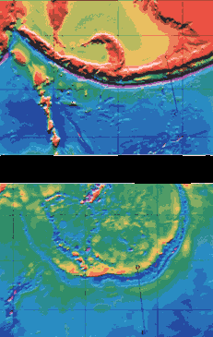
On other planets and moons
Extraterrestrial plate tectonics?
Global distribution of small thrust faults on Mercury! Planetary shrinkage!
Pioneer-Venus spacecraft measured a high amount of sulfur in the upper atmosphere of the planet; the sulfur amount then decreased over the next few years. A volcanic eruption?
The Magellan spacecraft revealed dramatic volcanic features and long, deep valleys similar in size and shape to oceanic trenches on Earth. Subduction?
Aleutian Trench, Earth
Artemis Corona, Venus
https://pubs.usgs.gov/gip/dynamic/unanswered.html#anchor19928310

Slide 26
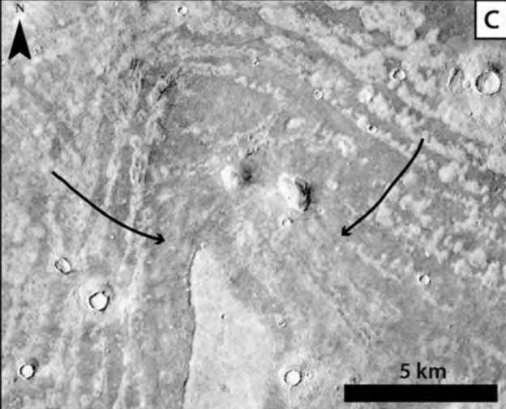
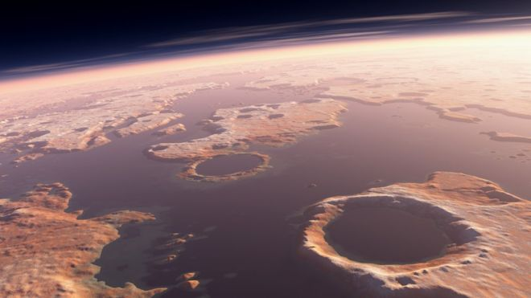
‘Quakes on other planets?
The Apollo Moon program placed seismometers on the Moon (1969 – Apollo 11) and during the 18 months that they were recording, many “moonquakes” were recorded. These appear to be due to tidal flexing of the body of the moon rather than proper geological activity.
In 1976, Viking 1 and Viking 2 landed on Mars with seismic instruments. While it remains in some debate, it is generally thought the seismometers detected no “marsquakes”… Now, we await detections by the InSight SEIS instrument.
Recently, it has been argued that there is evidence of Tsunami on Mars. The evidence does not imply large “marsquakes”; the characteristic tsunami deposits point to a major impact in what is thought to have been an ancient ocean covering much of the northern hemisphere of Mars.
This recent story (BBC) reports the study: Impact crater linked to Martian tsunamis

Slide 27
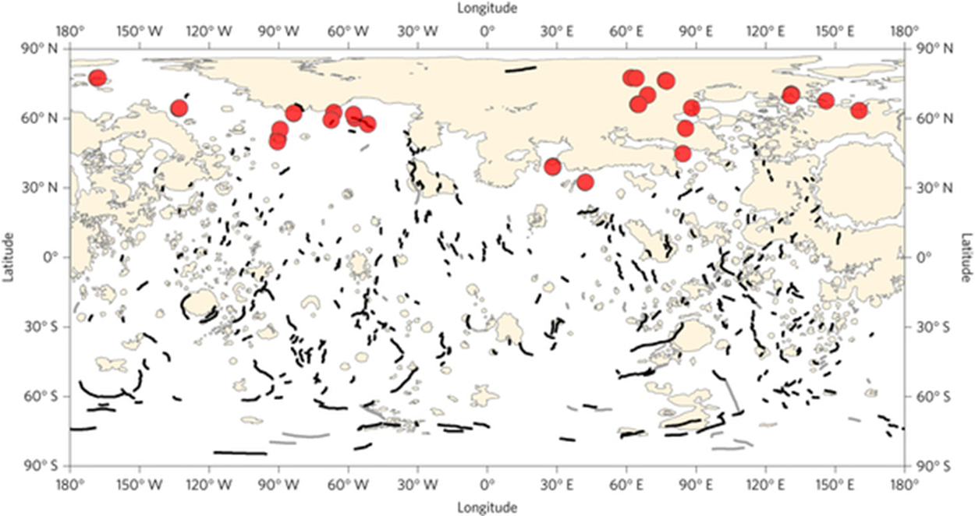
Mercury’s thrust faults
Mercury’s thrust faults indicate past geological activity.
Plate tectonics?

Slide 28
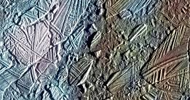
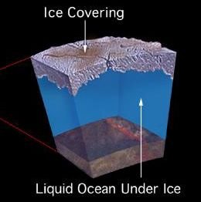
Europa’s ice plates
Europa’s thick ice plates show tectonic activity, cracking, re-cementing, faulting. It is a unique plate-tectonic style. It shows the evidence of a mobile sub-ice ocean.
Interpretation for internal structure: surface ice plates 10-20km thick floating on a deep (perhaps more than 100km) ocean lying over a rocky (warm?) mantle.

Slide 29
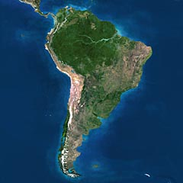
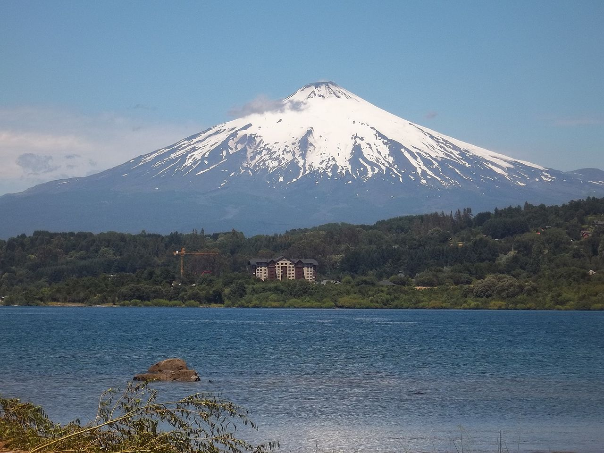
Volcanism – Andes Chain
We have seen that lineation of volcanism along subduction margins of continents is indicative of a plate-tectonic process. Subduction forms strato-volcanoes that are “felsic” (low in silica, Si0₂) in their effusive eruptions of tephra and lavas that form the mountains.
Villarrica volcano, Chile
https://en.wikipedia.org/wiki/Villarrica_(volcano)

Slide 30
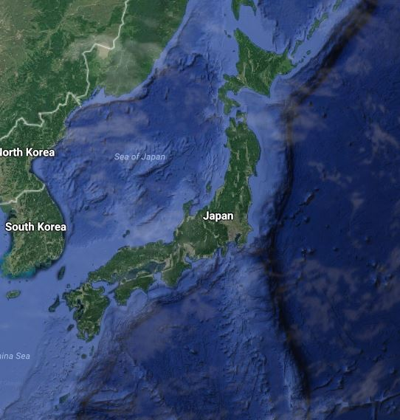
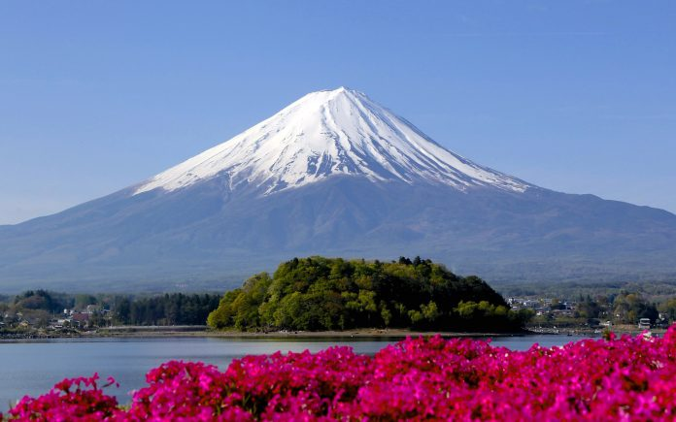
Volcanism – Japan Arc
Mount Fuji
We have also seen that linear island arcs of volcanism form where an oceanic plate subducts under another oceanic lithospheric plate.
Google Maps
https://en.wikipedia.org/wiki/Mount_Fuji

Slide 31
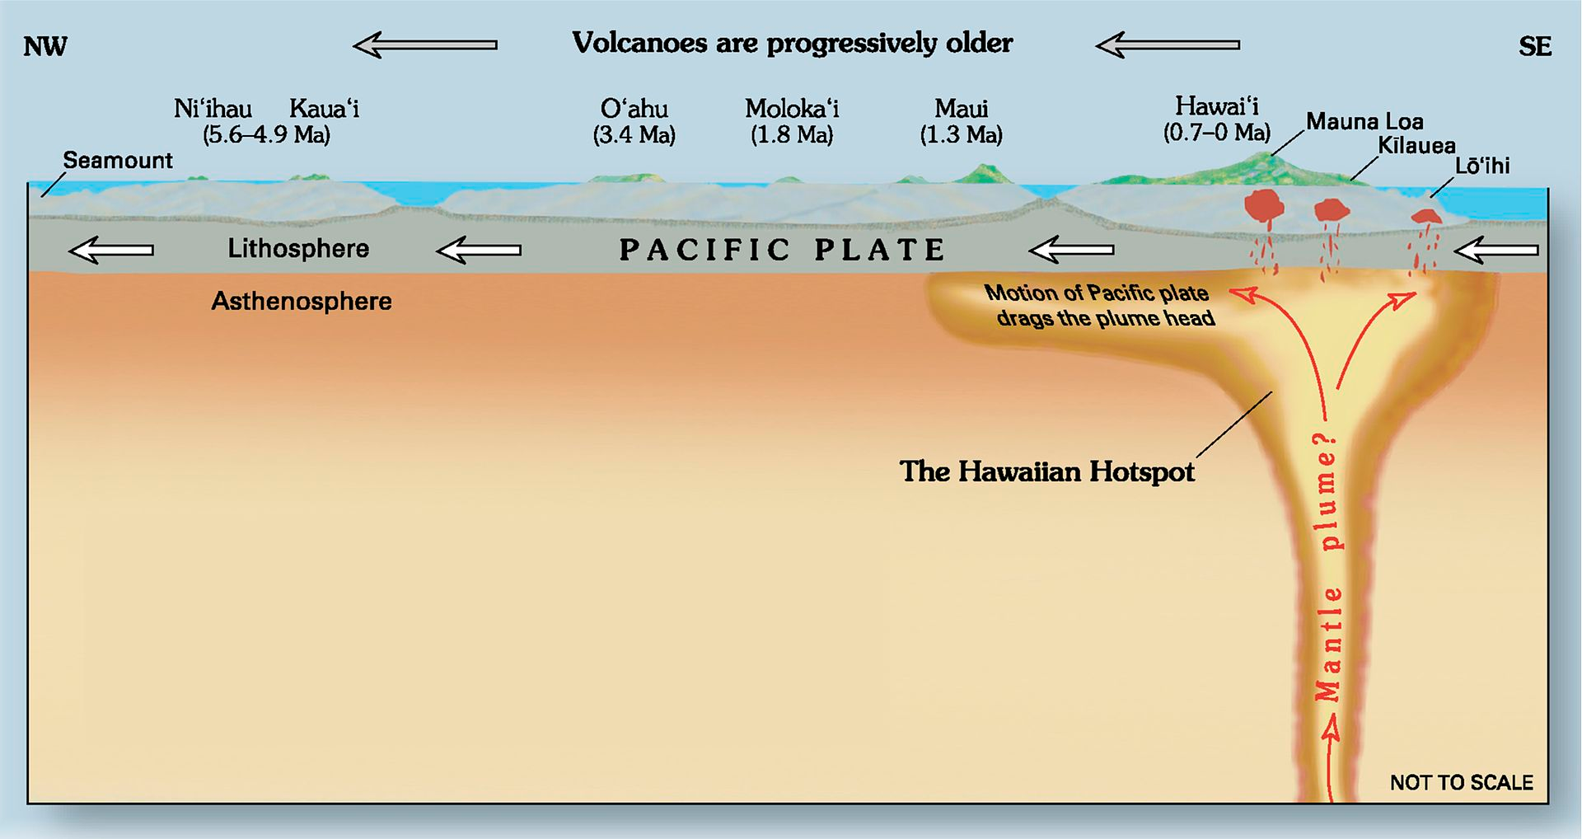
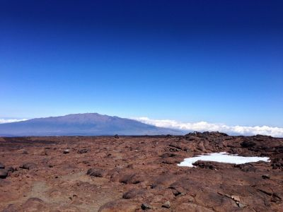
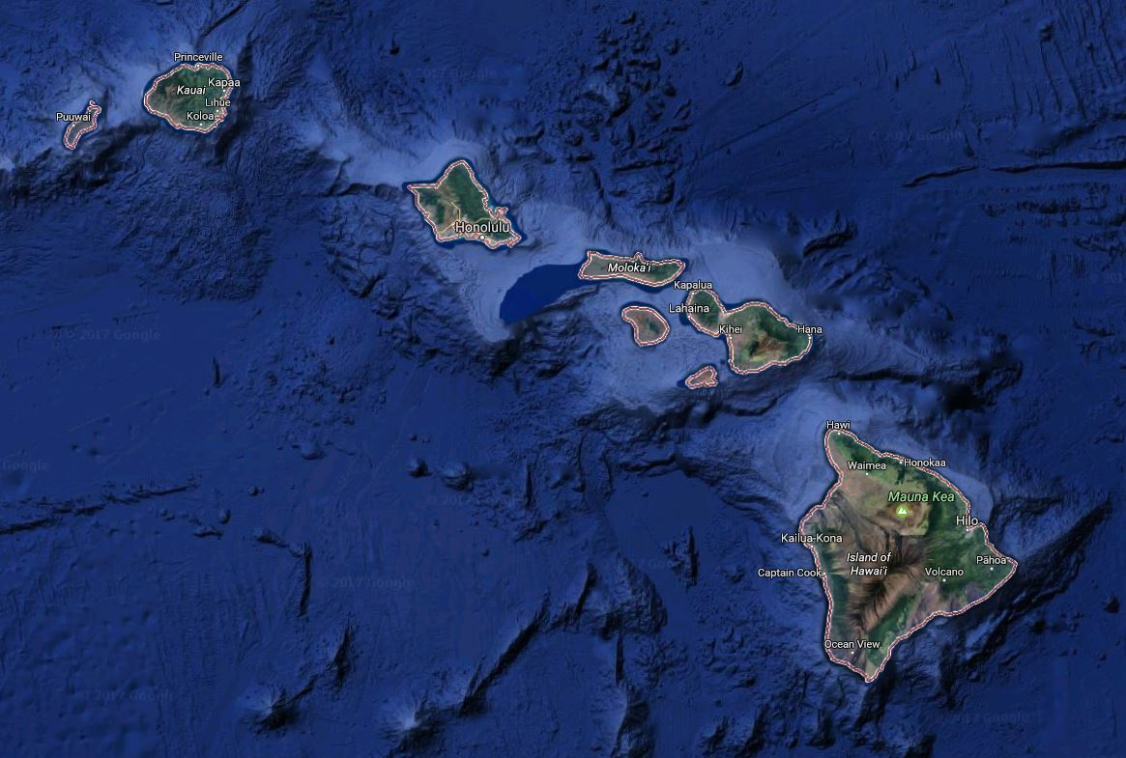
Hawaiian Chain
We have also seen where chains of volcanoes form as the lithosphere moves across what appears as an eruptive hotspot that penetrates to the surface.
The Hawaiian volcanism is basaltic, low viscosity, low in SiO₂ and so flows easily on low-angle slopes of shield volcanoes.
Mauna Loa, Hawaii
Google Maps
https://en.wikipedia.org/wiki/Mauna_Loa

Slide 32
Active Volcanism
We have seen that several bodies in the Solar System are volcanically active:
Io: The most volcanically active body in our Solar System. Explosive outflows of sulfurous materials and rock magma erupt from as many as 40 volcanoes on Io at present. Magmas have been radiant temperature measured to be hotter than the basaltic magmas of Hawaii.
Enceladus: Fissures in this small moon’s southern hemisphere allow eruptions, geysers, of water.
Titan: With its surface of water-ice rocks being eroded by channelled rivers of methane-ethane, the moon is, at least, climatalogically active. There are indications that methane-ethane is also erupted in geysers from the surface.
Triton: This moon of Neptune is much larger and more massive than Pluto. Orbiting Neptune in a direction opposing Neptune’s rotation suggests that it is a captured Kuiper object. Eruptions of geysers of liquid nitrogen were observed by Voyager in 1989. They are interpreted as sub-ice (probably water ice) volumes of liquid nitrogen being heated by the faint Sun penetrating the ice to vapourization. Liquid-to-vapour nitrogen temperature is about 80 K.

Slide 33
Volcanic chains?
Do we see chains of volcanoes indicative of plate motions even possibly active on other planets or moons?
Artemis Corona, Venus
Aleutian Trench, Earth
https://pubs.usgs.gov/gip/dynamic/unanswered.html#anchor19928310

Slide 34
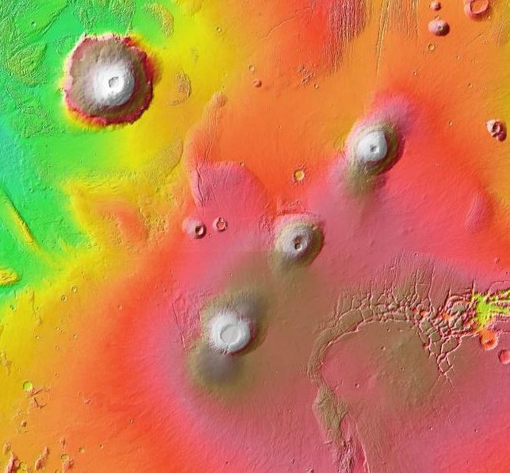
Past Volcanism
Large shield volcanic edifices on Mars and Venus, some larger than those on Earth, attest to the geological activity of these planets in their past.
Venus: Dating the surface by counting of impact craters suggests that Venus completely renewed its surface in a globe-wide flood of lavas between 400My and 700My ago. The largest volcanoes, Maat Mons and Sif Mons are larger than Mauna Loa from its deep water base to peak. The distribution of volcanoes does not argue for long subduction zones that would be expected of a planet with plate-tectonics.
Mars: Olympus Mons is the largest volcano in the Solar System. From crater counting of the region of the Tharsis Plain, we guess that it has been inactive for, at least, at least the past 10My and probably for the past 2Gy. The line of volcanoes, lower left to upper right, Arsia Mons, Pavoris Mons and Ascraceus Mons, all ancient volcanoes.

