Slide 1
Make sure your samples are clean and dry before doing coating. Dirty and wet samples will lead to bad coating and long waiting time.
During the evaporation process, the carbon tip generates high intensity light and UV radiation – NEVER look directly at the tip when coating.
Do not let other people who has not been trained to use the coater. You are responsible for any damage to the equipment through negligence or improper use (very costy for any part, at least $5000 for company engineer service call).
If you have problems or are in doubt , do not try to fix them yourself. Talk to me first.
You can get the Key to room 204 from main office. Remember to return the key after you are done.

Slide 2
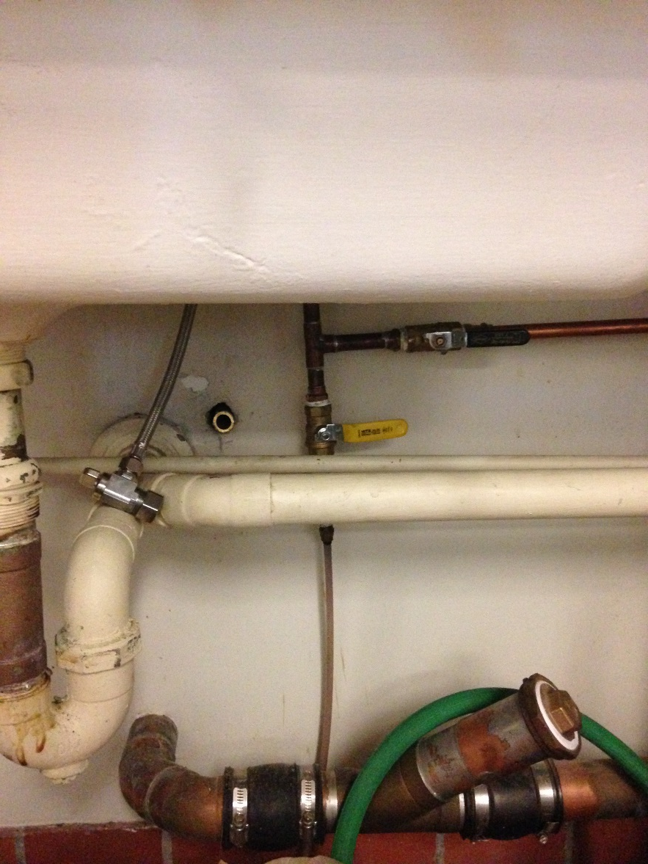
1) Open the water by rotating the yellow valve handle to vertical position (CCW).

Slide 3
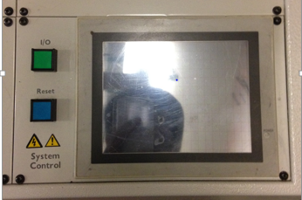
2) Depressing the I/O button and then the Reset button (the I/O button light is ON)
Display/Touch Control Panel

Slide 4
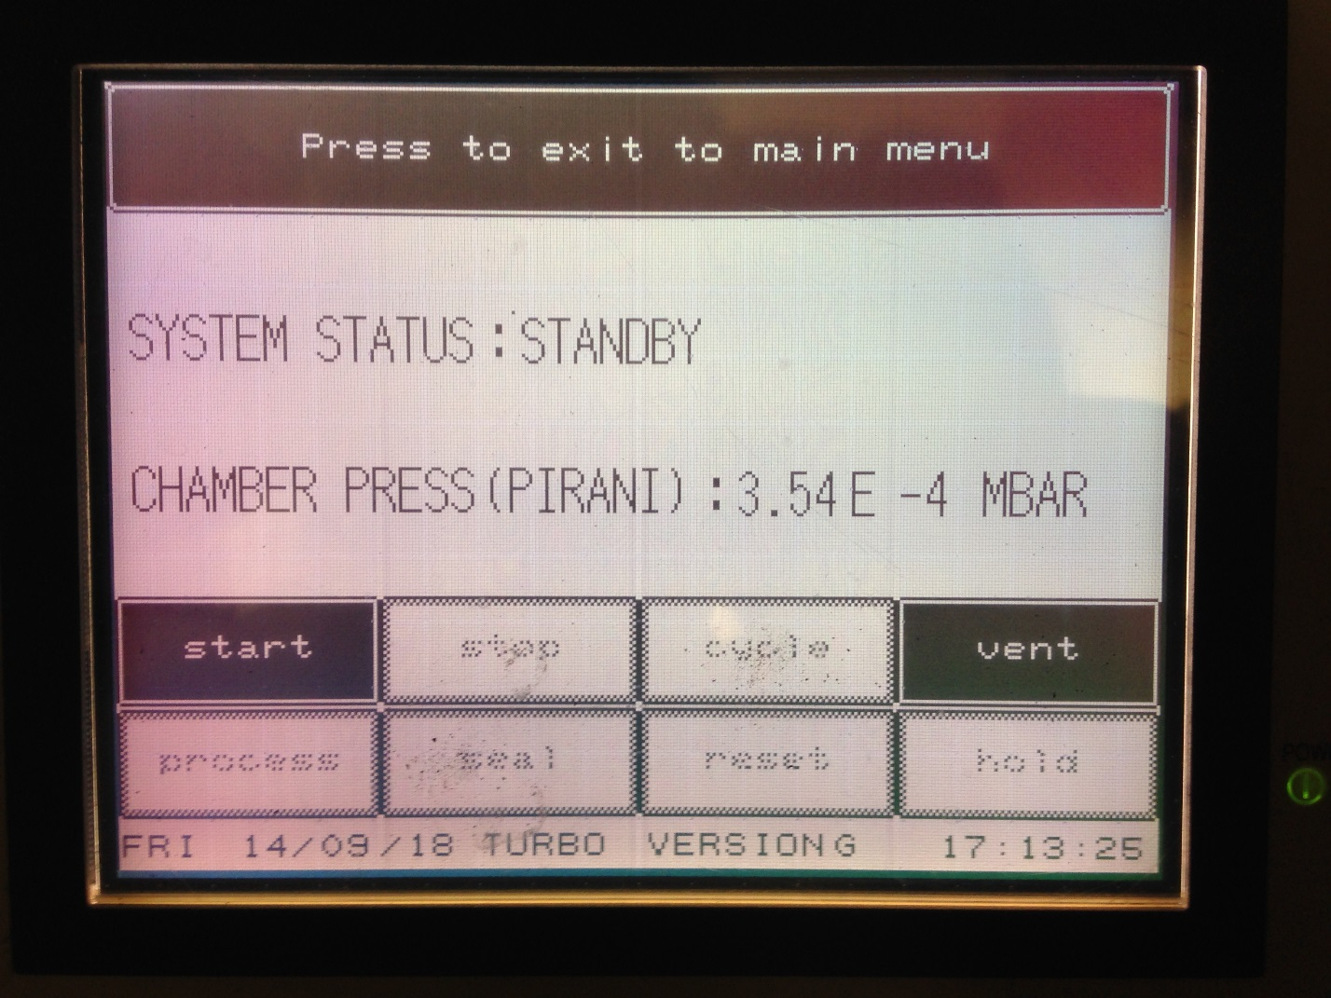
3) Press the Start button on the control panel.
Note: The touch control panel will most likely have fallen asleep. Touch it to activate the display.

Slide 5
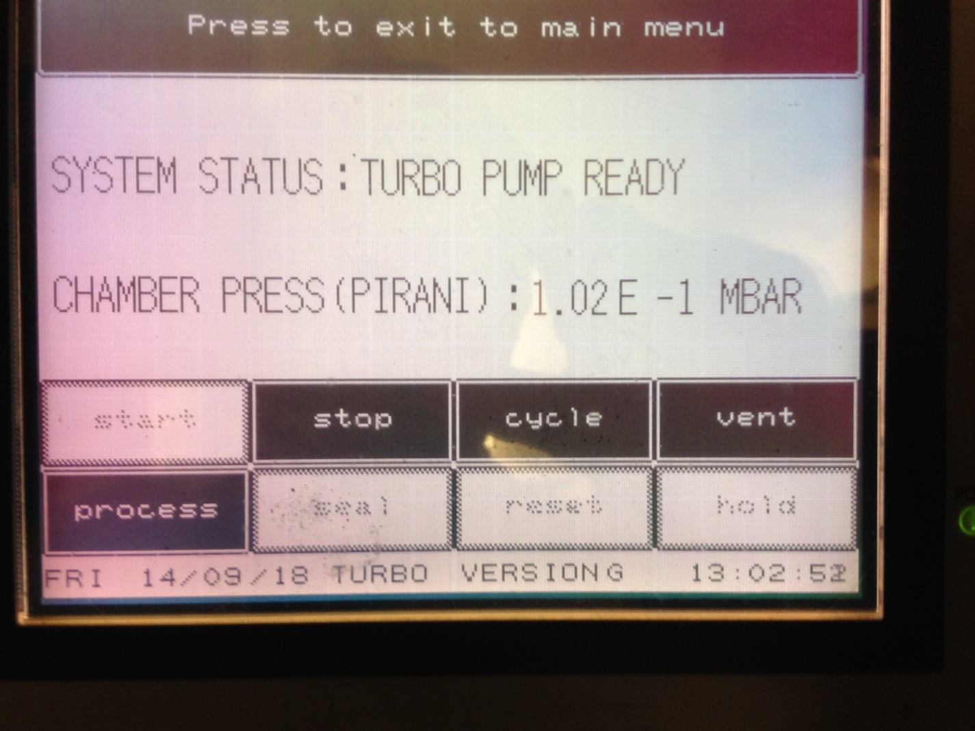
4) Wait the Turbo pump to warm up (takes about 10-15 min.) till you see “Turbo Pump Ready” on the control panel. Then press the Vent button to release chamber vacuum.
Note: If you don’t get the “Turbo Pump Ready “ message Or get other message at this stage, Do not continue and talk to me.

Slide 6
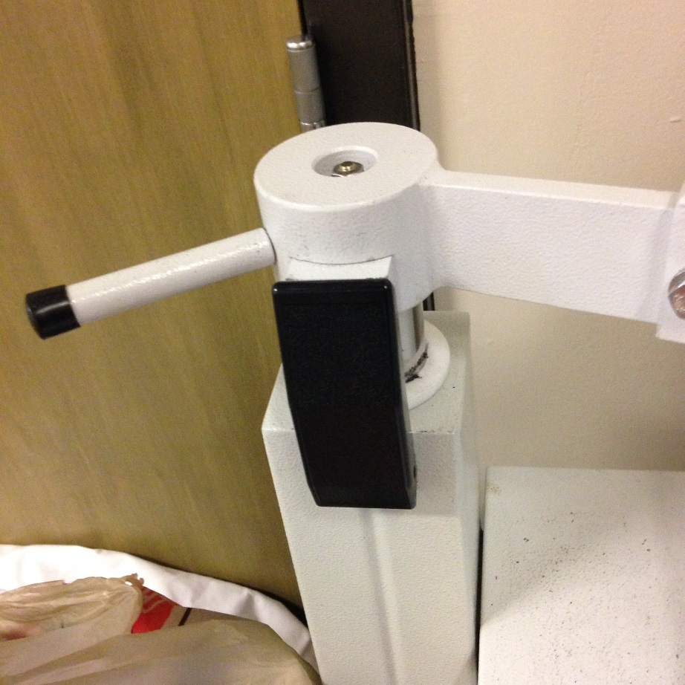
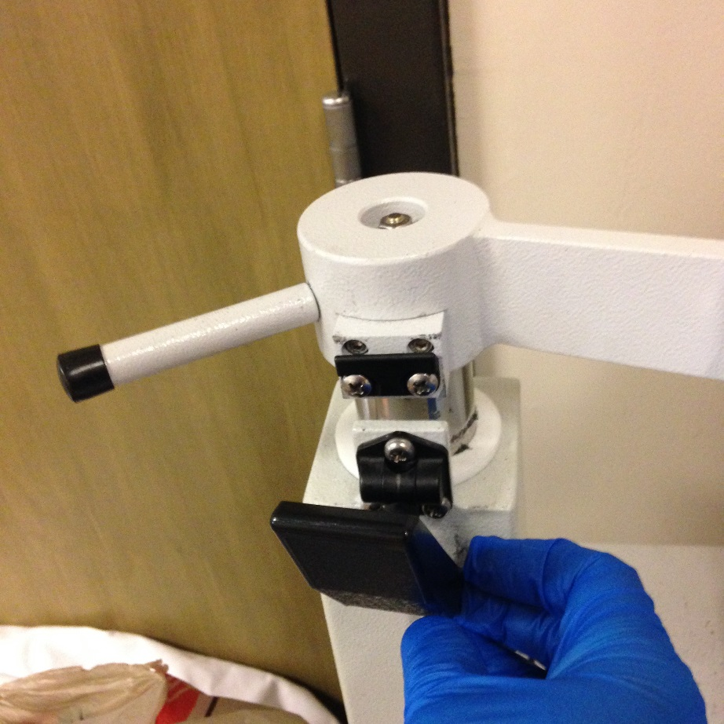
5) Release the latch / Clamp on the left side of coater.

Slide 7
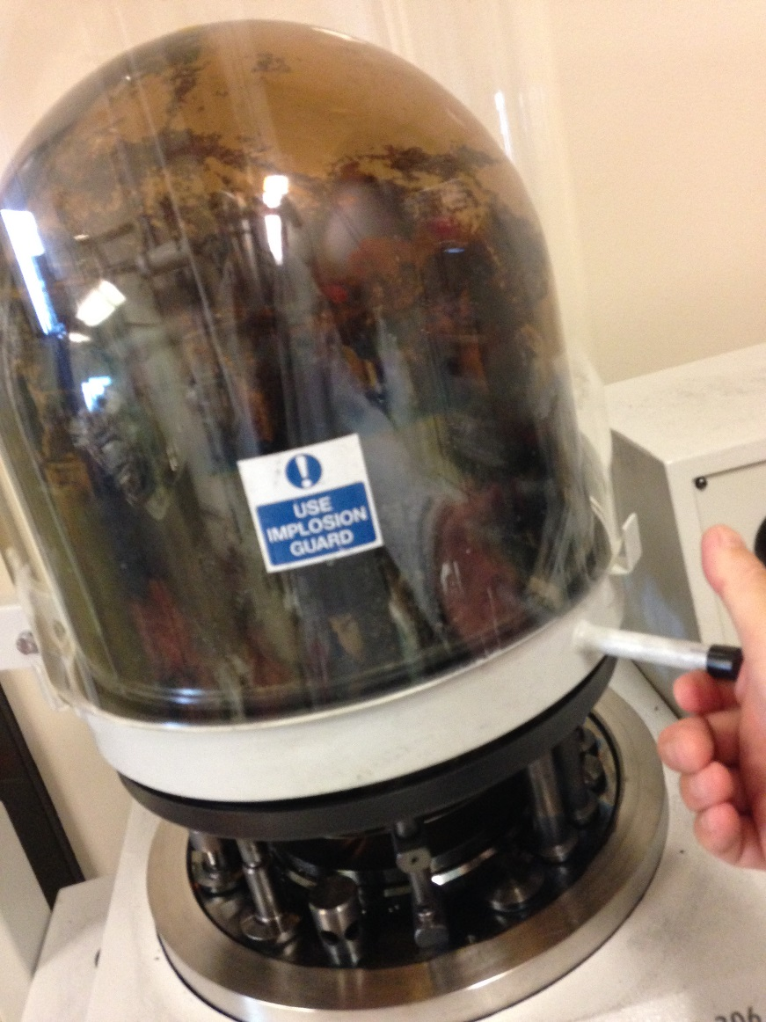
6) Lift the bell jar and implosion guard assembly and turn it away so that you can access the chamber.
Note: Care when handling the bell jar. Do not let it hit anything around!
Bell jar and implosion guard assembly

Slide 8
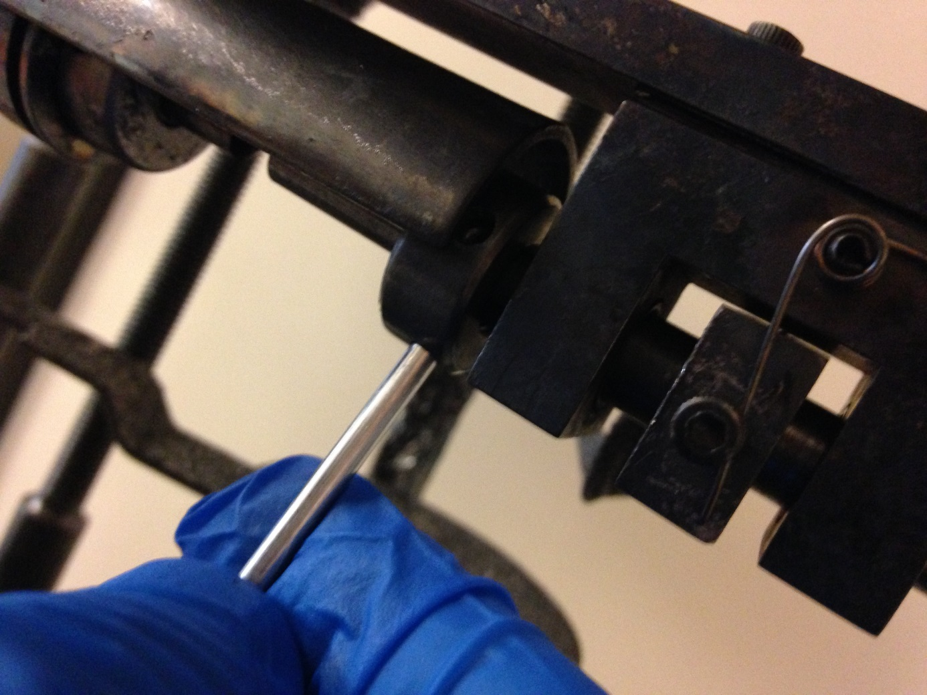
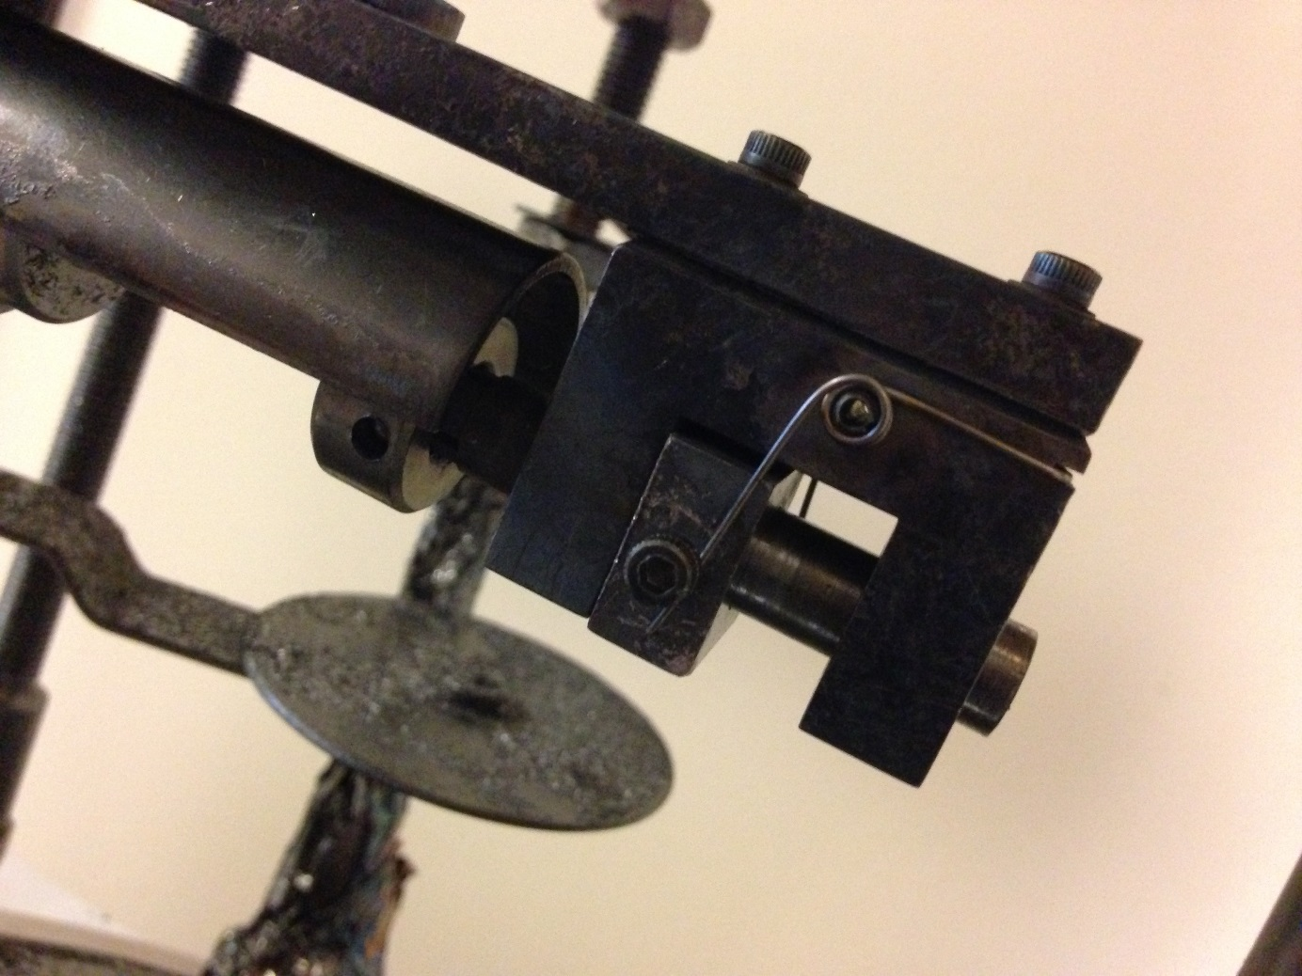
7) Use the Allen Key to loosen the lock bolt (CCW) on the right side of the carbon electrode holder and then pull out the used rod. Wearing gloves from here on!
Note: The whole holder may be very hot if coating has recently been performed. Do not touch with your hands to avoid burns.
Carbon electrode holder
Lock Bolt
Allen Key
Spring Block

Slide 9
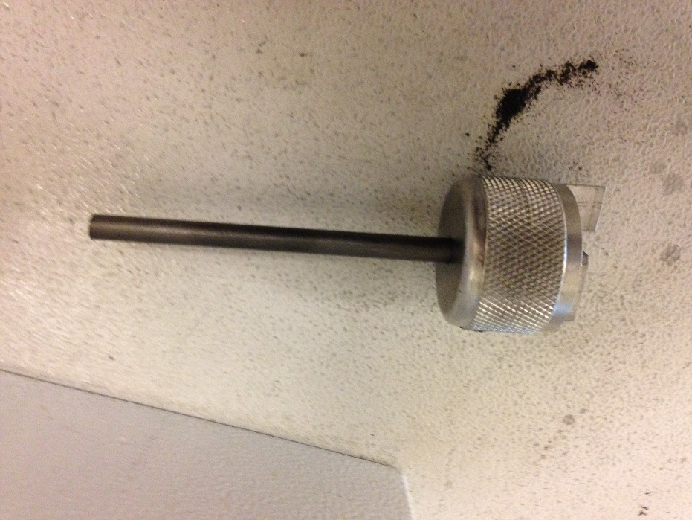
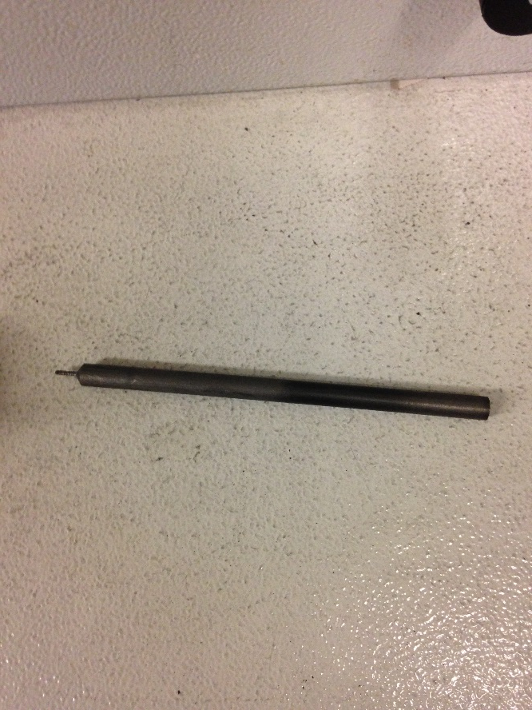
8) Use the carbon rod sharpener to sharp a carbon rod (about 5- 6 mm long tip).

Slide 10
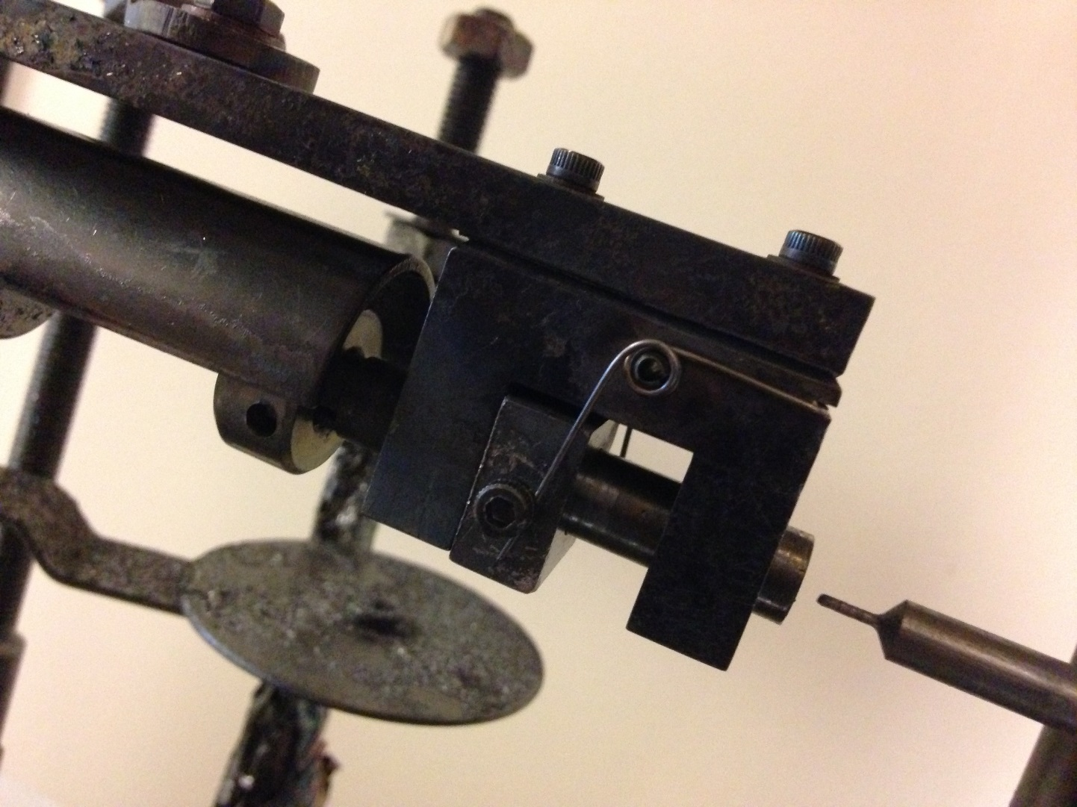
9) Install the sharped rod into the carbon electrode holder.

Slide 11
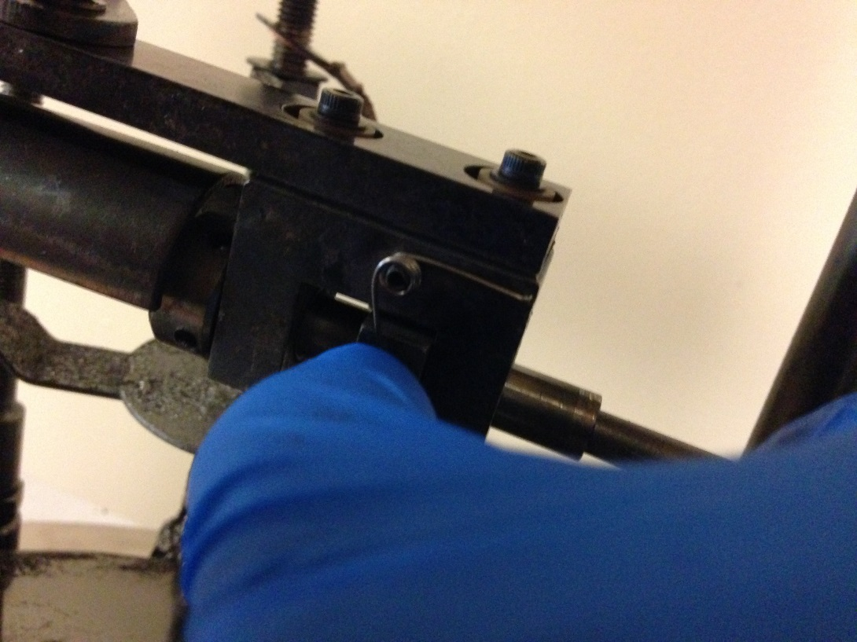
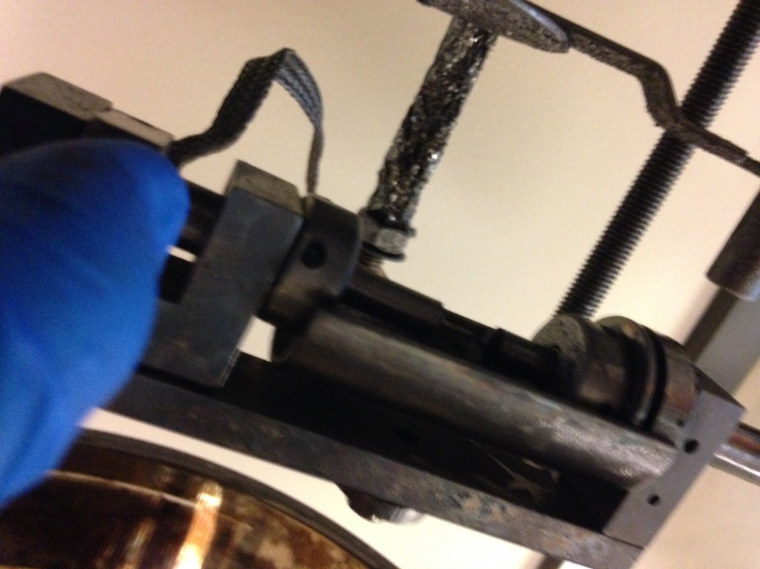
10) Push the spring block to the back end and hold it. Push the rod in till there is small gap (1 mm) between the two rods. Then use the Allen Key to tight up the lock bolt (CC) and then release the spring block (the two rods should touch each other.
1 mm gap

Slide 12
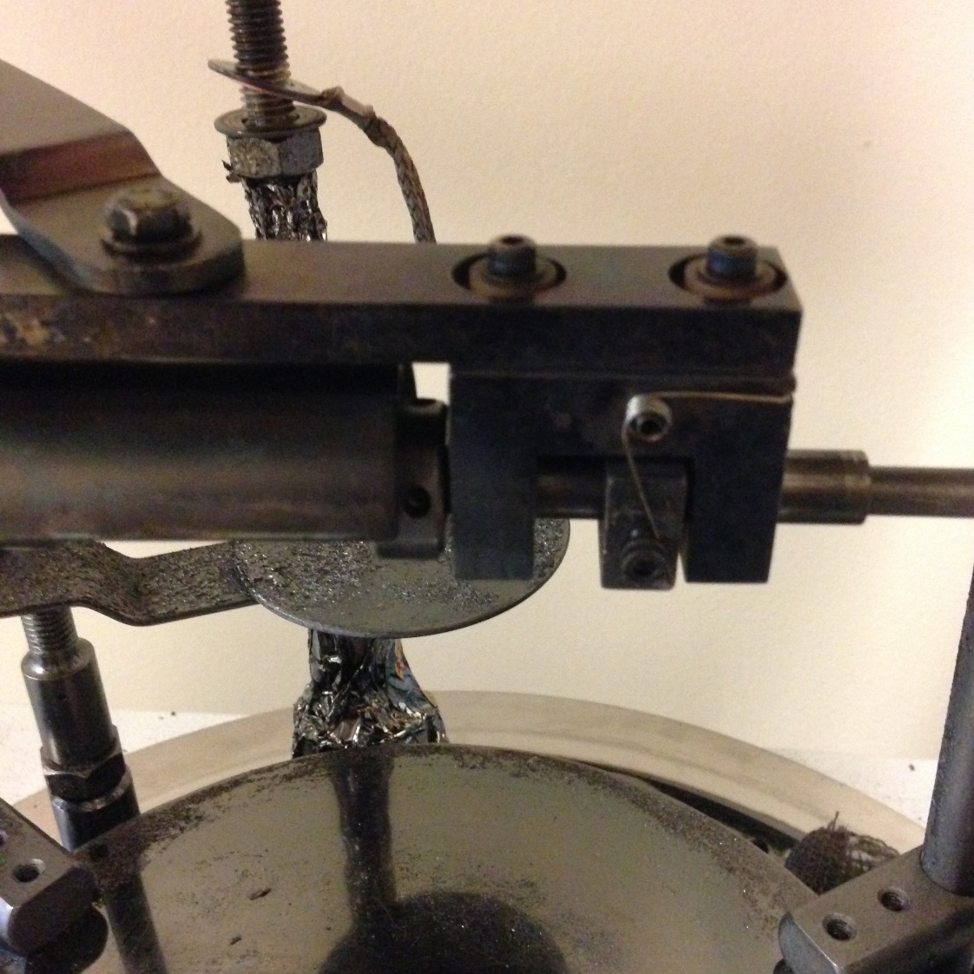
11)Place the samples on the baseplate below the tip of rod. You can put max 4 thin sections and 6 1-inch round mounts. If the baseplate is dirty, use kimwipes with methanol to clean it.
Obtain a small piece of paper and put it next to the samples. Place a screw on the paper (in order to judge deposition thickness of the coating). Rotate the metal plate under the carbon tip.
metal plate

Slide 13
12) Replace the bell jar and implosion guard assembly to close the chamber and then put the clamp on.
Bell jar and implosion guard assembly

Slide 14
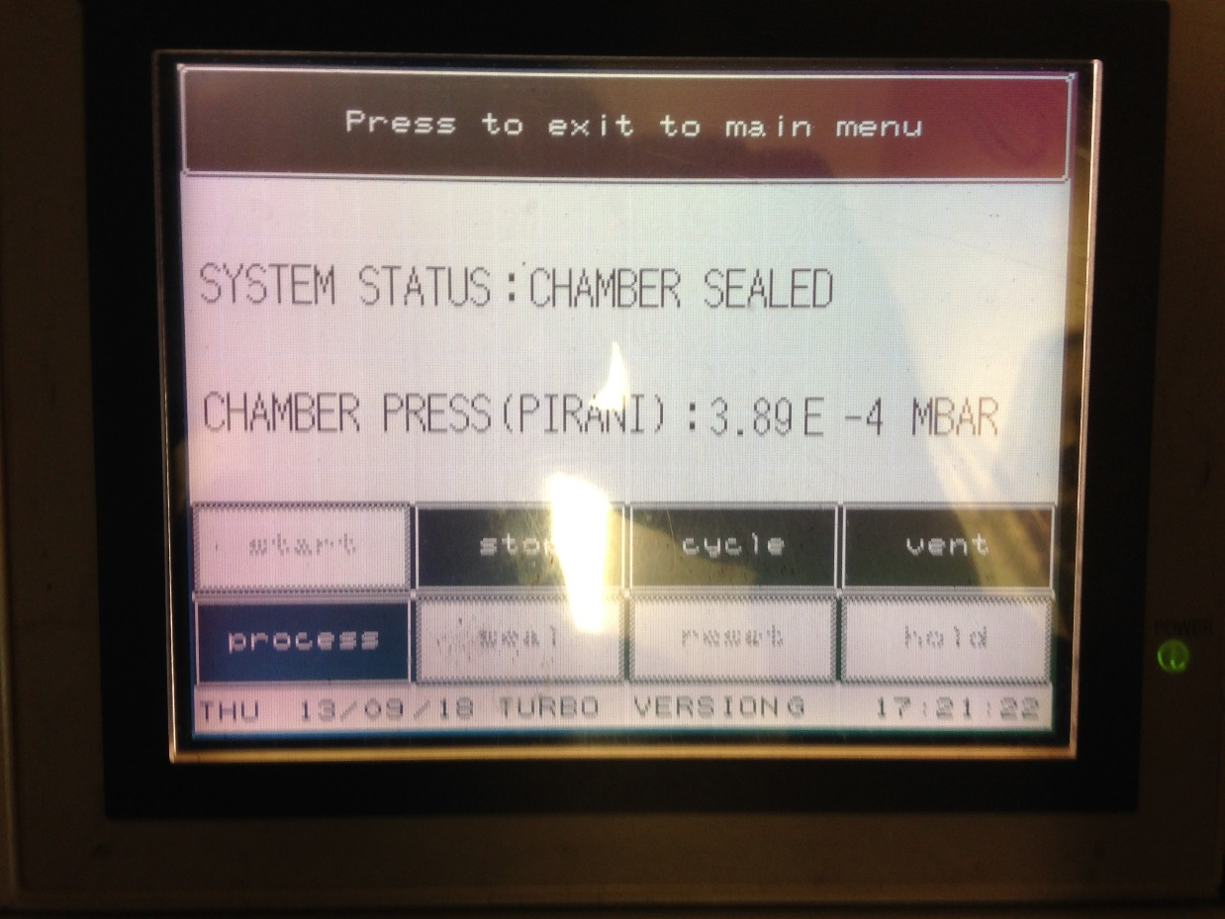
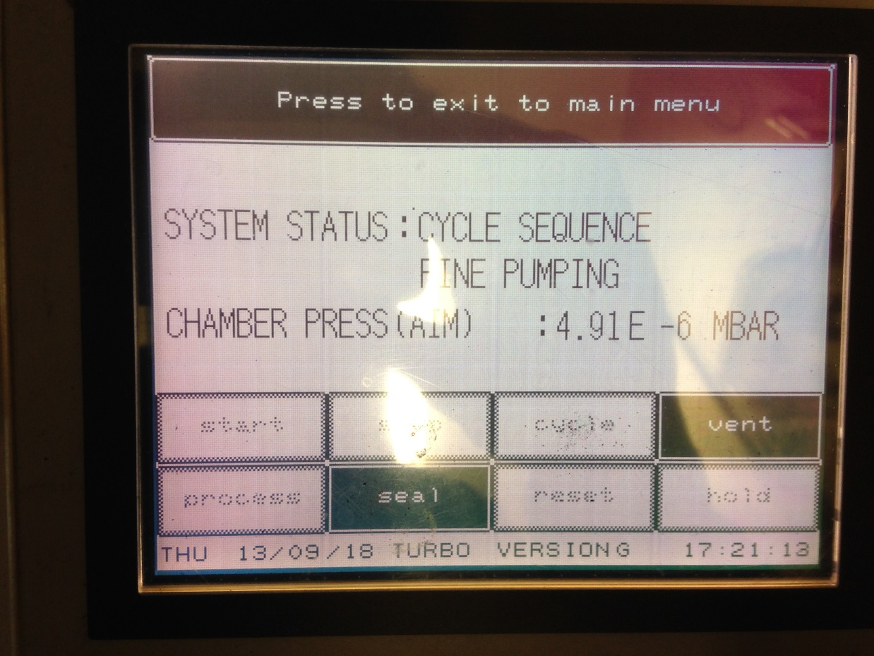
13) Press the cycle button on the control panel to pump down the chamber (you can go to do other things). WAIT till you have a good vacuum ( on -6 MBAR level). The better the vacuum, the better the coating.

Slide 15
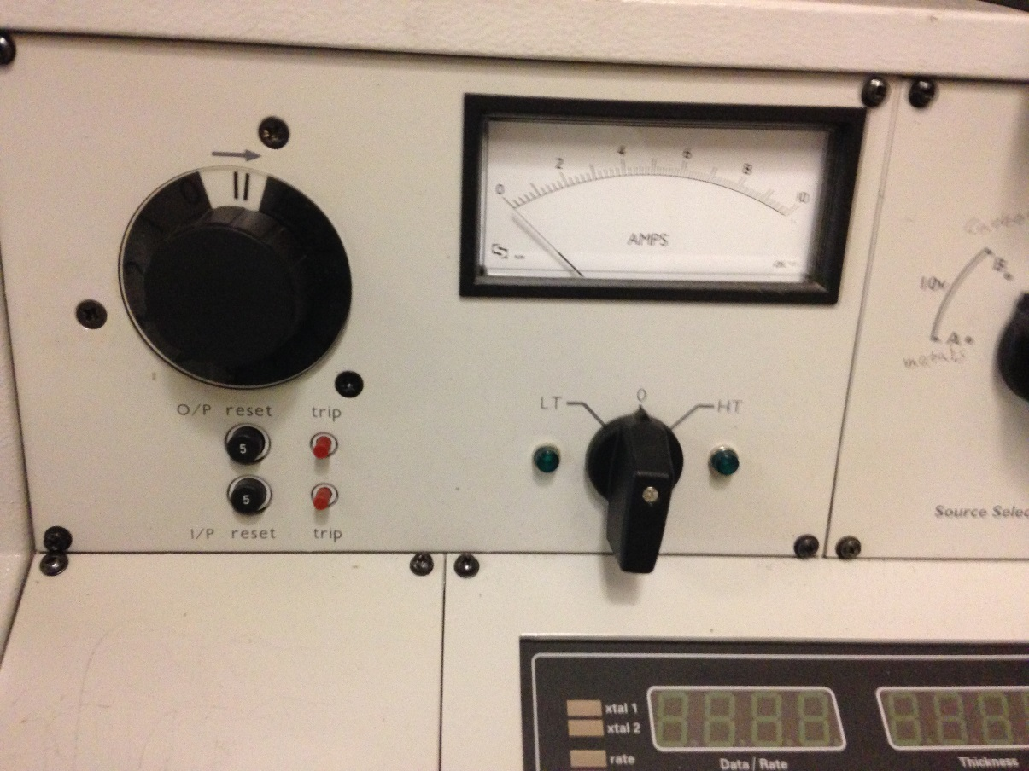
14) Once the vacuum is ready, you can start to do coating:
Switch the voltage control to LT
Increase the source current by turning the Power control knob (potentiometer) slowly (CC)
Once you see the carbon rod to become bright, stop increasing the current and wait about 30s to outgas the carbon rod.
Remove the metal plate.
Slowly turn the power control knob up until evaporation begins and then stop increasing the current and let the coating continue.
If you see less coating, you can increase the current again. Watch the paper. Rotate the Power control knob to zero (CCW) once desired thickness is obtained.
Turn the voltage control from LT to Zero.
Power control knob
Voltage Control

Slide 16
15) Press the Vent button to release chamber vacuum and wait a few minutes.

Slide 17
16) Release the clamp and lift the bell jar and implosion guard assembly. Remove the samples from the chamber. If more samples need to be coated, return to step 7.
Then close the bell jar and put on the clamp.
Bell jar and implosion guard assembly

Slide 18
17) Press the cycle button and wait till the chamber vacuum is on -5 BMAR level. Press the seal button (close the plate valve between the specimen chamber and the turbo pump) and the then press the Stop button.
Note: When the instrument is not in use the chamber is kept under vacuum.

Slide 19
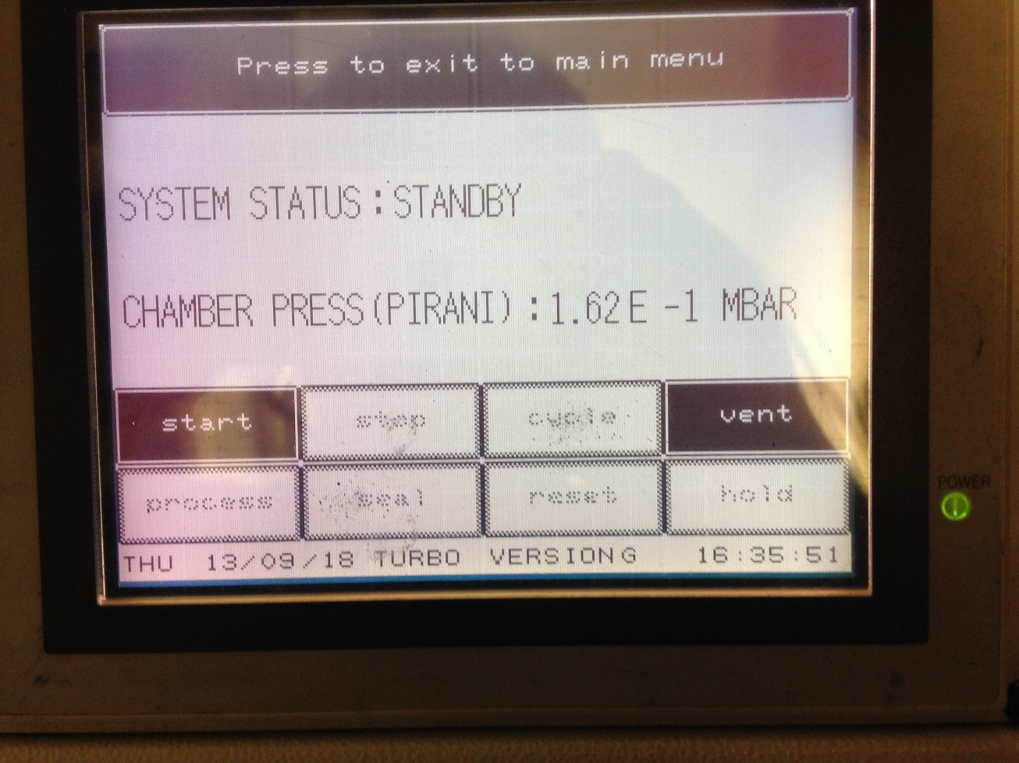
18) Wait till you see Standby and then press the I/O button (the light on the button should be Off)

Slide 20
19) Wait half an hour, turn off the water supply (turn the yellow valve handle to horizontal).

Slide 21
Clean the area and sign the logbook. Return the key to main office.

