Slide 1
Department of Earth and Planetary Sciences
McGill University
EPSC-221
GENERAL GEOLOGY
Anthony Williams-Jones and Alfonso Mucci
Anthony.Williams-jones@mcgill.ca; alfonso.mucci@mcgill.ca;
Frank Dawson Adams (FDA)-317/201
http://eps.mcgill.ca/~courses/c186-221

Slide 2
Teaching
Assistants
Caroline Seyler
(caroline.seyler@mail.mcgill.ca)
FDA-350
Jethro Sanz-Robinson
(jethro.sanz-robinson@mail.mcgill.ca)
FDA-346
Kyle Henderson
(kyle.henderson@mail.mcgill.ca)
FDA-346
Samantha Carruthers
(samantha.carruthers@mail.mcgill.ca)
FDA-404

Slide 3
Course outline, lecture slides, animation and exam sample:
http://eps.mcgill.ca/~courses/c186-221
WEEK TOPICS
1 Introduction (AM, AW-J))
-organization (course description and schedule), books, evaluation
1 History of the Earth (AW-J)
2 Mineralogy (AW-J)
3 Volcanism/Igneous rocks (AW-J)
5 Weathering, erosion and soils (AM)
6 Sedimentary rocks (AM)
7 Metamorphic rocks (AW-J)
8 Geological time (AW-J)
9 Structural geology (AW-J)
10 Plate Tectonics (AM)
11 Earthquakes (AW-J)
12 Mass wasting and slope stability (AW-J)
13 Running water and groundwater (AM)
14 Glaciers and glaciation (AM)

Slide 4
EPSC-221
GENERAL GEOLOGY
LABS:
Minerals
Igneous Rocks
Sedimentary Rocks
Metamorphic Rocks
SlopesTopoMaps
Coastal Geomorphology
Climate Data
Treasure Map
Contact hours: Two 1.0-hour lectures + laboratories
Evaluation
Mid-term (October 17th) 20%
Final Exam (Cumulative) 50%
Lab 30%

Slide 5
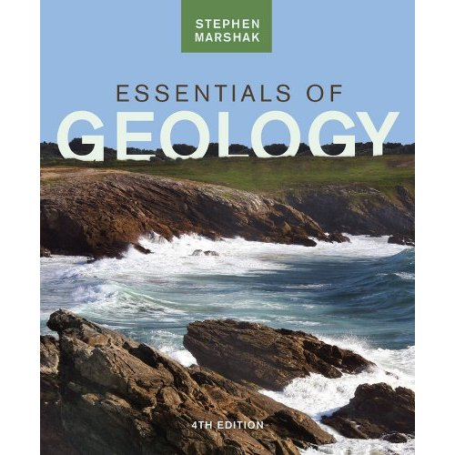
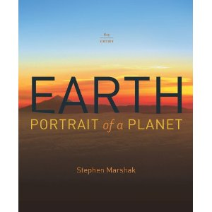
Recommended textbooks:
QE28.M3415
Marshak S. (2016) Essentials of Geology, Fifth Edition, W.W. Norton & Company Inc. New York, 629p.
QE26.3M362015
Marshak S. (2015) Earth: Portrait of a Planet, Fifth Edition, W.W. Norton & Company Inc. New York, 875pp.

